Slide 1
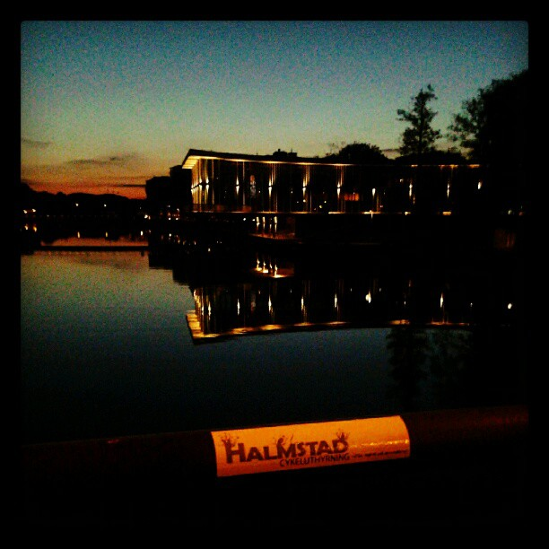


HOSTEL IN HALMSTAD. SWEDEN
FINAL PROJECT (2012). MARÍA MOLINA MARTÍN

Slide 2
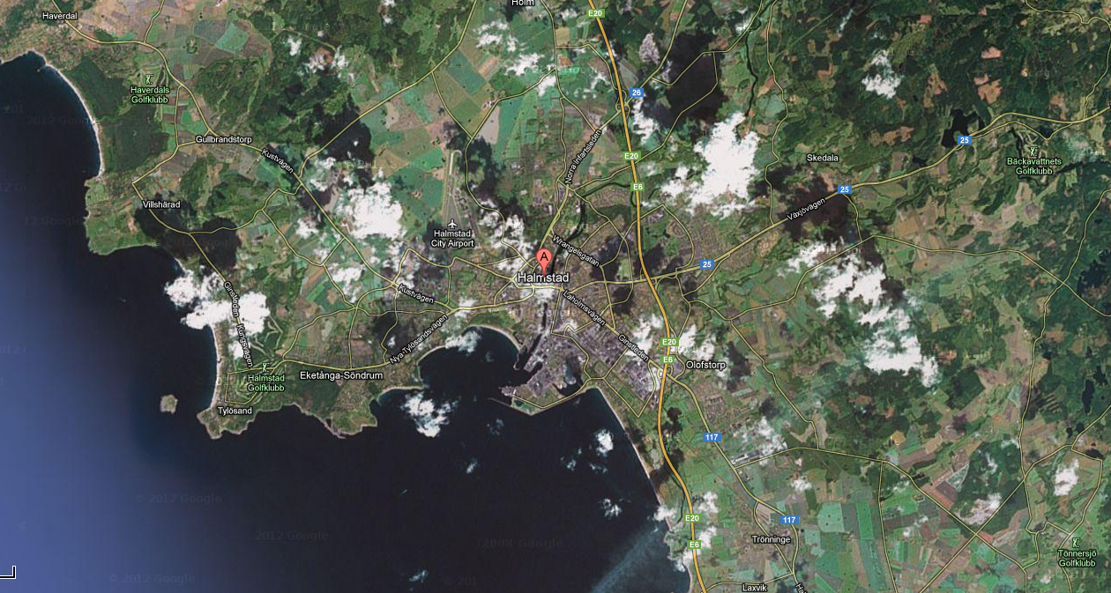
SITUATION of Halmstad
Halmstad is a city located in southwestern Sweden, in the province of Halland, located at the mouth of the river Nissan.

Slide 3
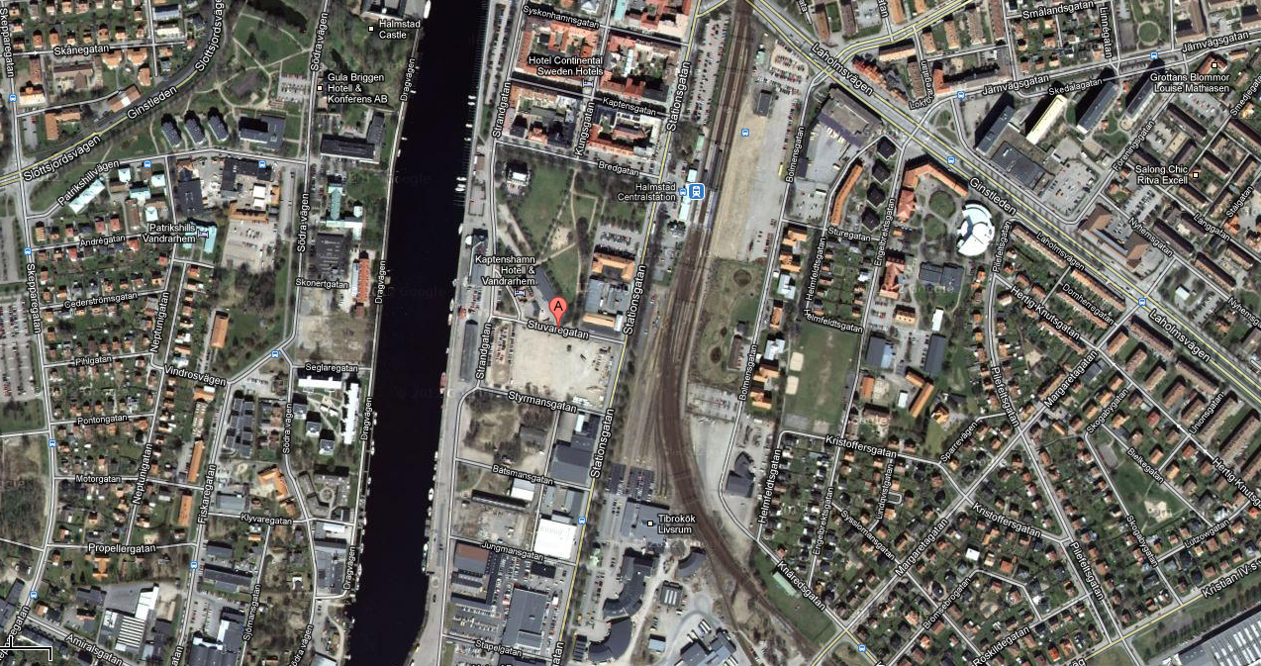
SITUATION OF THE LOT
The lot where I designed the hostel is located between Stuvaregatan and Styrmansgatan, near the Central Station of Halmstad.
It has approximately a surface of 15538 m2. Its form is almost rectangular, its dimensions are 180 x 93 m.

Slide 4
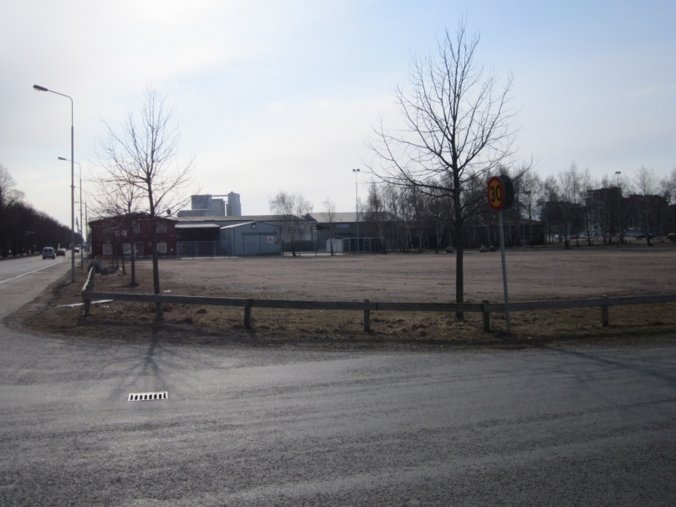
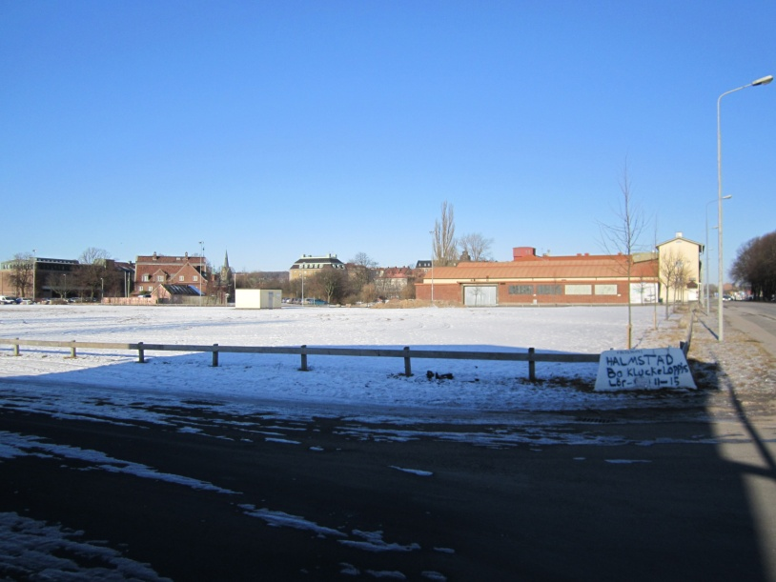
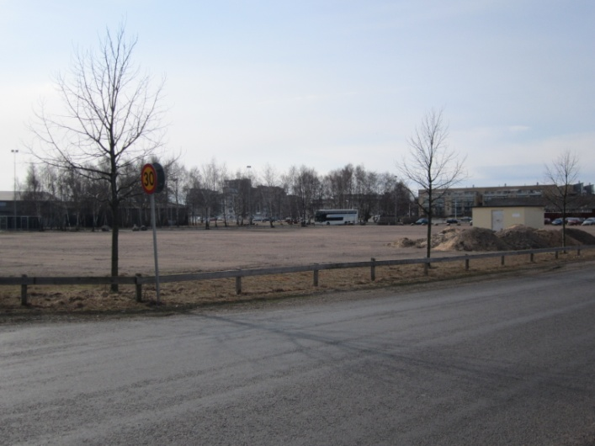
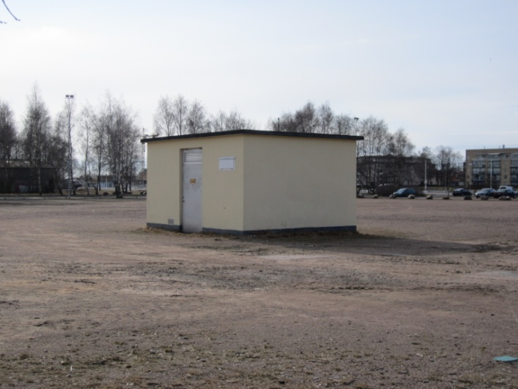
The surroundings of the lot
THE LOT

Slide 5
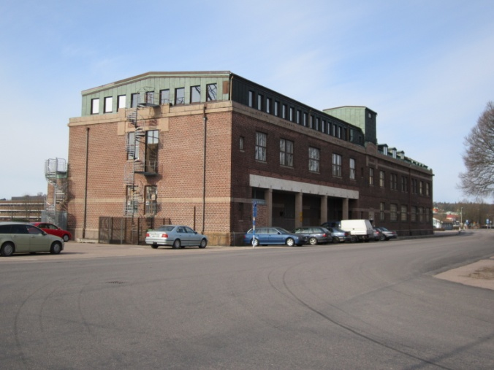
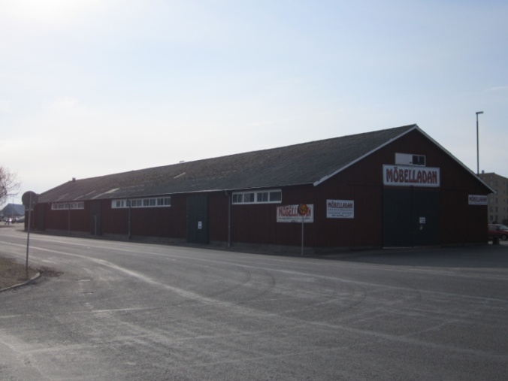
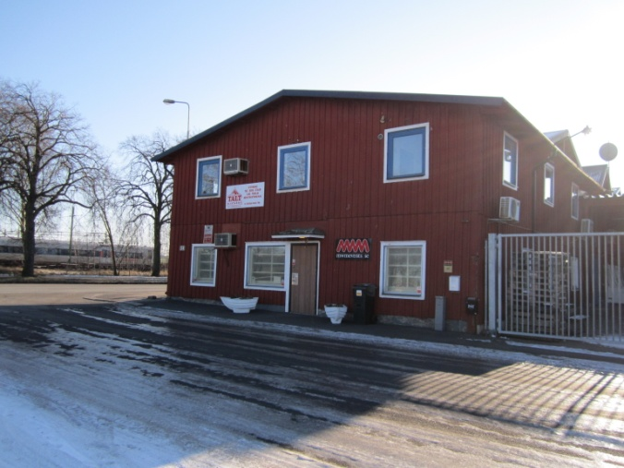
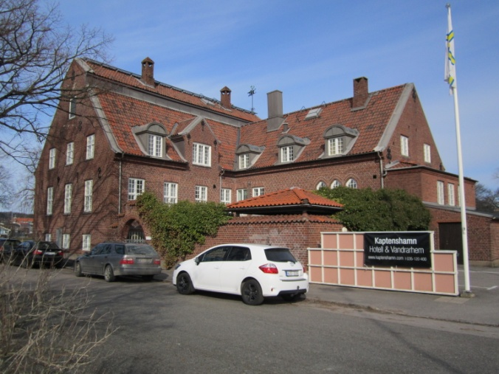
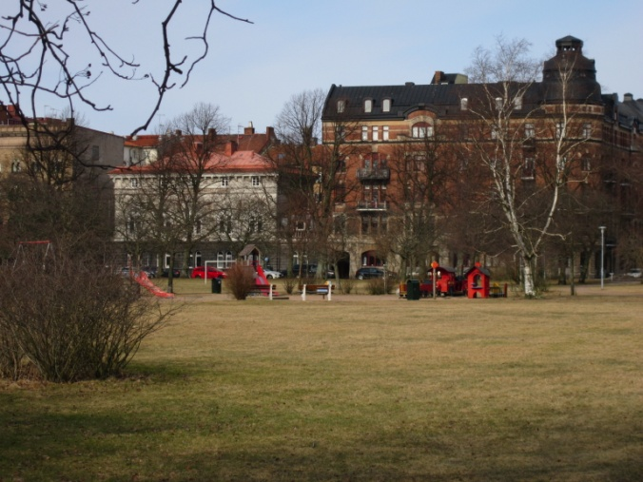
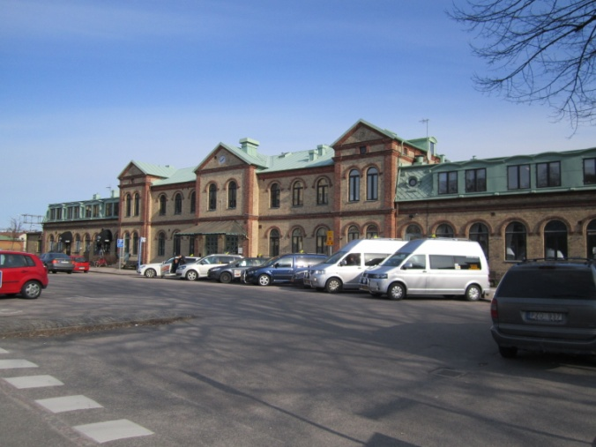
THE SURROUNDINGS OF THE LOT
In the surrounding area there are many buildings, the buildings closest to the lot are factories and an hotel. Behind them there are some residential buildings and the Central station.

Slide 6
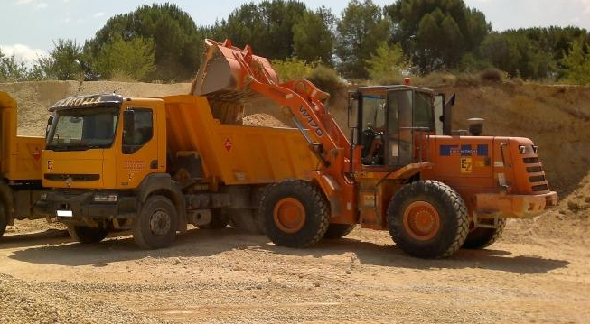
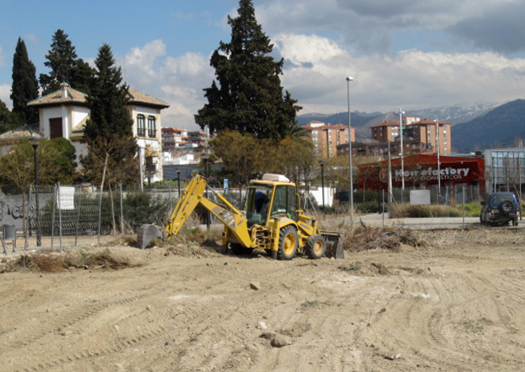
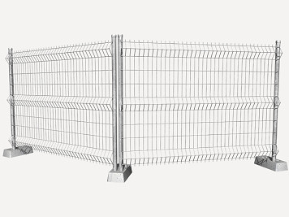
HOSTEL HALMSTAD
Characteristics of the construction
The first work to make is the cleaning of the site, removing the vegetal layer, with manual and mechanical means, and after the transportation of the land with trucks. Then, the fencing of the site.

Slide 7
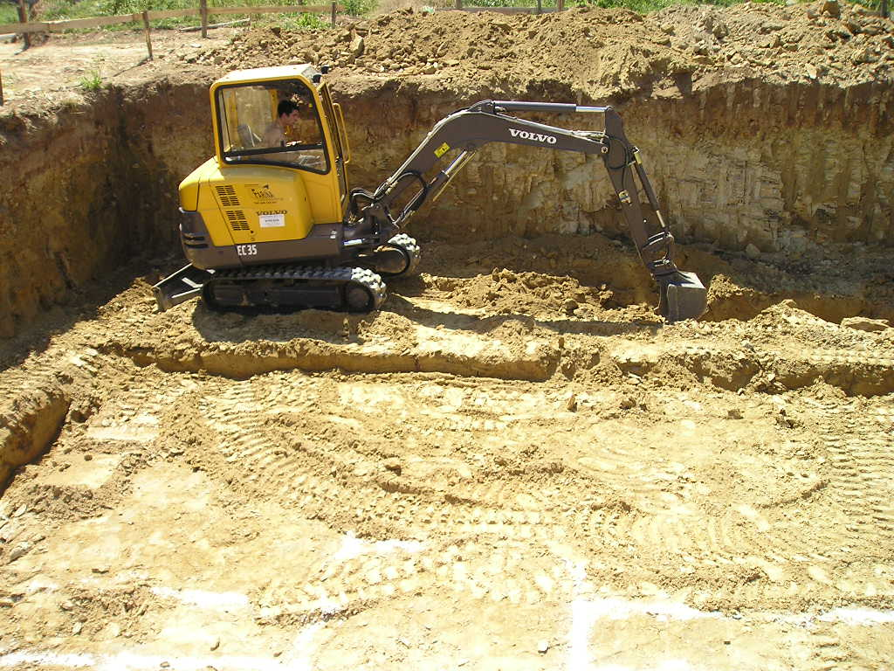
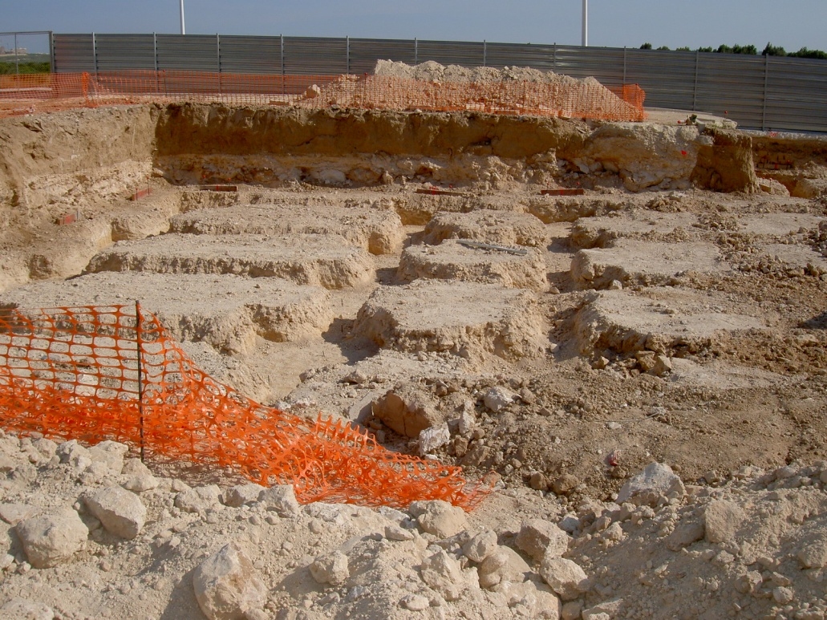
HOSTEL HALMSTAD
Characteristics of the construction
Then, the excavation of the foundation with mechanical methods.

Slide 8
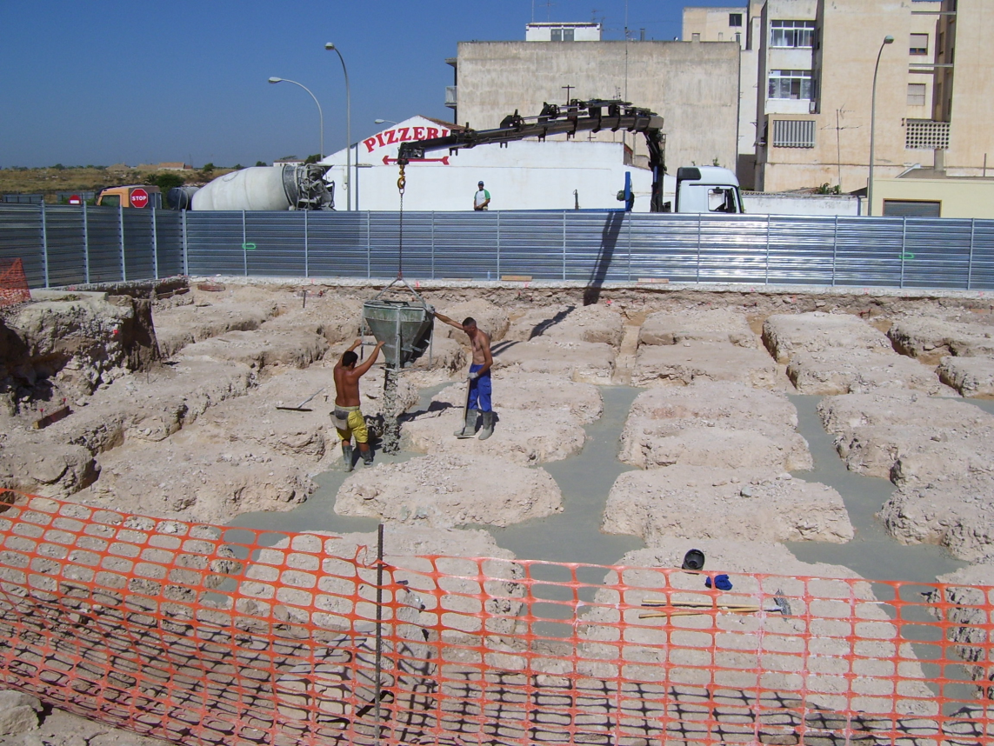
HOSTEL HALMSTAD
Characteristics of the construction
Concreting. A layer of cleaning concrete with 10 cm of thickness. The type of concrete is HA-30/B/25/IIIa+H for marine ambience and freezing.

Slide 9
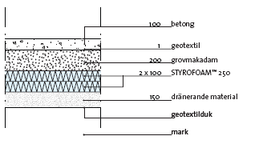
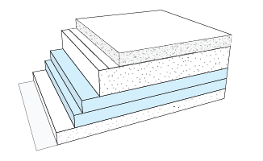
HOSTEL HALMSTAD
Characteristics of the construction
After the foundation, the ground slab is made with a solution of Isover (G:204).
Layers of the slab:
- Concrete.
- Geotextile.
- Coarse gravel.
- Insulation Styrofoam.
- Drainage material.
- Geotextile.
- Earth.

Slide 10
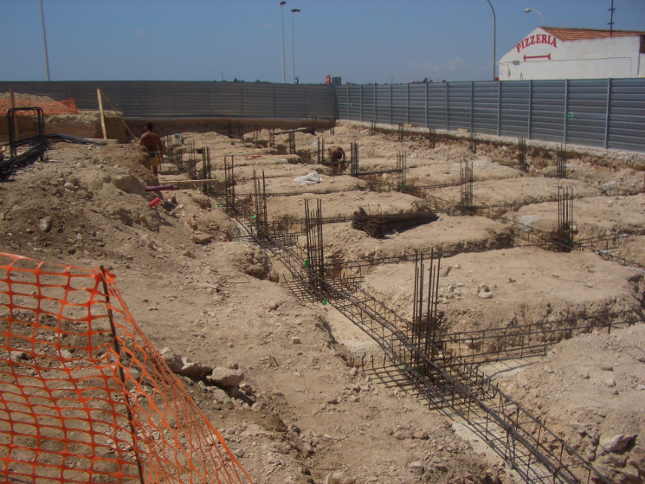
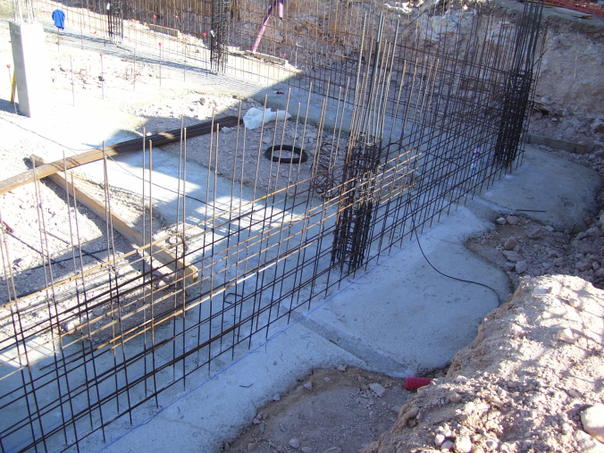
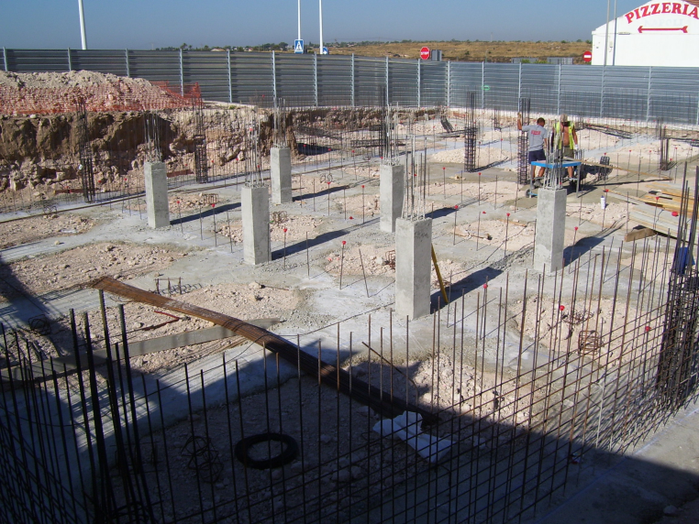
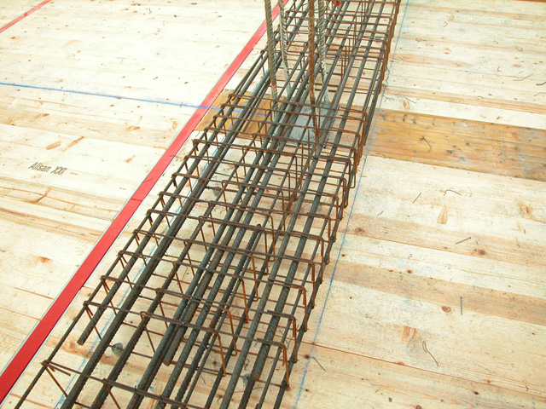
HOSTEL HALMSTAD
Characteristics of the construction
The structure is built with reinforced concrete: HA25/B/20/IIa.
The columns are square, of 30 x 30 cm. The beams are rectangular (flat), of 20 x 30 cm.

Slide 11
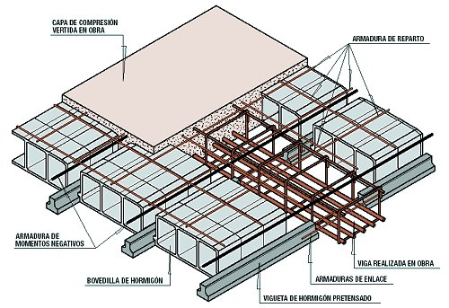
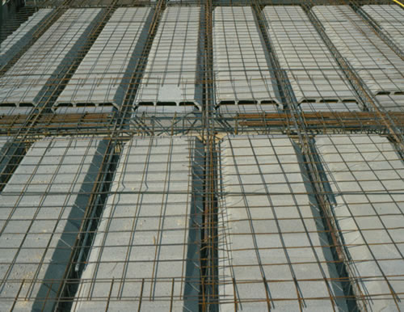
HOSTEL HALMSTAD
Characteristics of the construction
The structure is built with reinforced concrete: HA25/B/20/IIa.
The slabs of the floors have a thickness of 30 cm: 25 cm, made with ceramic vaults and joists semi resistant concrete with 70 cm intereje, and 5 cm layer of compression.

Slide 12
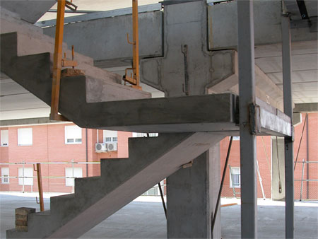
HOSTEL HALMSTAD
Characteristics of the construction
The slab of the stairs is made in situ with the same concrete: HA25/B/20/IIa, is linked with the floors of each plant by the reinforcing steel and has a thickness of 20 cm.

Slide 13
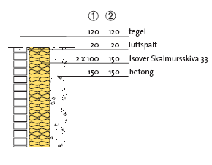
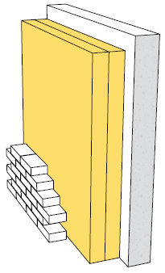
HOSTEL HALMSTAD
Characteristics of the construction
The facade is made with a solution of Isover (Y:208).
Layers:
- Bricks.
- Unventilated air space.
- Isolation.
- Concrete.

Slide 14
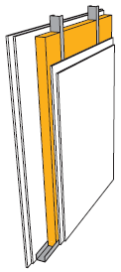
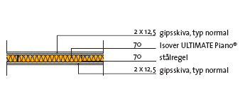
HOSTEL HALMSTAD
Characteristics of the construction
For the partitions, I choose two different types of Isover. One for the general partitions, and another one for the partitions in bathrooms.
The first one: (I:203).
Layers:
- Double gypsum board normal type.
- Isolation.
- Steel profiles.
- Double gypsum board normal type.

Slide 15
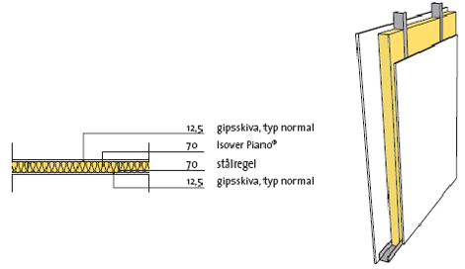
HOSTEL HALMSTAD
Characteristics of the construction
The second one: (I:201).
Layers:
- Gypsum board normal type.
- Isolation.
- Steel profiles.
- Gypsum board normal type.

Slide 16
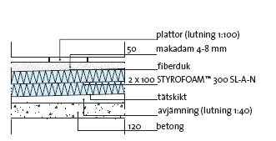
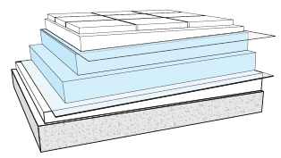
HOSTEL HALMSTAD
Characteristics of the construction
The roof is made with another solution of Isover. It is an inverted roof.
Layers:
- Tiles, no slope, 1:100.
- Macadam 4-8 mm.
- Protective film.
- Insulation: Styrofoam.
- Waterproofing.
- Mortar level, slope 1:40.
- Concrete of the slab.

Slide 17
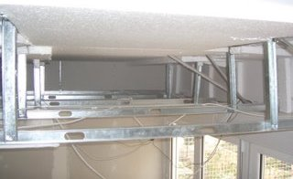
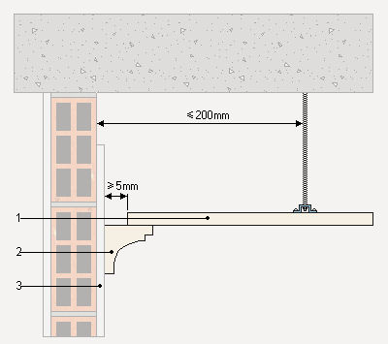
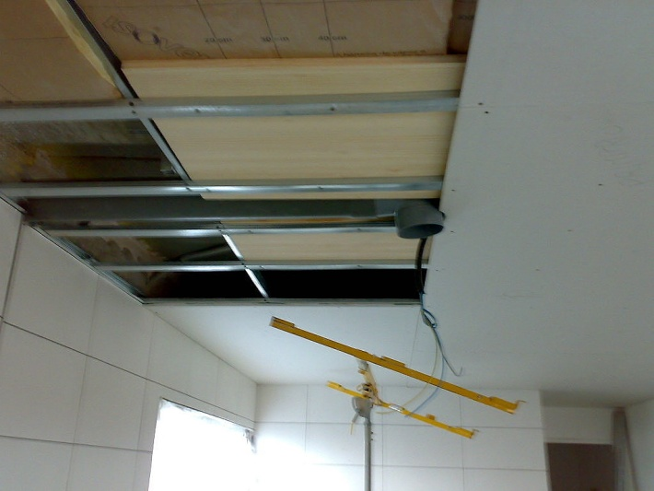
HOSTEL HALMSTAD
Characteristics of the construction
COATINGS
False ceilings: In all the building, a false ceiling will be with plaster boards 50x50 cm dimensions (1), supported by a metal structure, and executed with plaster molding (2), and finished with smooth plastic paint, washable of first quality.

Slide 18
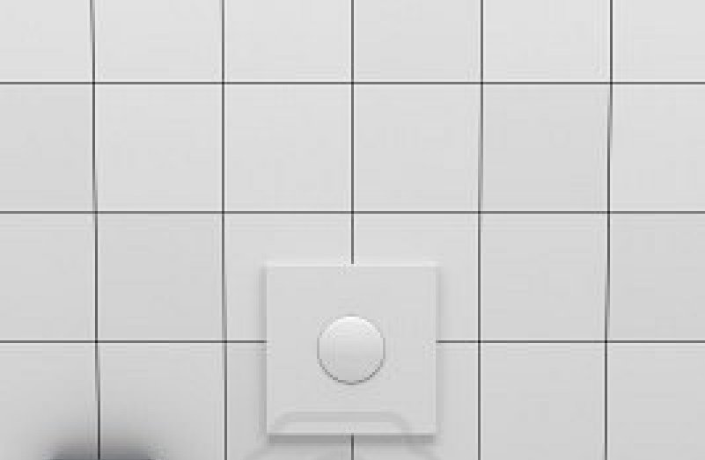
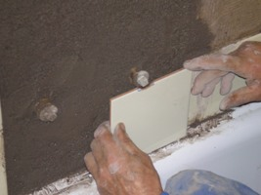
HOSTEL HALMSTAD
Characteristics of the construction
COATINGS
Wall coating:
All interior walls, except the bathrooms shall be finished smooth plastic paint.
In the coating of the walls of the bathrooms on the plasterboard consist of a layer of adhesive cement and then the tiles, ceramic tiles, of dimensions 20x20cm.

Slide 19
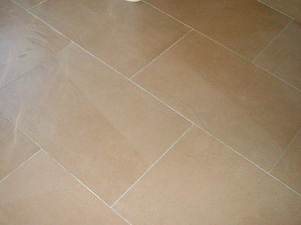
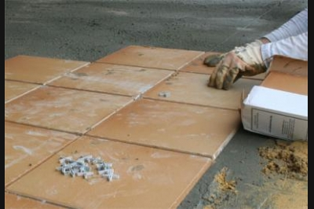
HOSTEL HAMSTAD
Characteristics of the construction
COATINGS
Pavements:
In all the building the ground pavement will be terrazzo or stoneware tiles.
On the concrete of the slab, it will spread a sheet impact resistant; a layer of mortar regularization; a layer of mortar grip; and finally tiles.

Slide 20
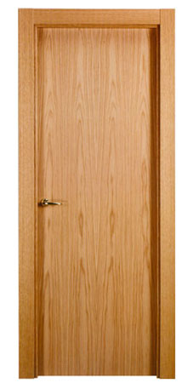
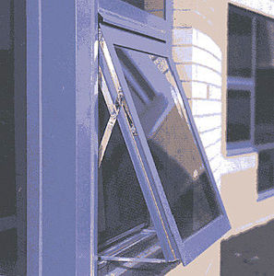
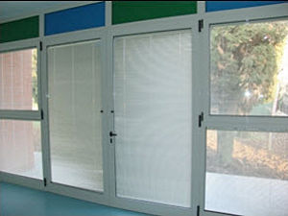
HOSTEL HALMSTAD
Characteristics of the construction
CARPENTRY
The interior carpentry is wood. And the exterior carpentry is aluminum.

Slide 21
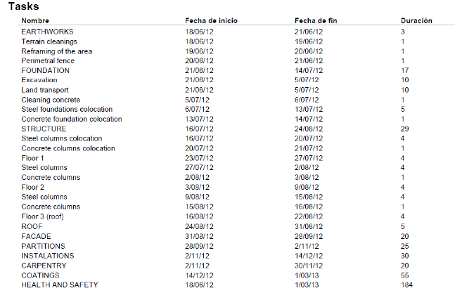
HOSTEL HALMSTAD
GANTT CHART *

Slide 22
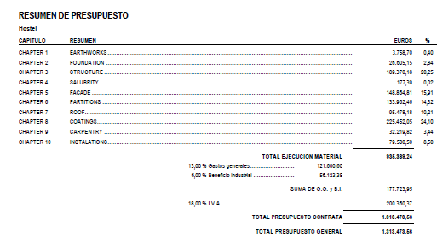
HOSTEL HALMSTAD
BUDGET
The total cost of the works is 1.313.473’56 €, approximately 11.895.213,28128 SEK.

Slide 23
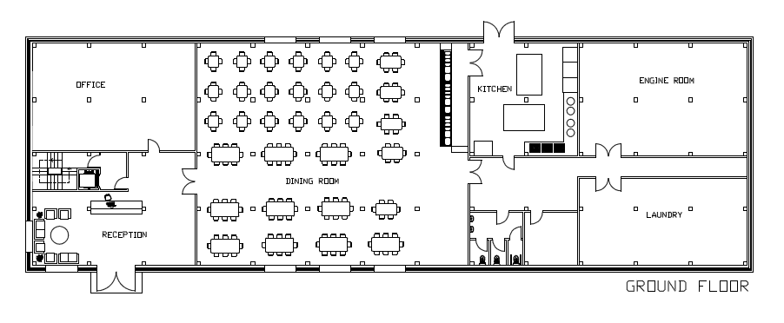
HOSTEL HALMSTAD
DRAWINGS

Slide 24
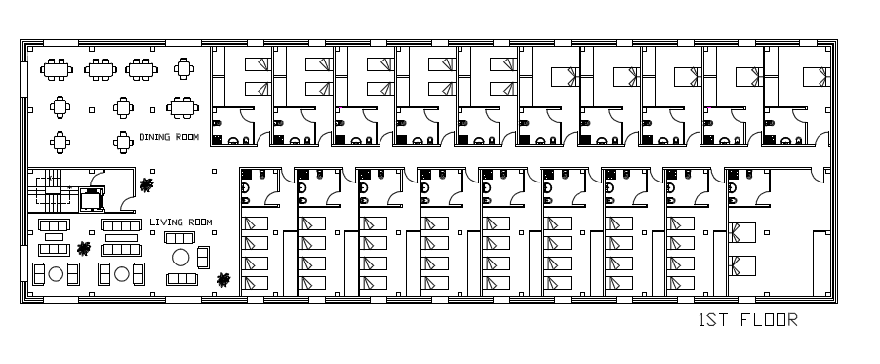
HOSTEL HALMSTAD
DRAWINGS

Slide 25
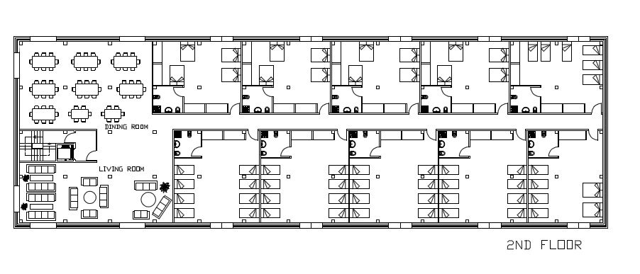
HOSTEL HALMSTAD
DRAWINGS

Slide 26

HOSTEL HALMSTAD
DRAWINGS

Slide 27

HOSTEL HALMSTAD
DRAWINGS

Slide 28

HOSTEL HALMSTAD
DRAWINGS

Slide 29

HOSTEL HALMSTAD
DRAWINGS

