Slide 1


Master of Science in Engineering Technology: Construction 2012/2013
Measuring the effect of the heat flow through a chimney with different altitudes of a rescaled model and validating the results with TRNSYS, a computer-simulated model.
Promotor: Dr. Carolina Aparicio Fernández
Dr. José Luis Vivancos Bono
Masterstudents: Jasper Degraeuwe
Bertie Vandendorpe

Slide 2
Introduction
Title meaning:
Measuring the effect of the heat flow through a chimney with different altitudes of a rescaled model and validating the results with TRNSYS, a computer-simulated model
Importance to society?
Our goals?
Other tests?
Other options?
Measuring the effect of the heat flow through a chimney with different altitudes of a rescaled model and validating the results with TRNSYS, a computer-simulated model.

Slide 3
Summary of the presentation
Rescaled model
TRNSYS- model
  Computer simulation of rescaled model
  Computer simulation of apartment building
Results
  Results of the measurements
  Comparing TRNSYS outputs with the measurements
  Results of the adjustments on the apartment
Verifying the results of the measurements
  Principle of natural ventilation
  Thermal Balance
  Blower door test
Conclusion
Measuring the effect of the heat flow through a chimney with different altitudes of a rescaled model and validating the results with TRNSYS, a computer-simulated model.

Slide 4
Summary of the presentation
Rescaled model
TRNSYS- model
  Computer simulation of rescaled model
  Computer simulation of apartment building
Results
  Results of the measurements
  Comparing TRNSYS outputs with the measurements
  Results of the adjustments on the apartment
Verifying the results of the measurements
  Principle of natural ventilation
  Thermal Balance
  Blower door test
Conclusion
Measuring the effect of the heat flow through a chimney with different altitudes of a rescaled model and validating the results with TRNSYS, a computer-simulated model.

Slide 5
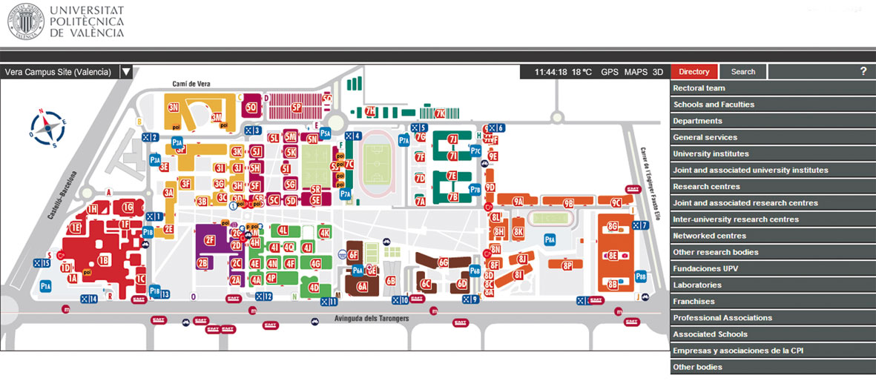
Rescaled model
Location
Measuring the effect of the heat flow through a chimney with different altitudes of a rescaled model and validating the results with TRNSYS, a computer-simulated model.

Slide 6
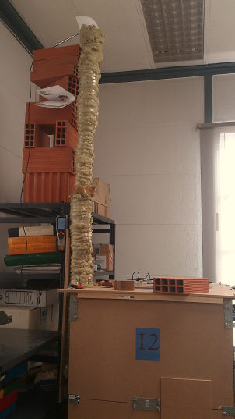
Rescaled model
Specifications
  MDF
  Rockwool
  PVC- Pipe
Measuring the effect of the heat flow through a chimney with different altitudes of a rescaled model and validating the results with TRNSYS, a computer-simulated model.

Slide 7
Rescaled model
Tests
  Measurement equipment (TESTO 435 Equipment)
  General method
  Adjustments
    Window opening (10, 50 or 100 cm²)
    Pipe length (1 m or 2 m)
    Temperature difference (1, 2, 3 or 4 lamps)
    -> 24 results
Measuring the effect of the heat flow through a chimney with different altitudes of a rescaled model and validating the results with TRNSYS, a computer-simulated model.

Slide 8
Summary of the presentation
Rescaled model
TRNSYS- model
  Computer simulation of rescaled model
  Computer simulation of apartment building
Results
  Results of the measurements
  Comparing TRNSYS outputs with the measurements
  Results of the adjustments on the apartment
Verifying the results of the measurements
  Principle of natural ventilation
  Thermal Balance
  Blower door test
Conclusion
Measuring the effect of the heat flow through a chimney with different altitudes of a rescaled model and validating the results with TRNSYS, a computer-simulated model.

Slide 9
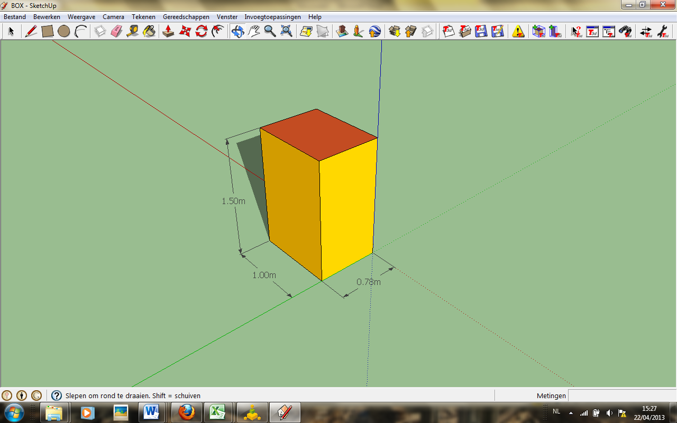
2.1 Computer simulation of rescaled model
Making of
  Sketch-Up TM
Measuring the effect of the heat flow through a chimney with different altitudes of a rescaled model and validating the results with TRNSYS, a computer-simulated model.

Slide 10
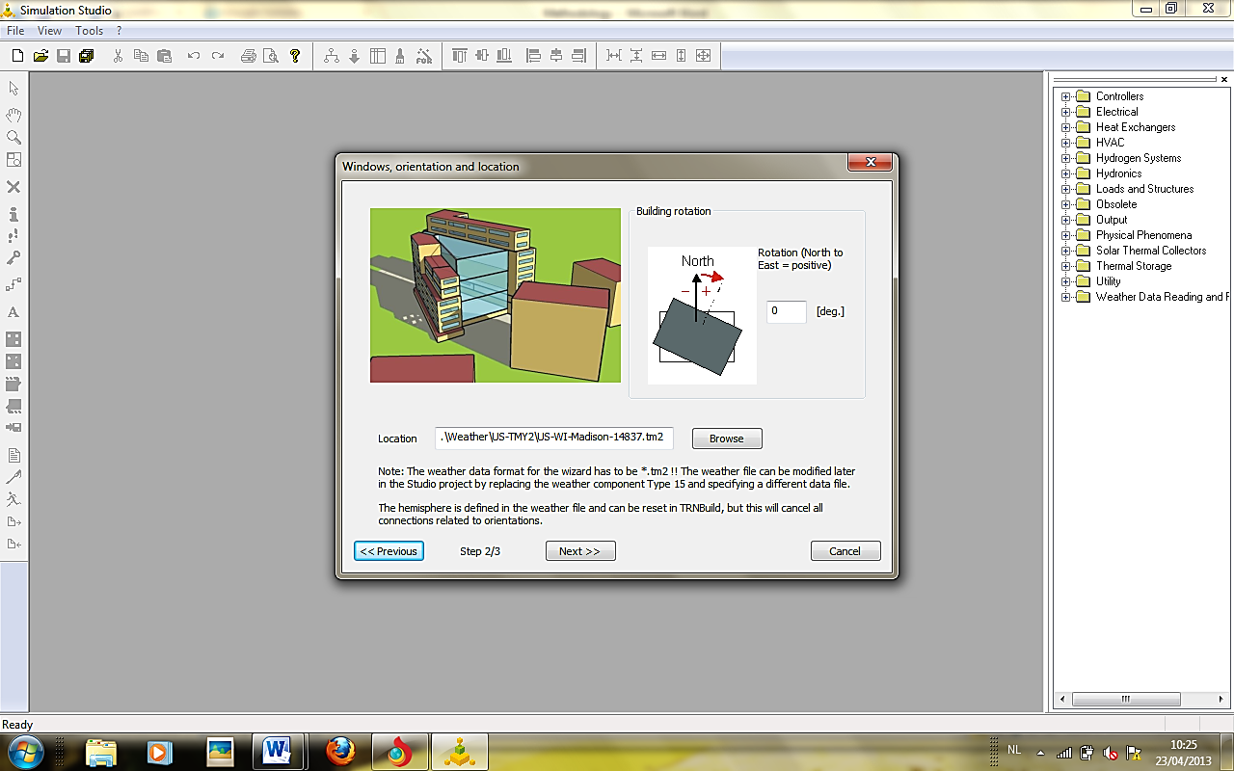
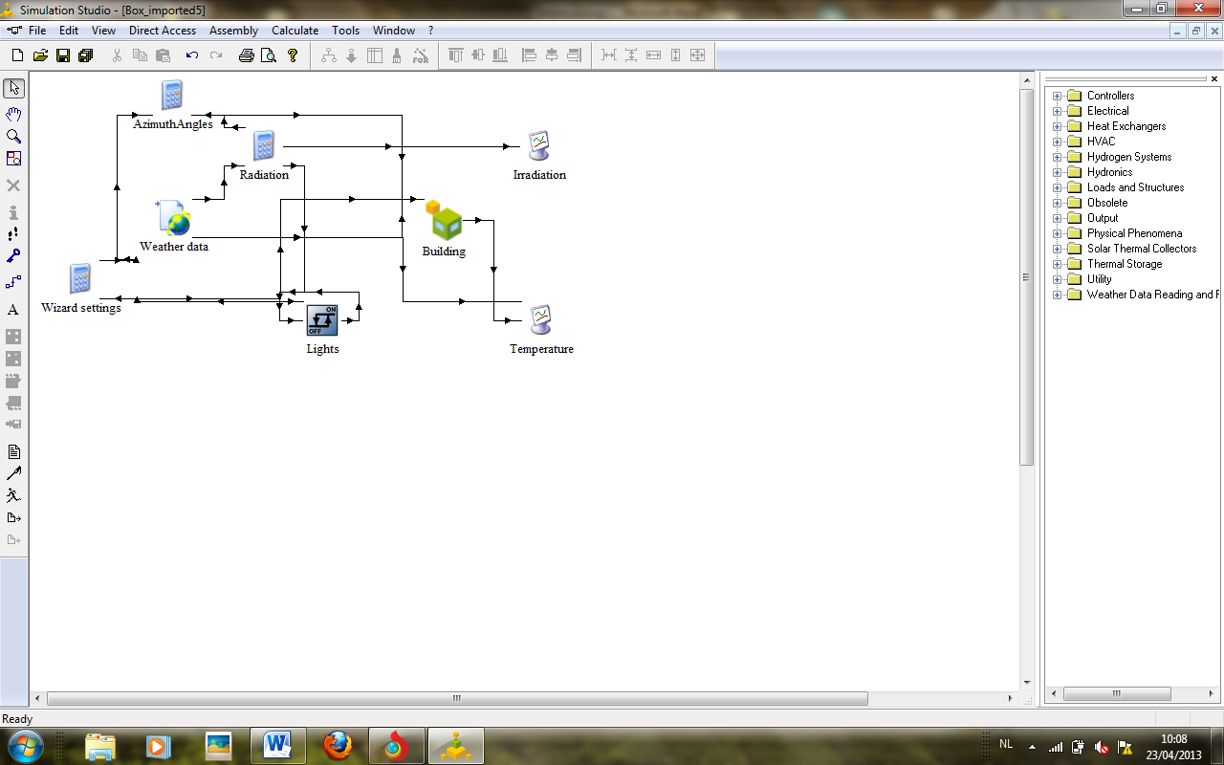
2.1 Computer simulation of rescaled model
Making of
Measuring the effect of the heat flow through a chimney with different altitudes of a rescaled model and validating the results with TRNSYS, a computer-simulated model.

Slide 11
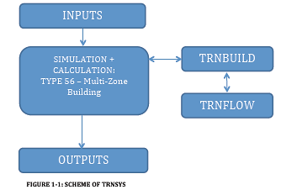
2.1 Computer simulation of rescaled model
Making of
  TRNSYS-file
Measuring the effect of the heat flow through a chimney with different altitudes of a rescaled model and validating the results with TRNSYS, a computer-simulated model.

Slide 12
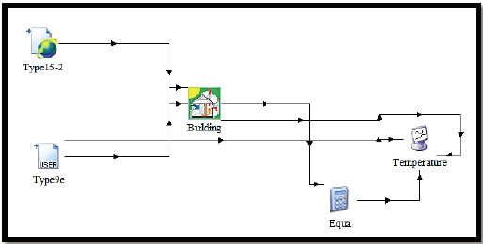
2.1 Computer simulation of rescaled model
Making of
  TRNSYS Simulation Studio
Measuring the effect of the heat flow through a chimney with different altitudes of a rescaled model and validating the results with TRNSYS, a computer-simulated model.

Slide 13
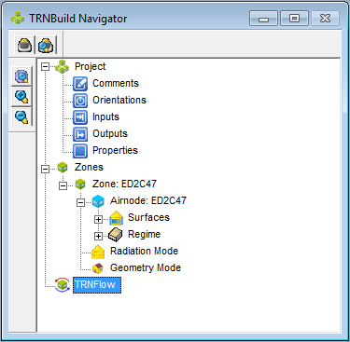
2.1 Computer simulation of rescaled model
Making of
  TRNBUILD:
    Walls
    Optional Equipment:
      Initial Values
      Heating Type Manager
Measuring the effect of the heat flow through a chimney with different altitudes of a rescaled model and validating the results with TRNSYS, a computer-simulated model.

Slide 14
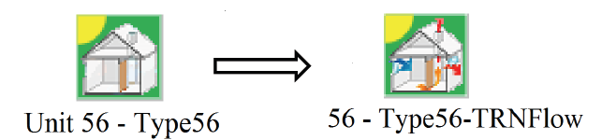
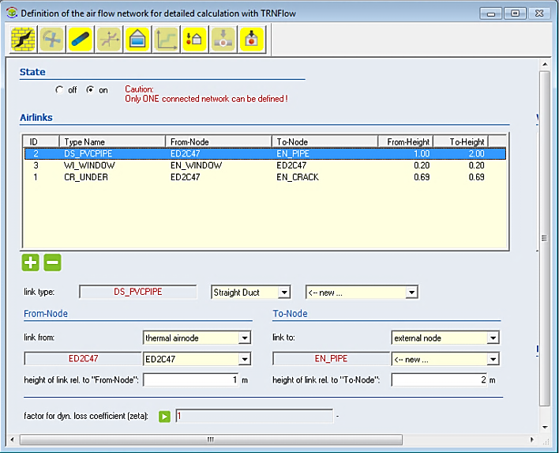
2.1 Computer simulation of rescaled model
Making of
  TRNFLOW
Measuring the effect of the heat flow through a chimney with different altitudes of a rescaled model and validating the results with TRNSYS, a computer-simulated model.

Slide 15
Summary of the presentation
Rescaled model
TRNSYS- model
  Computer simulation of rescaled model
  Computer simulation of apartment building
Results
  Results of the measurements
  Comparing TRNSYS outputs with the measurements
  Results of the adjustments on the apartment
Verifying the results of the measurements
  Principle of natural ventilation
  Thermal Balance
  Blower door test
Conclusion
Measuring the effect of the heat flow through a chimney with different altitudes of a rescaled model and validating the results with TRNSYS, a computer-simulated model.

Slide 16
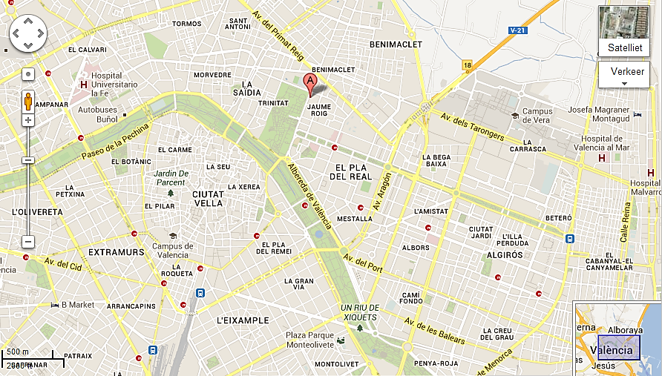
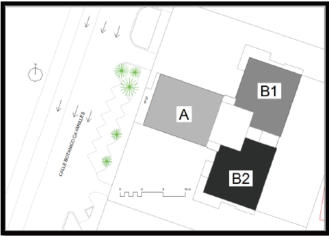
2.2 Computer simulation of apartment model
Location
Measuring the effect of the heat flow through a chimney with different altitudes of a rescaled model and validating the results with TRNSYS, a computer-simulated model.

Slide 17
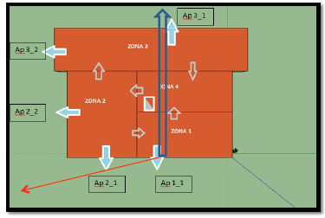
2.2 Computer simulation of apartment model
Making of
  Sketch-Up TM
Measuring the effect of the heat flow through a chimney with different altitudes of a rescaled model and validating the results with TRNSYS, a computer-simulated model.

Slide 18
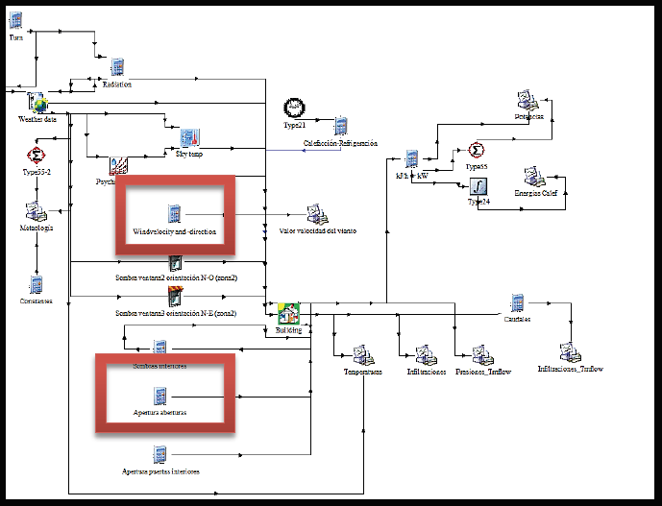
2.2 Computer simulation of apartment model
Making of
  TRNSYS-file
Measuring the effect of the heat flow through a chimney with different altitudes of a rescaled model and validating the results with TRNSYS, a computer-simulated model.

Slide 19
2.2 Computer simulation of apartment model
Adaptations in TRNSYS
  Adaptation of wind direction and
  wind velocity
  Adaptation of the window opening
Measuring the effect of the heat flow through a chimney with different altitudes of a rescaled model and validating the results with TRNSYS, a computer-simulated model.

Slide 20
Summary of the presentation
Rescaled model
TRNSYS- model
  Computer simulation of rescaled model
  Computer simulation of apartment building
Results
  Results of the measurements
  Comparing TRNSYS outputs with the measurements
  Results of the adjustments on the apartment
Verifying the results of the measurements
  Principle of natural ventilation
  Thermal Balance
  Blower door test
Conclusion
Measuring the effect of the heat flow through a chimney with different altitudes of a rescaled model and validating the results with TRNSYS, a computer-simulated model.

Slide 21
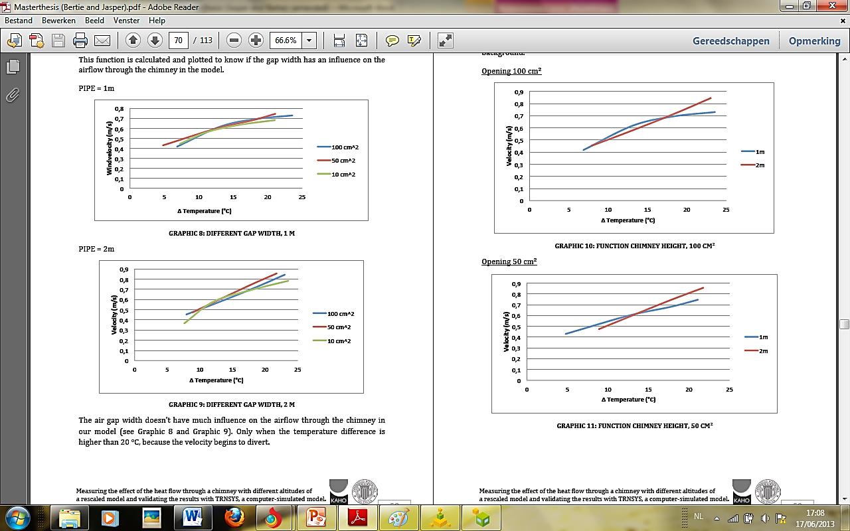

3.1 Results of the measurements
Pipe length:
1 m 2 m
Measuring the effect of the heat flow through a chimney with different altitudes of a rescaled model and validating the results with TRNSYS, a computer-simulated model.

Slide 22
Summary of the presentation
Rescaled model
TRNSYS- model
  Computer simulation of rescaled model
  Computer simulation of apartment building
Results
  Results of the measurements
  Comparing TRNSYS outputs with the measurements
  Results of the adjustments on the apartment
Verifying the results of the measurements
  Principle of natural ventilation
  Thermal Balance
  Blower door test
Conclusion
Measuring the effect of the heat flow through a chimney with different altitudes of a rescaled model and validating the results with TRNSYS, a computer-simulated model.

Slide 23
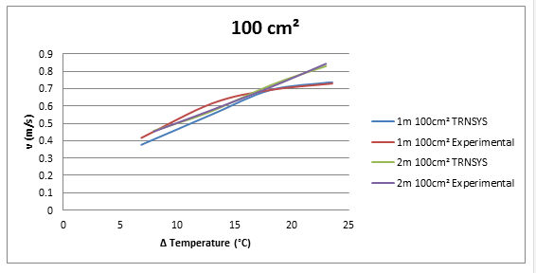
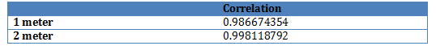
3.2 Comparing TRNSYS outputs with measurements
 |  |  | v [m/s]
 |  | ΔT | TRNSYS | Manual | Mean/Difference
1 meter | 4 lamps | 23.57 | 0.738 | 0.73 | 0.734
2 meter | 4 lamps | 23.01 | 0.8303 | 0.844 | 0.8375
 |  |  |  |  | 0.1035
Measuring the effect of the heat flow through a chimney with different altitudes of a rescaled model and validating the results with TRNSYS, a computer-simulated model.

Slide 24
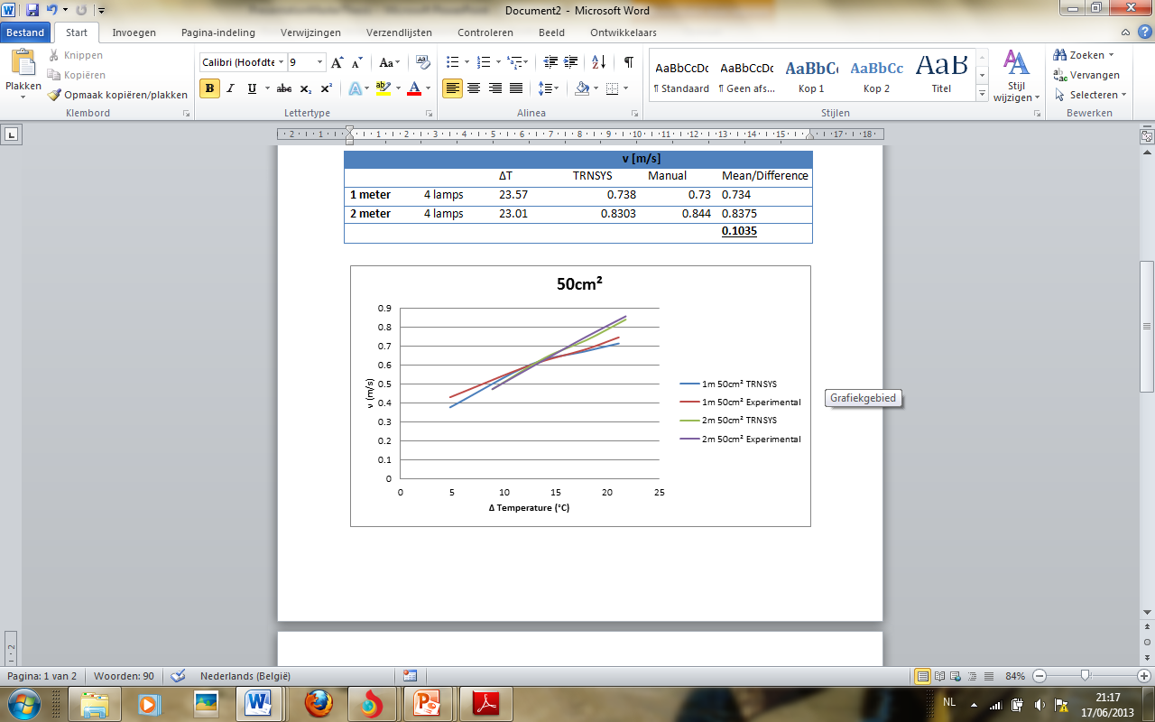
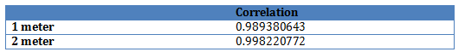
3.2 Comparing TRNSYS outputs with measurements
 |  |  | v [m/s]
 |  | ΔT | TRNSYS | Manual | Mean/Difference
1 meter | 4 lamps | 21.1 | 0.714 | 0.746 | 0.73
2 meter | 4 lamps | 21.77 | 0.8401 | 0.857 | 0.84855
 |  |  |  |  | 0.11855
Measuring the effect of the heat flow through a chimney with different altitudes of a rescaled model and validating the results with TRNSYS, a computer-simulated model.

Slide 25
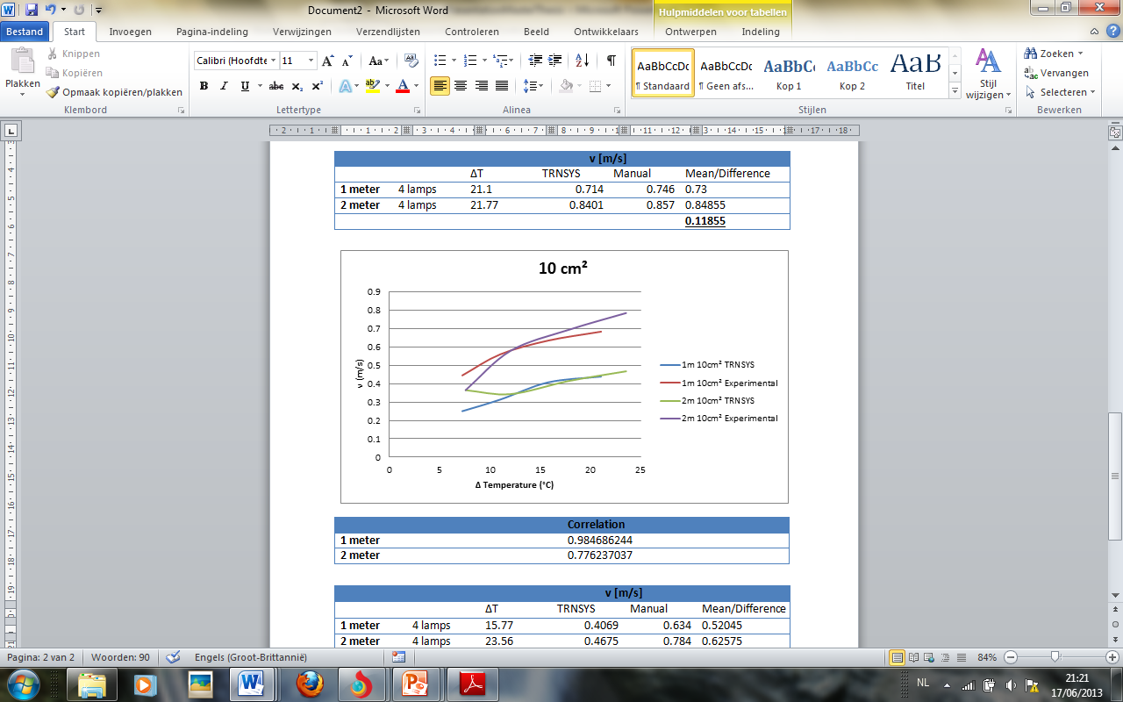
3.2 Comparing TRNSYS outputs with measurements
 | Correlation
1 meter | 0.984686244
2 meter | 0.776237037
Measuring the effect of the heat flow through a chimney with different altitudes of a rescaled model and validating the results with TRNSYS, a computer-simulated model.

Slide 26
Summary of the presentation
Rescaled model
TRNSYS- model
  Computer simulation of rescaled model
  Computer simulation of apartment building
Results
  Results of the measurements
  Comparing TRNSYS outputs with the measurements
  Results of the adjustments on the apartment
Verifying the results of the measurements
  Principle of natural ventilation
  Thermal Balance
  Blower door test
Conclusion
Measuring the effect of the heat flow through a chimney with different altitudes of a rescaled model and validating the results with TRNSYS, a computer-simulated model.

Slide 27
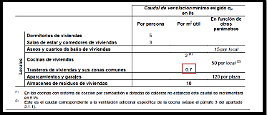
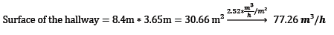
3.3 Results of the adjustments on the apartment
Measuring the effect of the heat flow through a chimney with different altitudes of a rescaled model and validating the results with TRNSYS, a computer-simulated model.

Slide 28
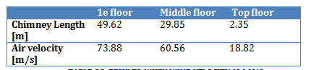
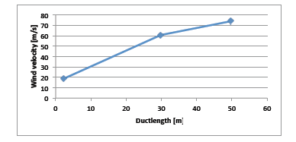
3.3 Results of the adjustments on the apartment
0 m/s
Measuring the effect of the heat flow through a chimney with different altitudes of a rescaled model and validating the results with TRNSYS, a computer-simulated model.

Slide 29
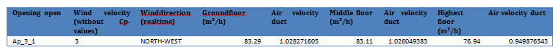
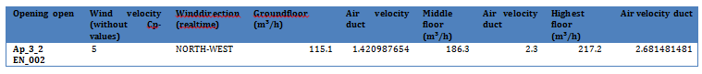
3.3 Results of the adjustments on the apartment
3 m/s
5 m/s
Measuring the effect of the heat flow through a chimney with different altitudes of a rescaled model and validating the results with TRNSYS, a computer-simulated model.

Slide 30
Summary of the presentation
Rescaled model
TRNSYS- model
  Computer simulation of rescaled model
  Computer simulation of apartment building
Results
  Results of the measurements
  Comparing TRNSYS outputs with the measurements
  Results of the adjustments on the apartment
Verifying the results of the measurements
  Principle of natural ventilation
  Thermal Balance
  Blower door test
Conclusion
Measuring the effect of the heat flow through a chimney with different altitudes of a rescaled model and validating the results with TRNSYS, a computer-simulated model.

Slide 31
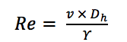
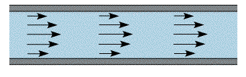
4.1 Principle of natural ventilation
Reynolds number
(1)
Measuring the effect of the heat flow through a chimney with different altitudes of a rescaled model and validating the results with TRNSYS, a computer-simulated model.

Slide 32
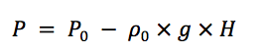
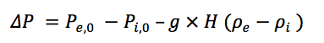
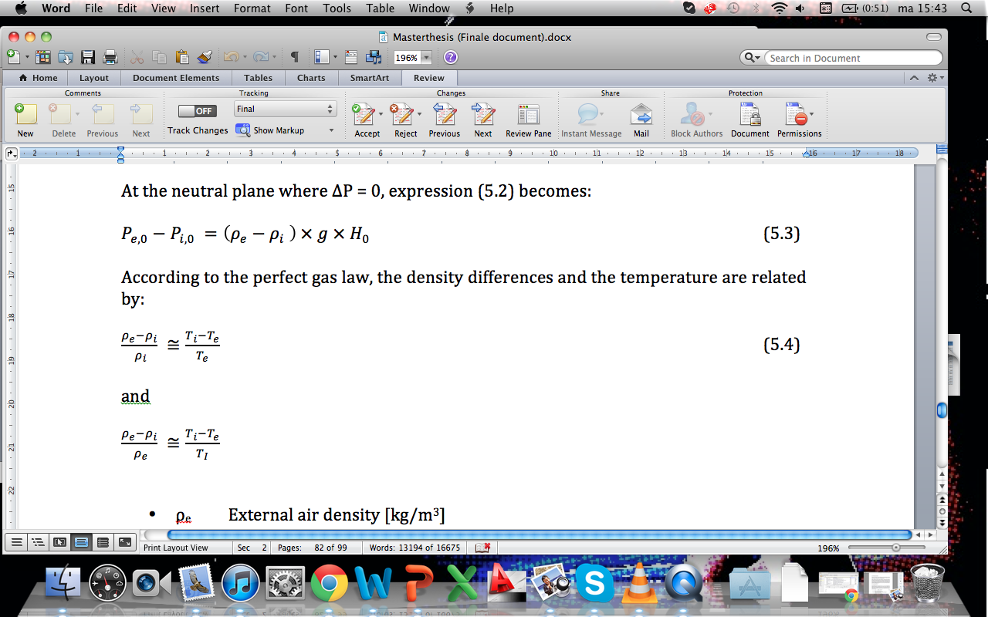
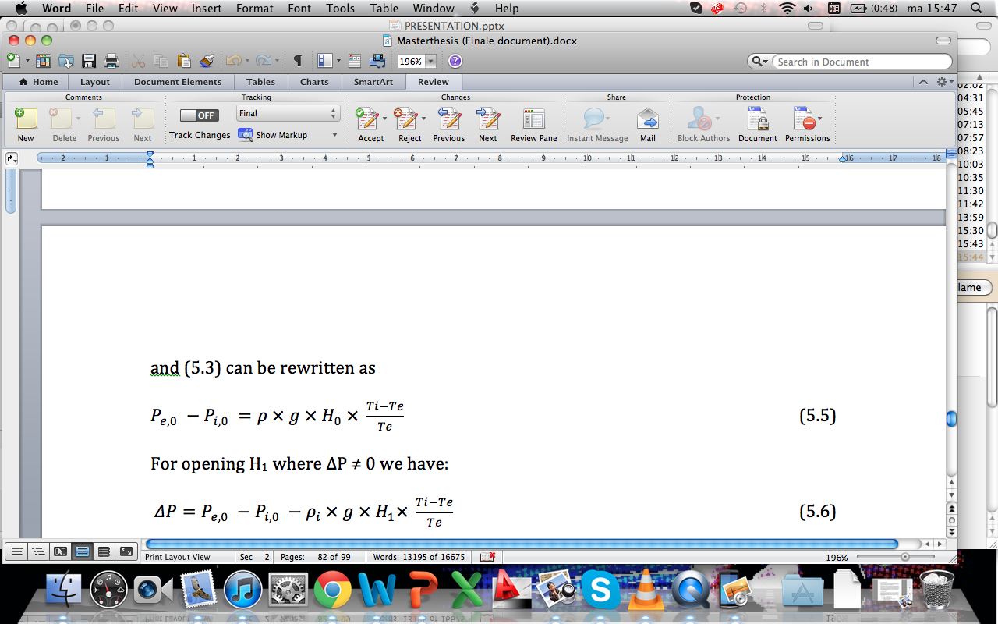
4.1 Principle of natural ventilation
Operating forces natural ventilation
Thermal Buoyancy
  Air exchange
  Different densities
  (2) (Zhigang L., 2007)
  (3)
  (4)
  (5) (6)
Measuring the effect of the heat flow through a chimney with different altitudes of a rescaled model and validating the results with TRNSYS, a computer-simulated model.

Slide 33
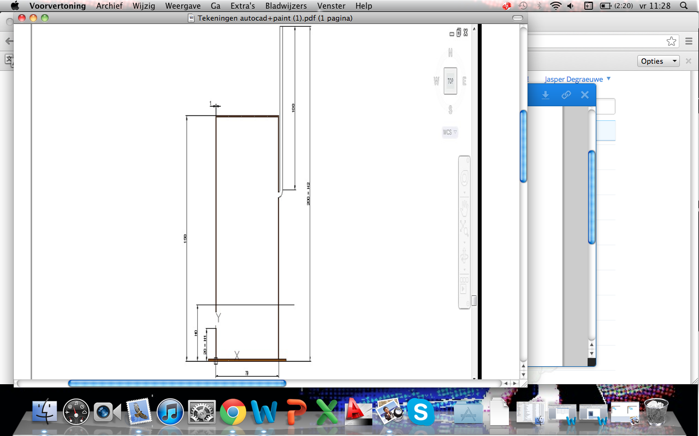
4.1 Principle of natural ventilation
Thermal Buoyancy
Measuring the effect of the heat flow through a chimney with different altitudes of a rescaled model and validating the results with TRNSYS, a computer-simulated model.

Slide 34
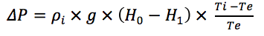
4.1 Principle of natural ventilation
Thermal Buoyancy
(7) (6)
(8)
Measuring the effect of the heat flow through a chimney with different altitudes of a rescaled model and validating the results with TRNSYS, a computer-simulated model.

Slide 35
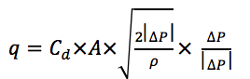
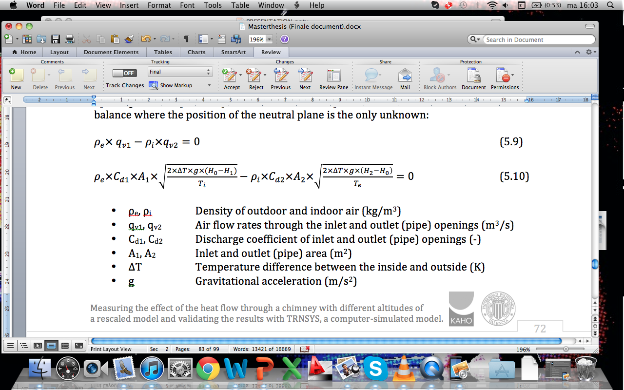
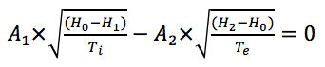
4.1 Principle of natural ventilation
Thermal Buoyancy
  (9) (Heiselberg P., 2003)
  (10)
Final Formula (11):
Measuring the effect of the heat flow through a chimney with different altitudes of a rescaled model and validating the results with TRNSYS, a computer-simulated model.

Slide 36
4.1 Principle of natural ventilation
Thermal Buoyancy
(8)
(9)
2
Measuring the effect of the heat flow through a chimney with different altitudes of a rescaled model and validating the results with TRNSYS, a computer-simulated model.

Slide 37
4.1 Principle of natural ventilation
Thermal Buoyancy
Measuring the effect of the heat flow through a chimney with different altitudes of a rescaled model and validating the results with TRNSYS, a computer-simulated model.

Slide 38
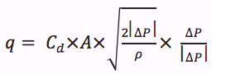
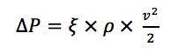
4.1 Principle of natural ventilation
Thermal Buoyancy + ventilation losses of the curve
(9)
and
(12)
Measuring the effect of the heat flow through a chimney with different altitudes of a rescaled model and validating the results with TRNSYS, a computer-simulated model.

Slide 39
4.1 Principle of natural ventilation
Thermal Buoyancy + ventilation losses of the curve
Measuring the effect of the heat flow through a chimney with different altitudes of a rescaled model and validating the results with TRNSYS, a computer-simulated model.

Slide 40
4.1 Principle of natural ventilation
Verifying
Measuring the effect of the heat flow through a chimney with different altitudes of a rescaled model and validating the results with TRNSYS, a computer-simulated model.

Slide 41
Summary of the presentation
Rescaled model
TRNSYS- model
  Computer simulation of rescaled model
  Computer simulation of apartment building
Results
  Results of the measurements
  Comparing TRNSYS outputs with the measurements
  Results of the adjustments on the apartment
Verifying the results of the measurements
  Principle of natural ventilation
  Thermal Balance
  Blower door test
Conclusion
Measuring the effect of the heat flow through a chimney with different altitudes of a rescaled model and validating the results with TRNSYS, a computer-simulated model.

Slide 42
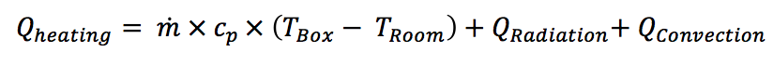
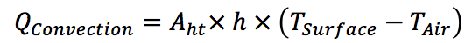
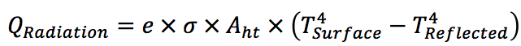
4.2 Thermal Balance
Measuring the effect of the heat flow through a chimney with different altitudes of a rescaled model and validating the results with TRNSYS, a computer-simulated model.

Slide 43
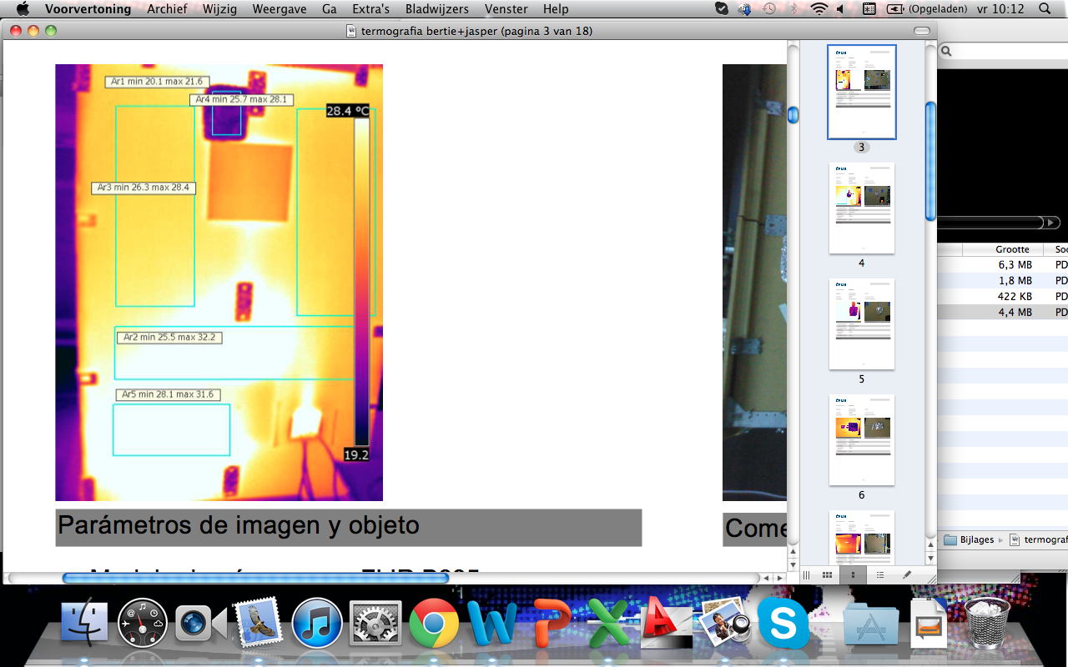
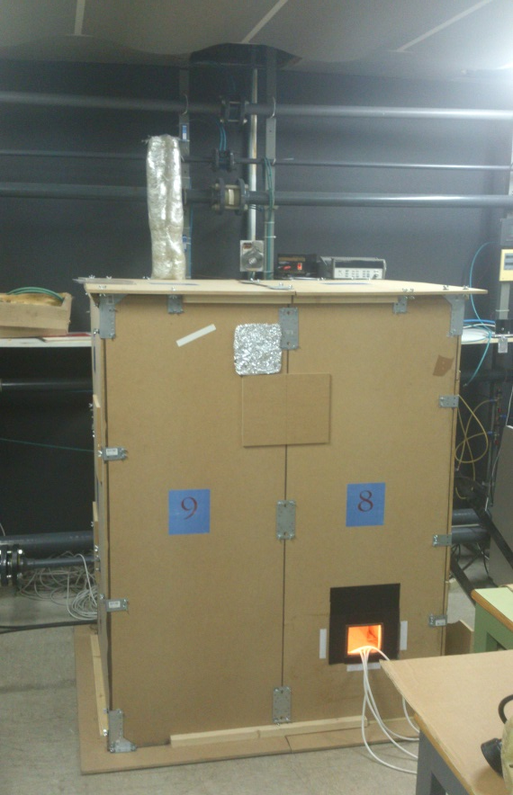
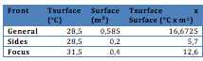
4.2 Thermal Balance
Parameters:
Heating source : 4 lamps, 480 W
Opening: 100 cm²
Length pipe: 1 m
Measuring the effect of the heat flow through a chimney with different altitudes of a rescaled model and validating the results with TRNSYS, a computer-simulated model.

Slide 44
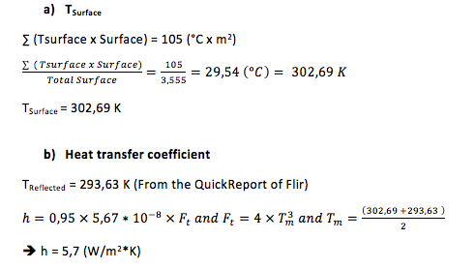
4.2 Thermal Balance
Measuring the effect of the heat flow through a chimney with different altitudes of a rescaled model and validating the results with TRNSYS, a computer-simulated model.

Slide 45
4.2 Thermal Balance
Thermal Balance
Q_{Radiation} = 184,90 W
Q_{Convection} = 194,00 W
Q_{Heating} = ( 1,18 × 0,0006628 × 1000 × 23,57) + 184,90 + 194,00 = 396,34 Watt
Measuring the effect of the heat flow through a chimney with different altitudes of a rescaled model and validating the results with TRNSYS, a computer-simulated model.

Slide 46
Summary of the presentation
Rescaled model
TRNSYS- model
  Computer simulation of rescaled model
  Computer simulation of apartment building
Results
  Results of the measurements
  Comparing TRNSYS outputs with the measurements
  Results of the adjustments on the apartment
Verifying the results of the measurements
  Principle of natural ventilation
  Thermal Balance
  Blower door test
Conclusion
Measuring the effect of the heat flow through a chimney with different altitudes of a rescaled model and validating the results with TRNSYS, a computer-simulated model.

Slide 47
4.3 Blower door test
Definition
  Overpressure and under pressure
  50 Pa
  Leakages, airtightness,…
  Moisture damage, mould formation,…
Measuring the effect of the heat flow through a chimney with different altitudes of a rescaled model and validating the results with TRNSYS, a computer-simulated model.

Slide 48
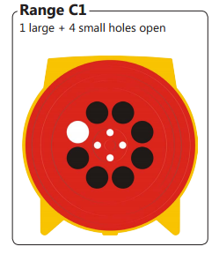
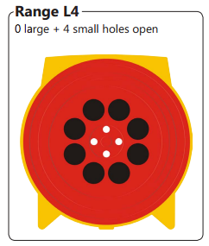
4.3 Blower door test
Range
100 cm² / 50 cm²
10 cm²
Measuring the effect of the heat flow through a chimney with different altitudes of a rescaled model and validating the results with TRNSYS, a computer-simulated model.

Slide 49
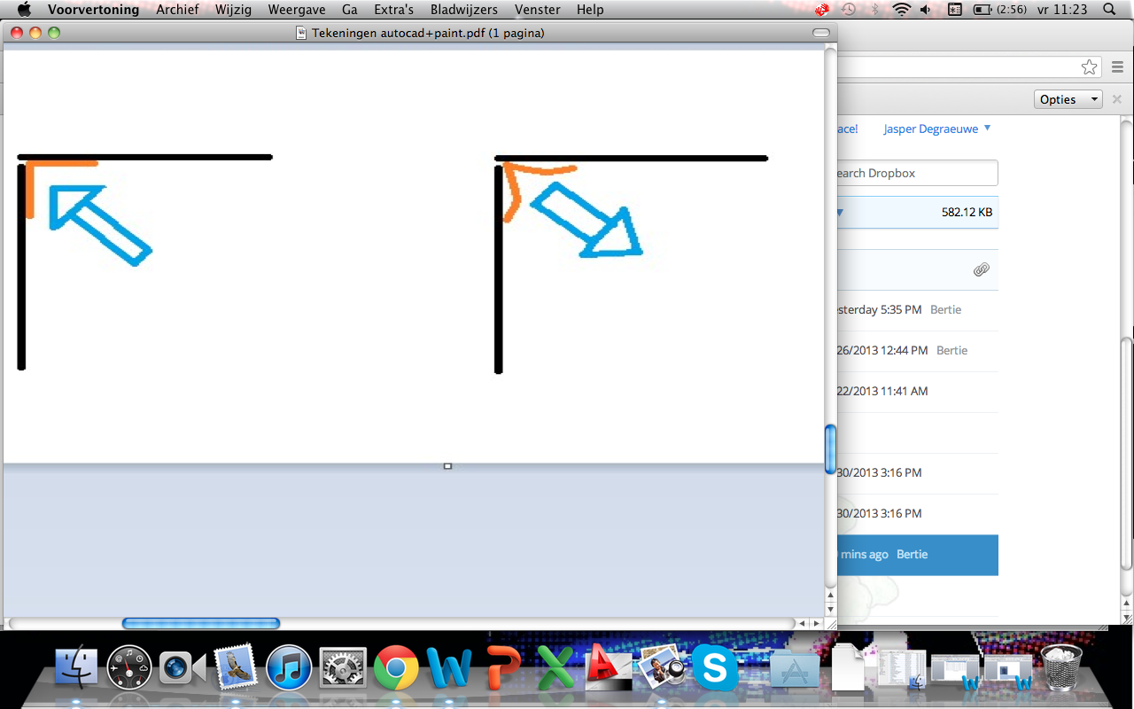
4.3 Blower door test
Measuring the effect of the heat flow through a chimney with different altitudes of a rescaled model and validating the results with TRNSYS, a computer-simulated model.

Slide 50
Summary of the presentation
Rescaled model
TRNSYS- model
  Computer simulation of rescaled model
  Computer simulation of apartment building
Results
  Results of the measurements
  Comparing TRNSYS outputs with the measurements
  Results of the adjustments on the apartment
Verifying the results of the measurements
  Principle of natural ventilation
  Thermal Balance
  Blower door test
Conclusion
Measuring the effect of the heat flow through a chimney with different altitudes of a rescaled model and validating the results with TRNSYS, a computer-simulated model.

Slide 51
5. Conclusion
Temperature rise → Density drop
3 methods: Experimental, TRNSYS (Experimental + Apartment) and Thermal Buoyancy
Verified → Thermal Balance
4 parameters manipulated
    Window opening
    Temperature difference
    Chimney height
    Wind velocity
Measuring the effect of the heat flow through a chimney with different altitudes of a rescaled model and validating the results with TRNSYS, a computer-simulated model.

Slide 52
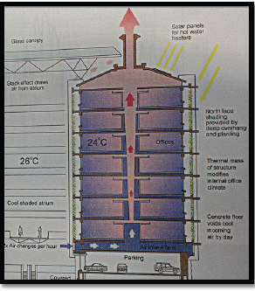
5. Conclusion
Future solutions
Measuring the effect of the heat flow through a chimney with different altitudes of a rescaled model and validating the results with TRNSYS, a computer-simulated model.

Slide 53
Acknowledgements
Special thanks to:
  Javier Calvo Diaz
  Carolina Sabina Aparicio Fernandez
  José Luis Vivancos Bono
  Rafael Royo Pastor
  Javi Biscer
  Pepe José Segovia
Measuring the effect of the heat flow through a chimney with different altitudes of a rescaled model and validating the results with TRNSYS, a computer-simulated model.

Slide 54
Any questions?
Measuring the effect of the heat flow through a chimney with different altitudes of a rescaled model and validating the results with TRNSYS, a computer-simulated model.

