Slide 1



CFD study and manufacturing of a wing with winglets
For the improvement of a laboratory practice for Aerodynamics
Javier Ferrero Micó
Tutor: Xandra Marcelle Margot
Escuela Técnica Superior de Ingeniería del Diseño
Centro de Motores Térmicos
Universitat Politècnica de Valencia
Aerospace Engineering
Academic course 2016-2017

Slide 2
Index
Introduction
CAD Design & Manufacturing
CFD Analysis
  ANSYS: Design Modeler & Meshing
  Fluent: Set Up
Results
Conclusions

Slide 3
Index
Introduction
CAD Design & Manufacturing
CFD Analysis
  ANSYS: Design Modeler & Meshing
  Fluent: Set Up
Results
Conclusions

Slide 4
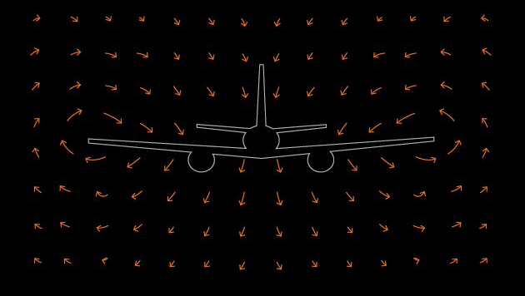
Introduction
Circulation of air

Slide 5
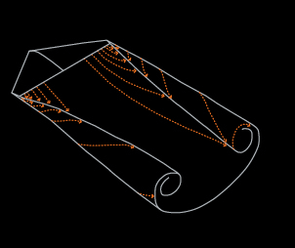
Introduction
Vortex wake

Slide 6
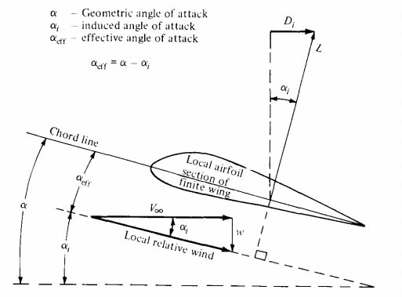
Introduction
Induced drag scheme

Slide 7
Index
Introduction
CAD Design & Manufacturing
CFD Analysis
  ANSYS: Design Modeler & Meshing
  Fluent: Set Up
Results
Conclusions

Slide 8

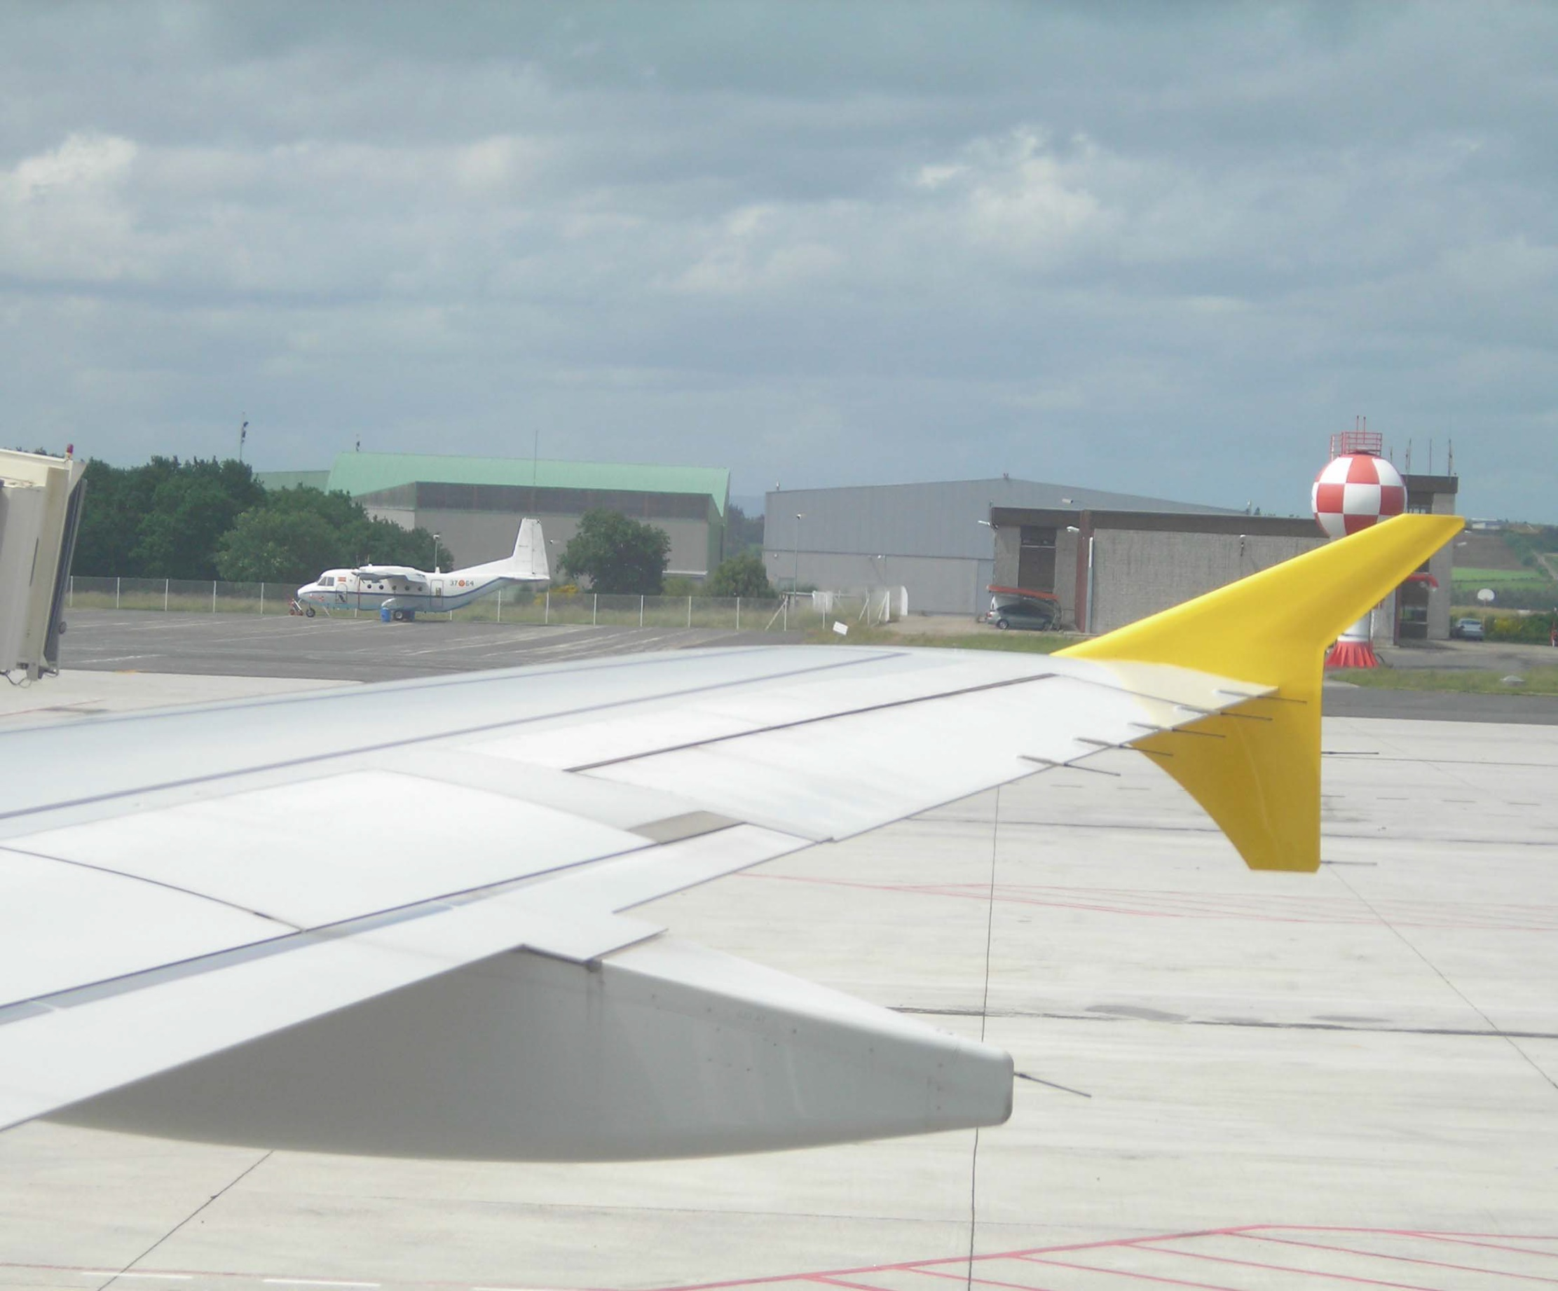
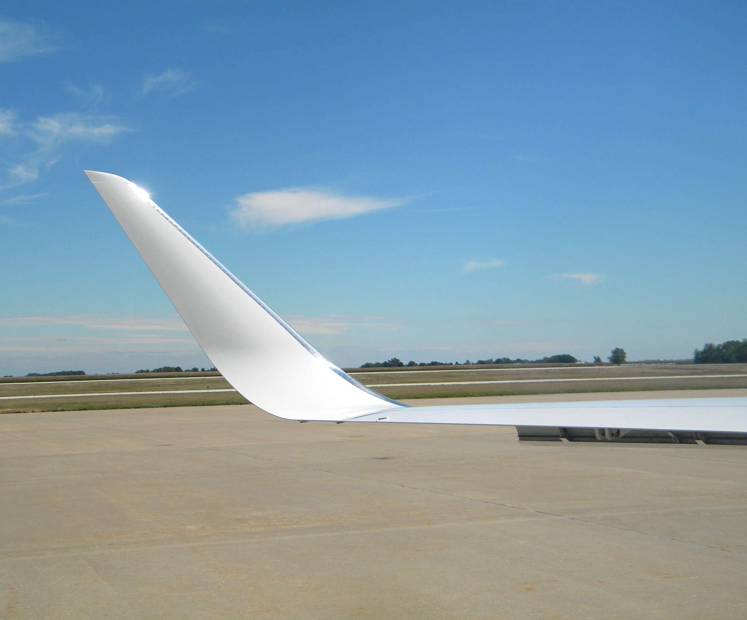
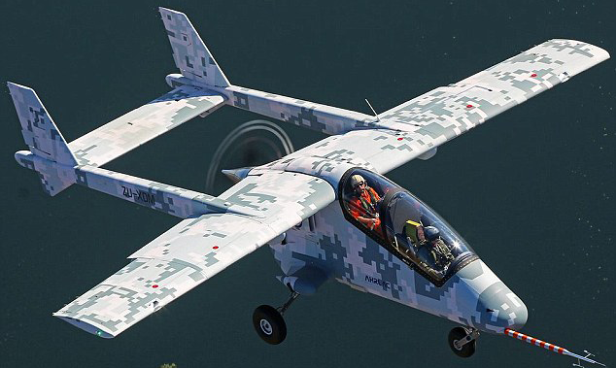
CAD Design & Manufacturing
A320 Geometry for the wing shape
Four wingtip shapes:
  No winglet
  Blended Winglet
  Raked Winglet
  Endplate Winglet

Slide 9
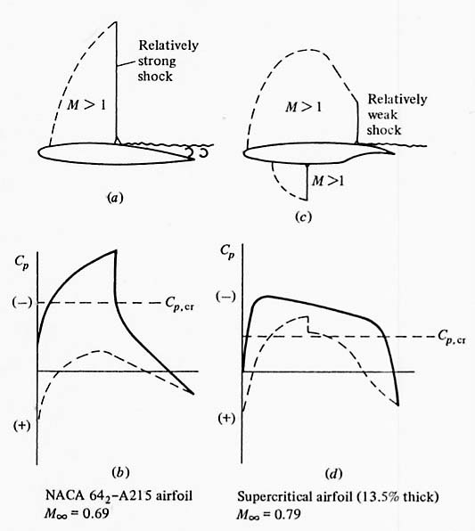
CAD Desing & Manufacturing

Slide 10
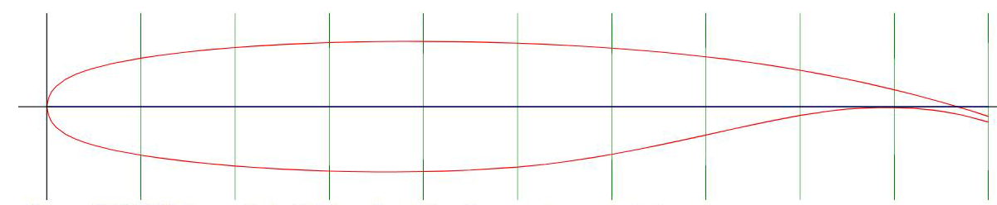
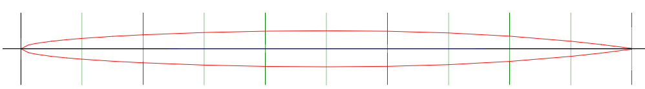
CAD Desing & Manufacturing
SC(2)-0714 Supercritical airfoil (Ref. NASA TP-2890)
NACA 16-006

Slide 11
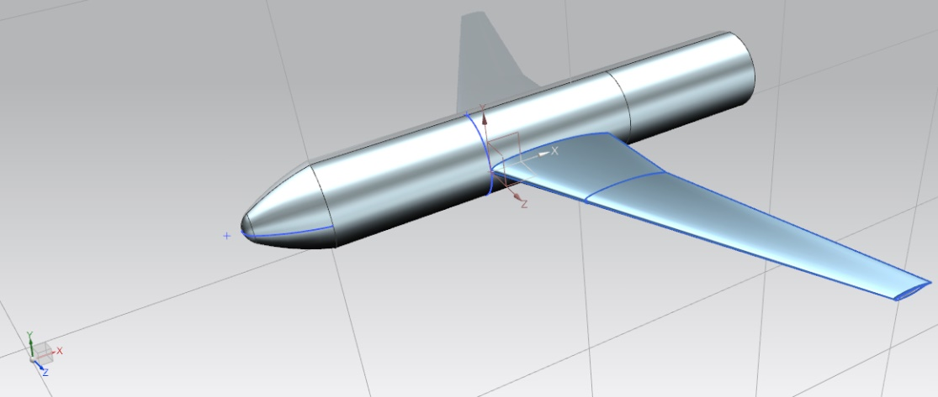
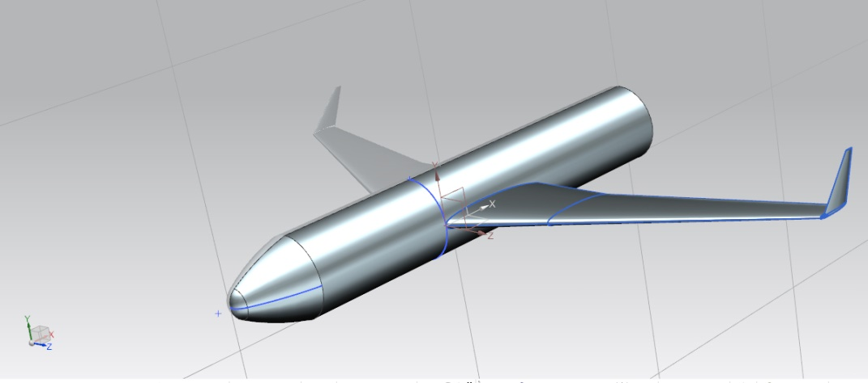
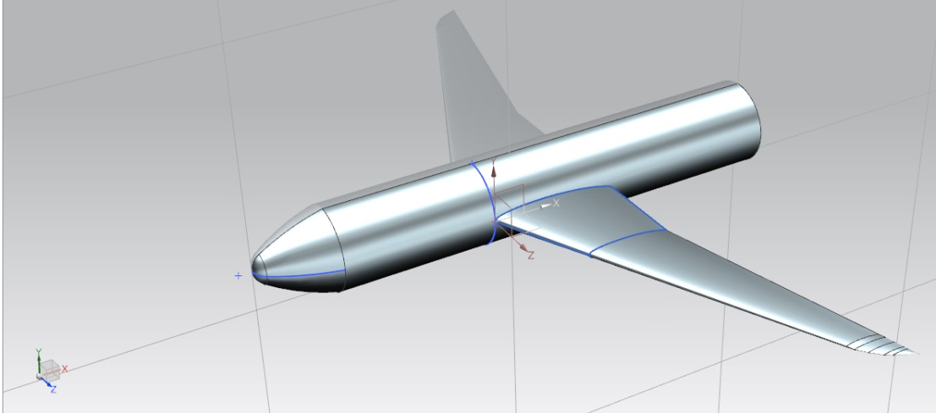
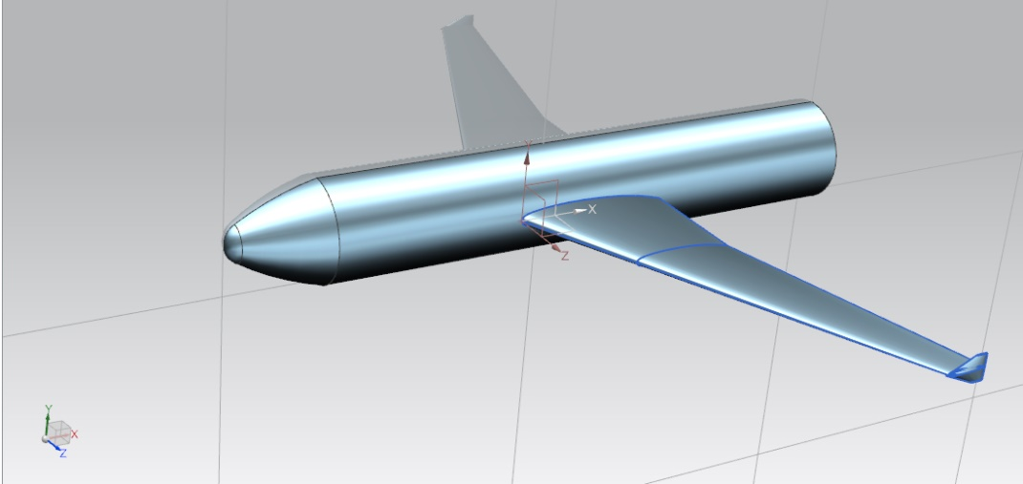
CAD Desing & Manufacturing

Slide 12
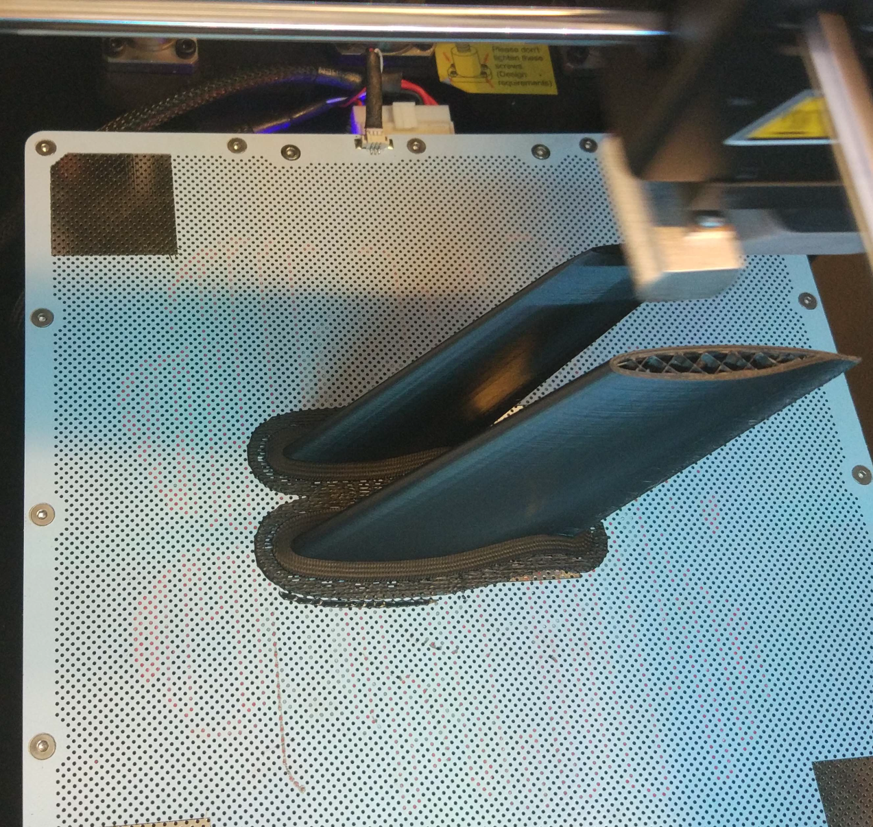
CAD Desing & Manufacturing

Slide 13
Index
Introduction
CAD Design & Manufacturing
CFD Analysis
  ANSYS: Design Modeler & Meshing
  Fluent: Set Up
Results
Conclusions

Slide 14
Index
Introduction
CAD Design & Manufacturing
CFD Analysis
  ANSYS: Design Modeler & Meshing
  Fluent: Set Up
Results
Conclusions

Slide 15
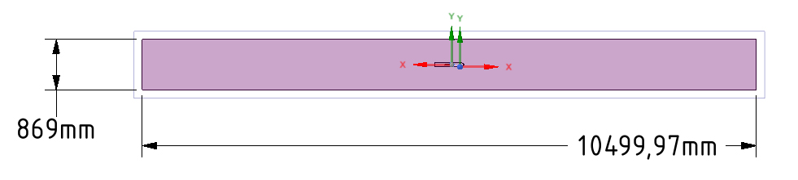
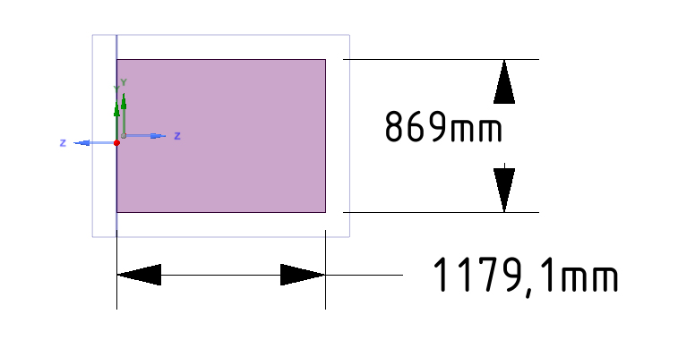
  ANSYS: Design Modeler & Meshing

Slide 16
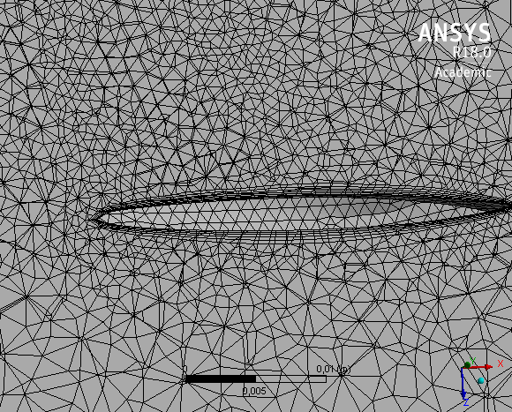
  ANSYS: Design Modeler & Meshing

Slide 17
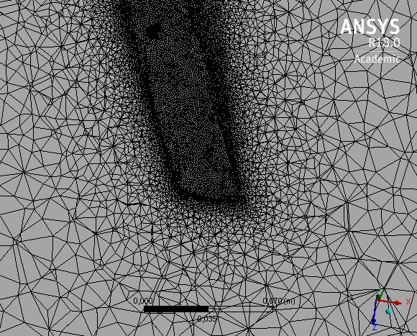
  ANSYS: Design Modeler & Meshing

Slide 18
Index
Introduction
CAD Design & Manufacturing
CFD Analysis
  ANSYS: Design Modeler & Meshing
  Fluent: Set Up
Results
Conclusions

Slide 19
Fluent: Set Up
Models
Energy Equation (On)
Turbulence Viscosity Equation
  k-ω model
  k-ε model
Materials
Air: Density (ideal gas) & Viscosity (Sutherland law)
Solid: Default
Notes:
relationship between the dynamic viscosity and the absolute temperature of an ideal gas

Slide 20
Fluent: Set Up
Reference Values & Boundary Conditions
Height: 37000 [ft] ( ≈11000 [m])
Atmospheric Pressure: 22632,04 [Pa]
Density: 0.363918 [kg/m3]
Temperature: 216.65 [K]
MACH Num.: 0.76 [-]
Angle of Attack: 0 [rad]

Slide 21
Index
Introduction
CAD Design & Manufacturing
CFD Analysis
  ANSYS: Design Modeler & Meshing
  Fluent: Set Up
Results
Conclusions

Slide 22
Results
Wingtip Type | CL | CD
No-winglet | 0.3117462 | 0.092454724
Raked Winglet | 0.3842515 | 0.042420095
Blended Winglet | 0.3974334 | 0.04334174
Endplate winglet | 0.35273417 | 0.042000862

Slide 23
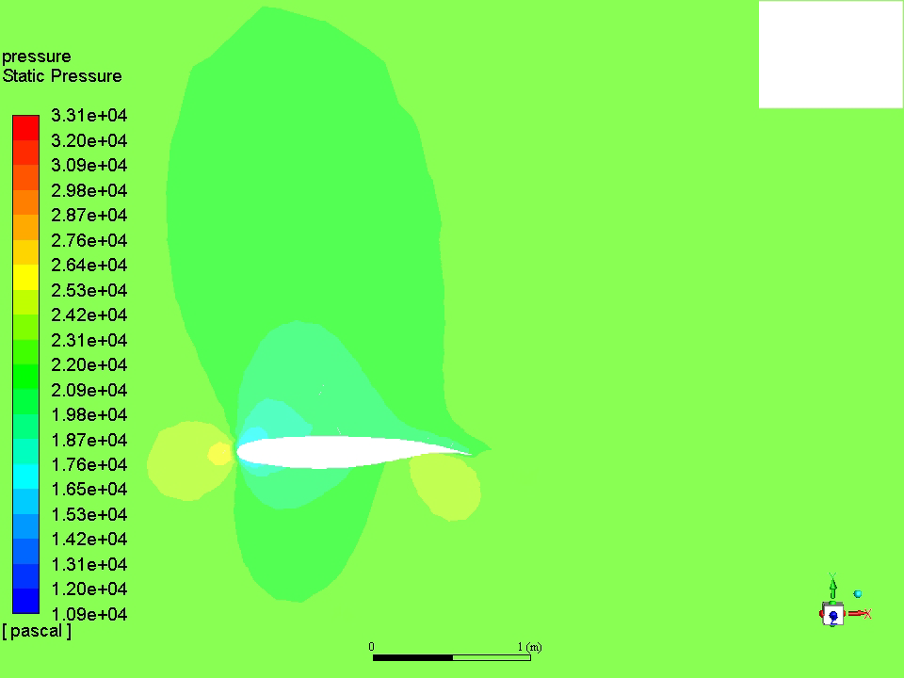
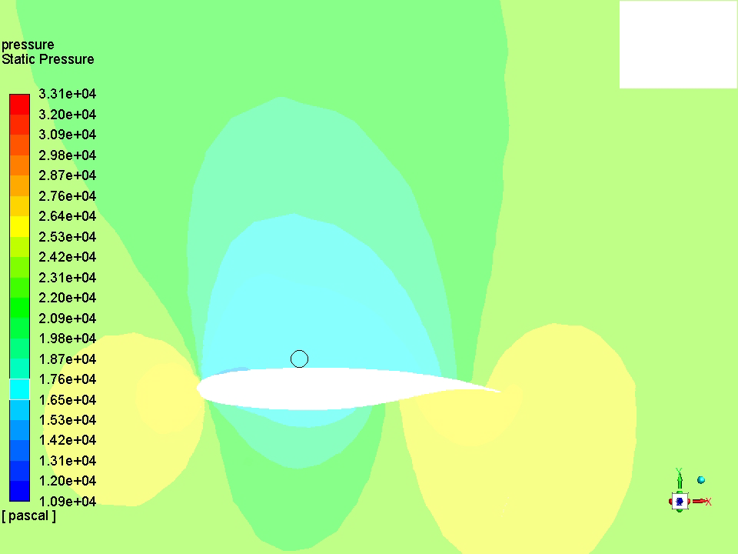
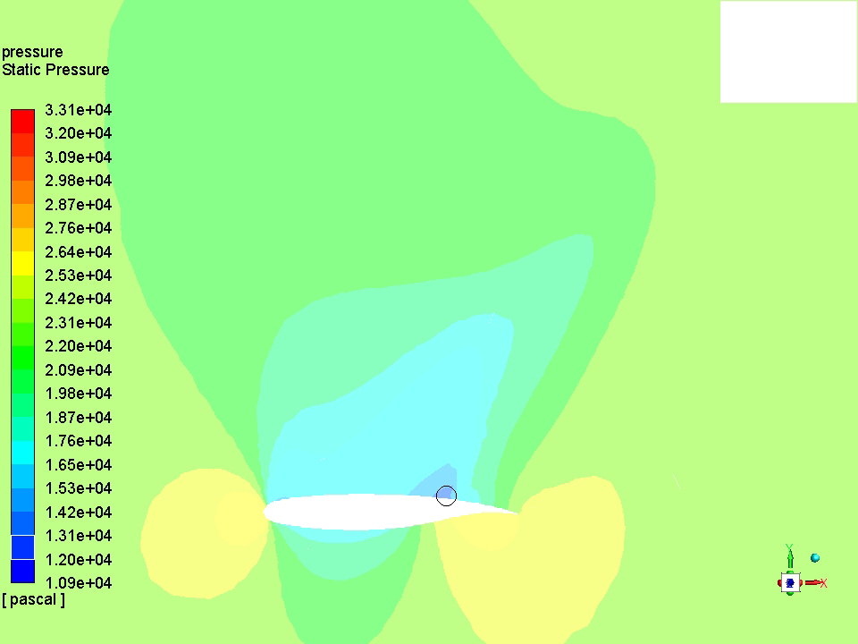
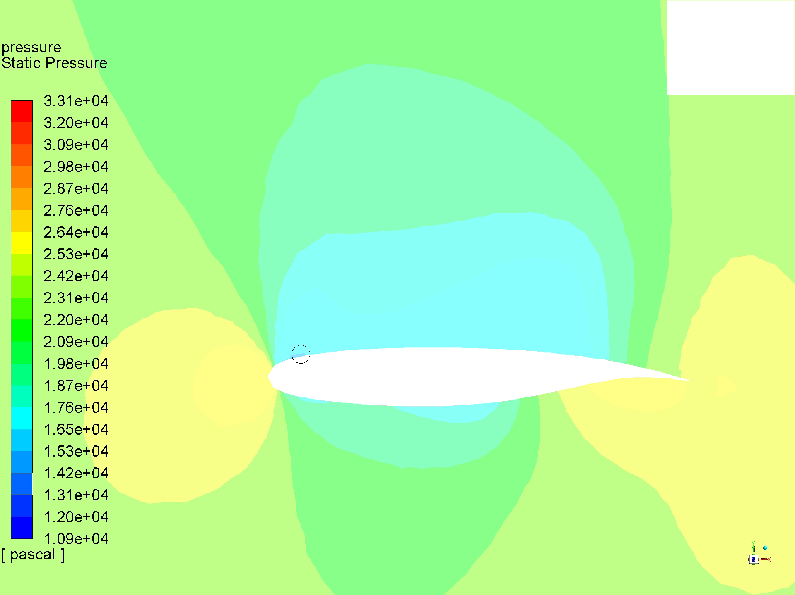
Results: Static Pressure
Endplate winglet
No-winglet
Raked winglet
Blended winglet

Slide 24
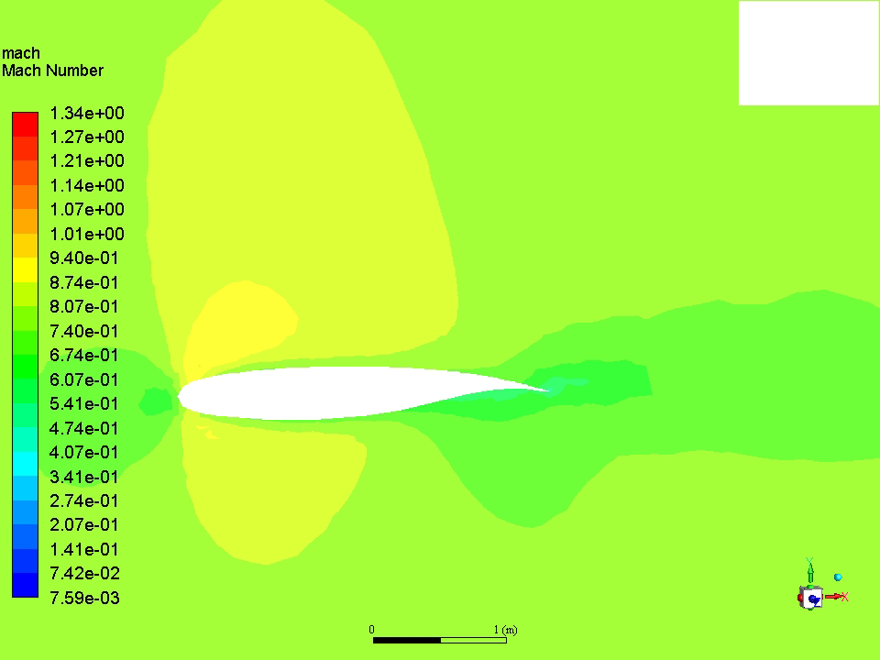
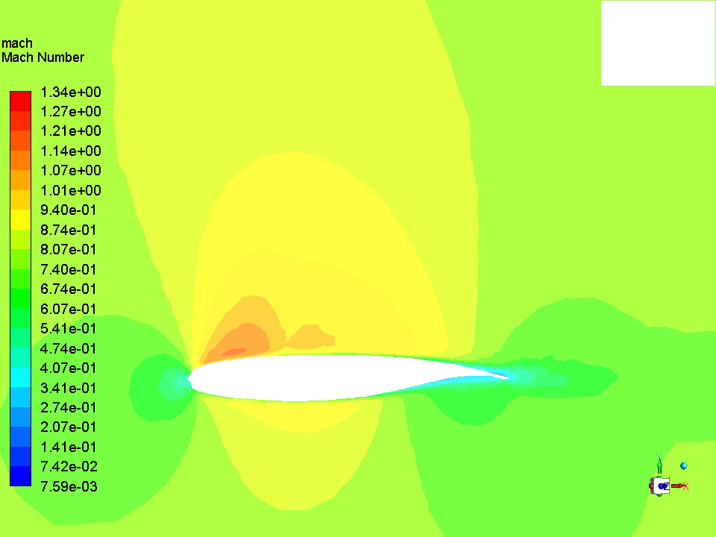
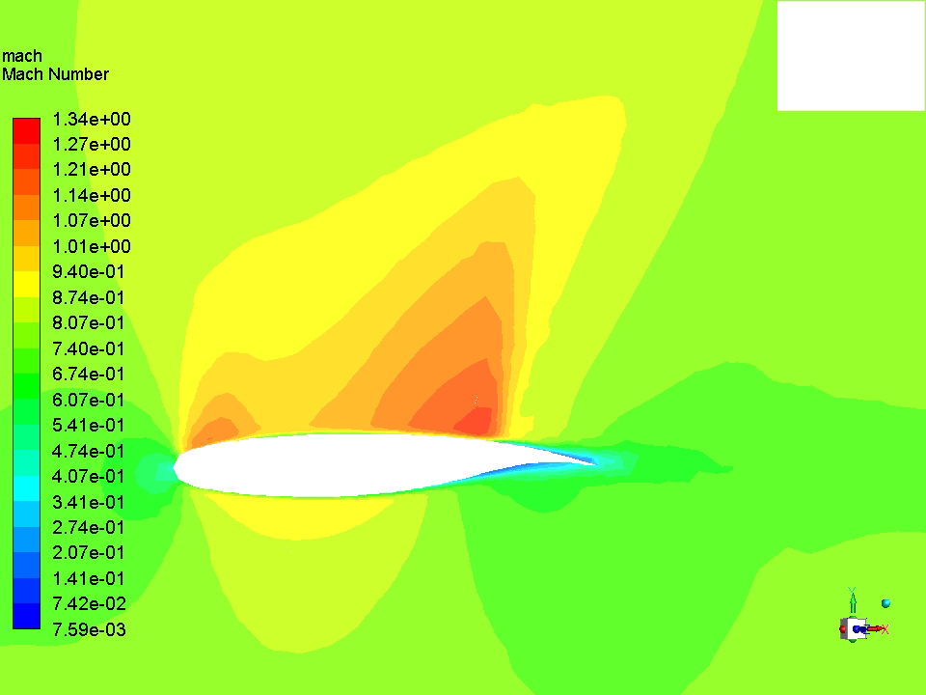
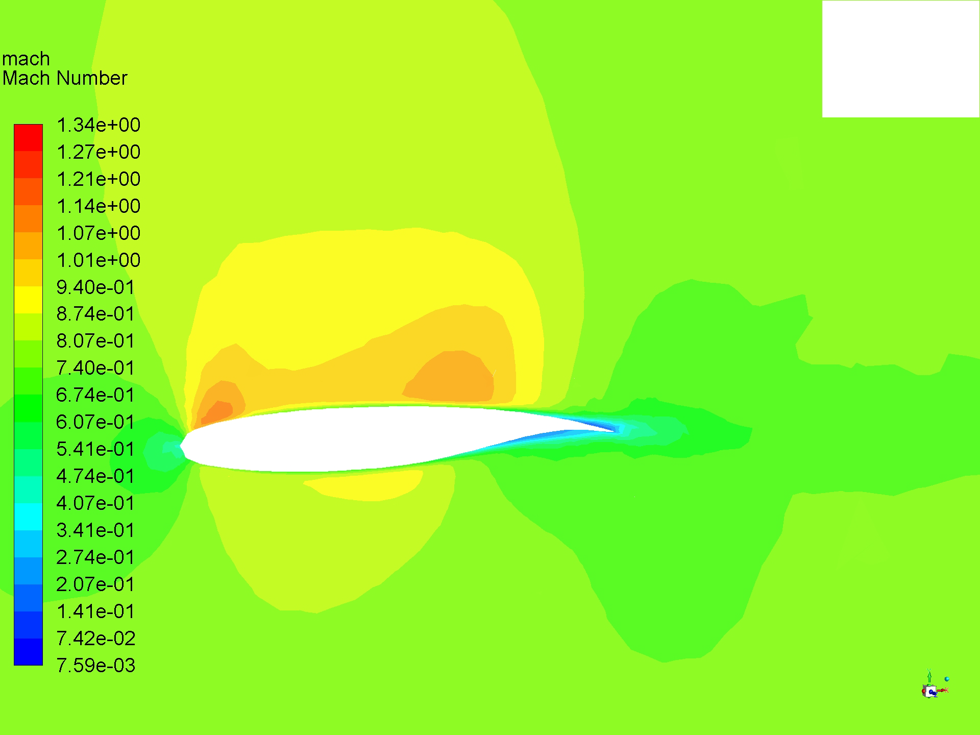
Results: Mach Number
Raked winglet
Blended winglet
No winglet
Endplate winglet

Slide 25
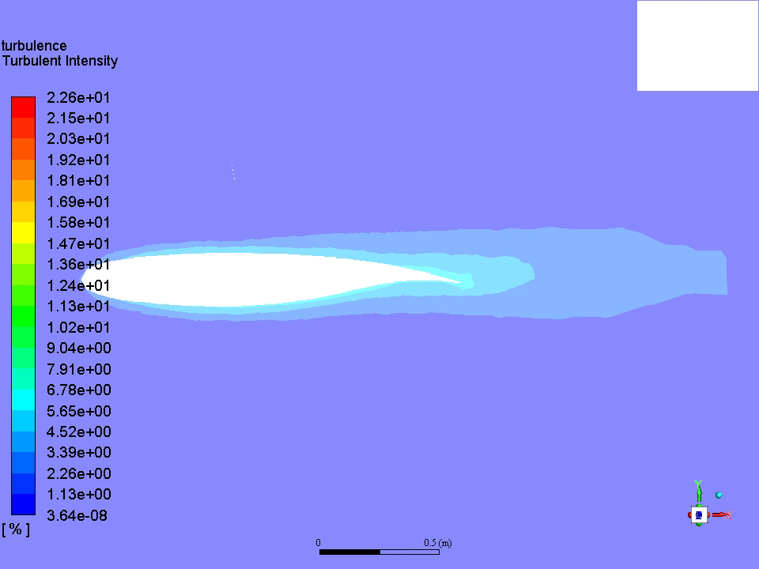
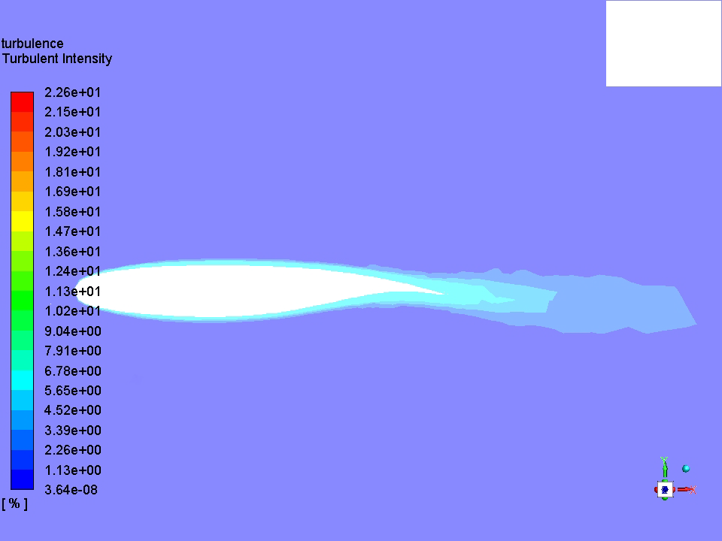
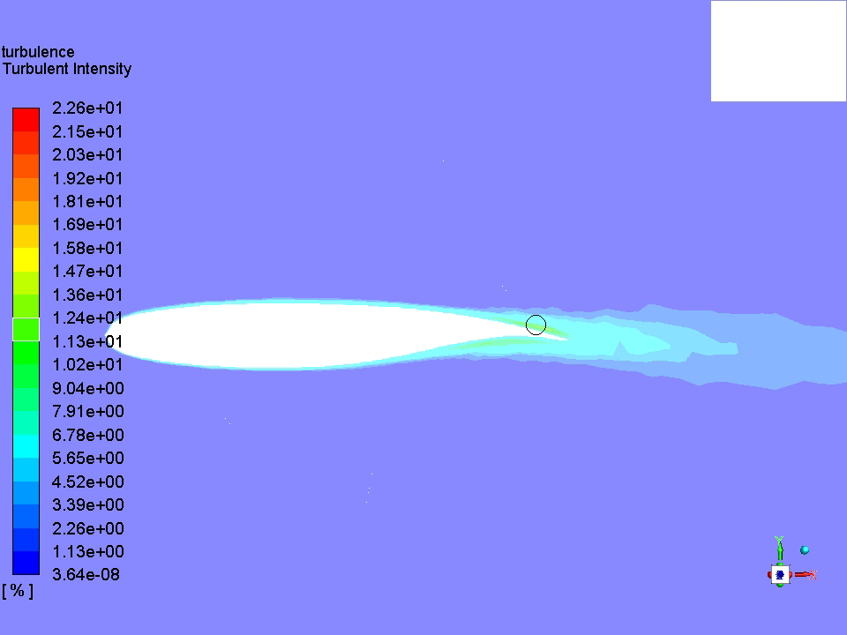
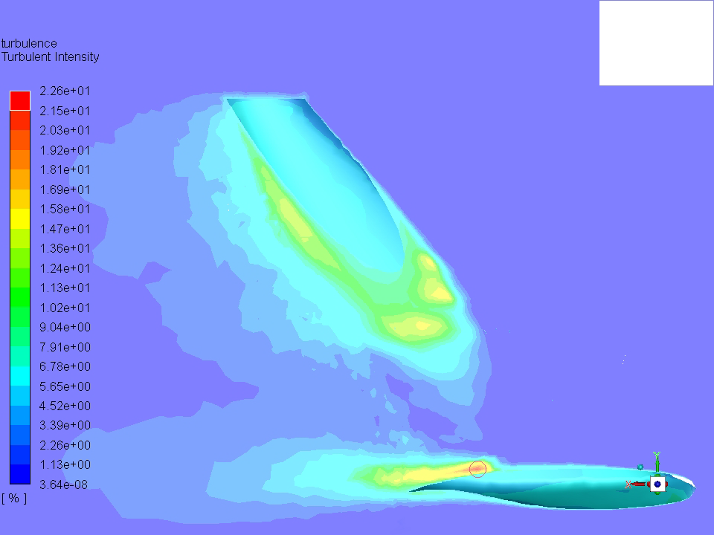
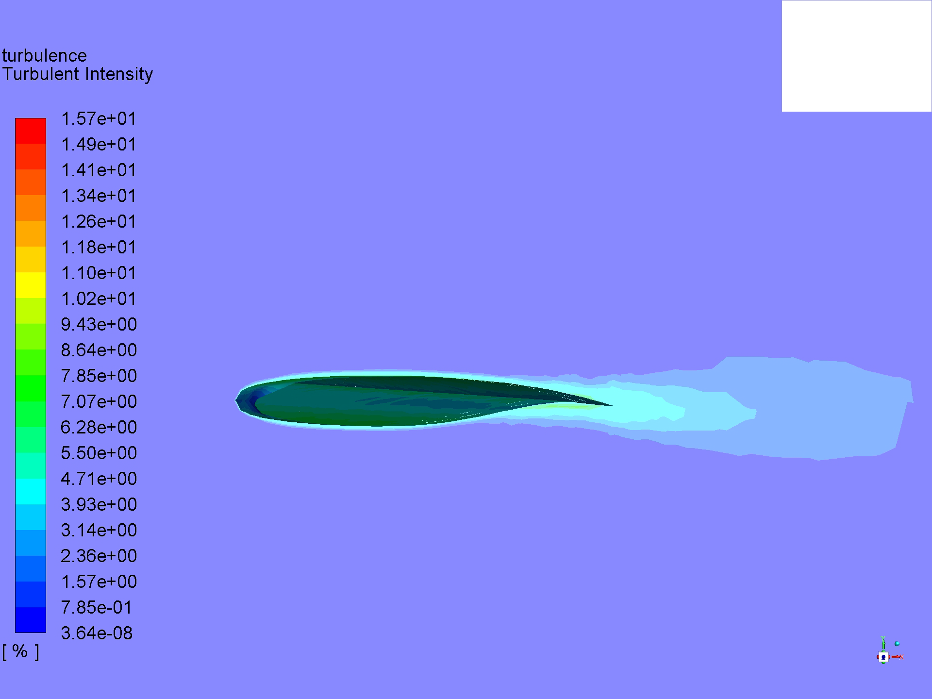
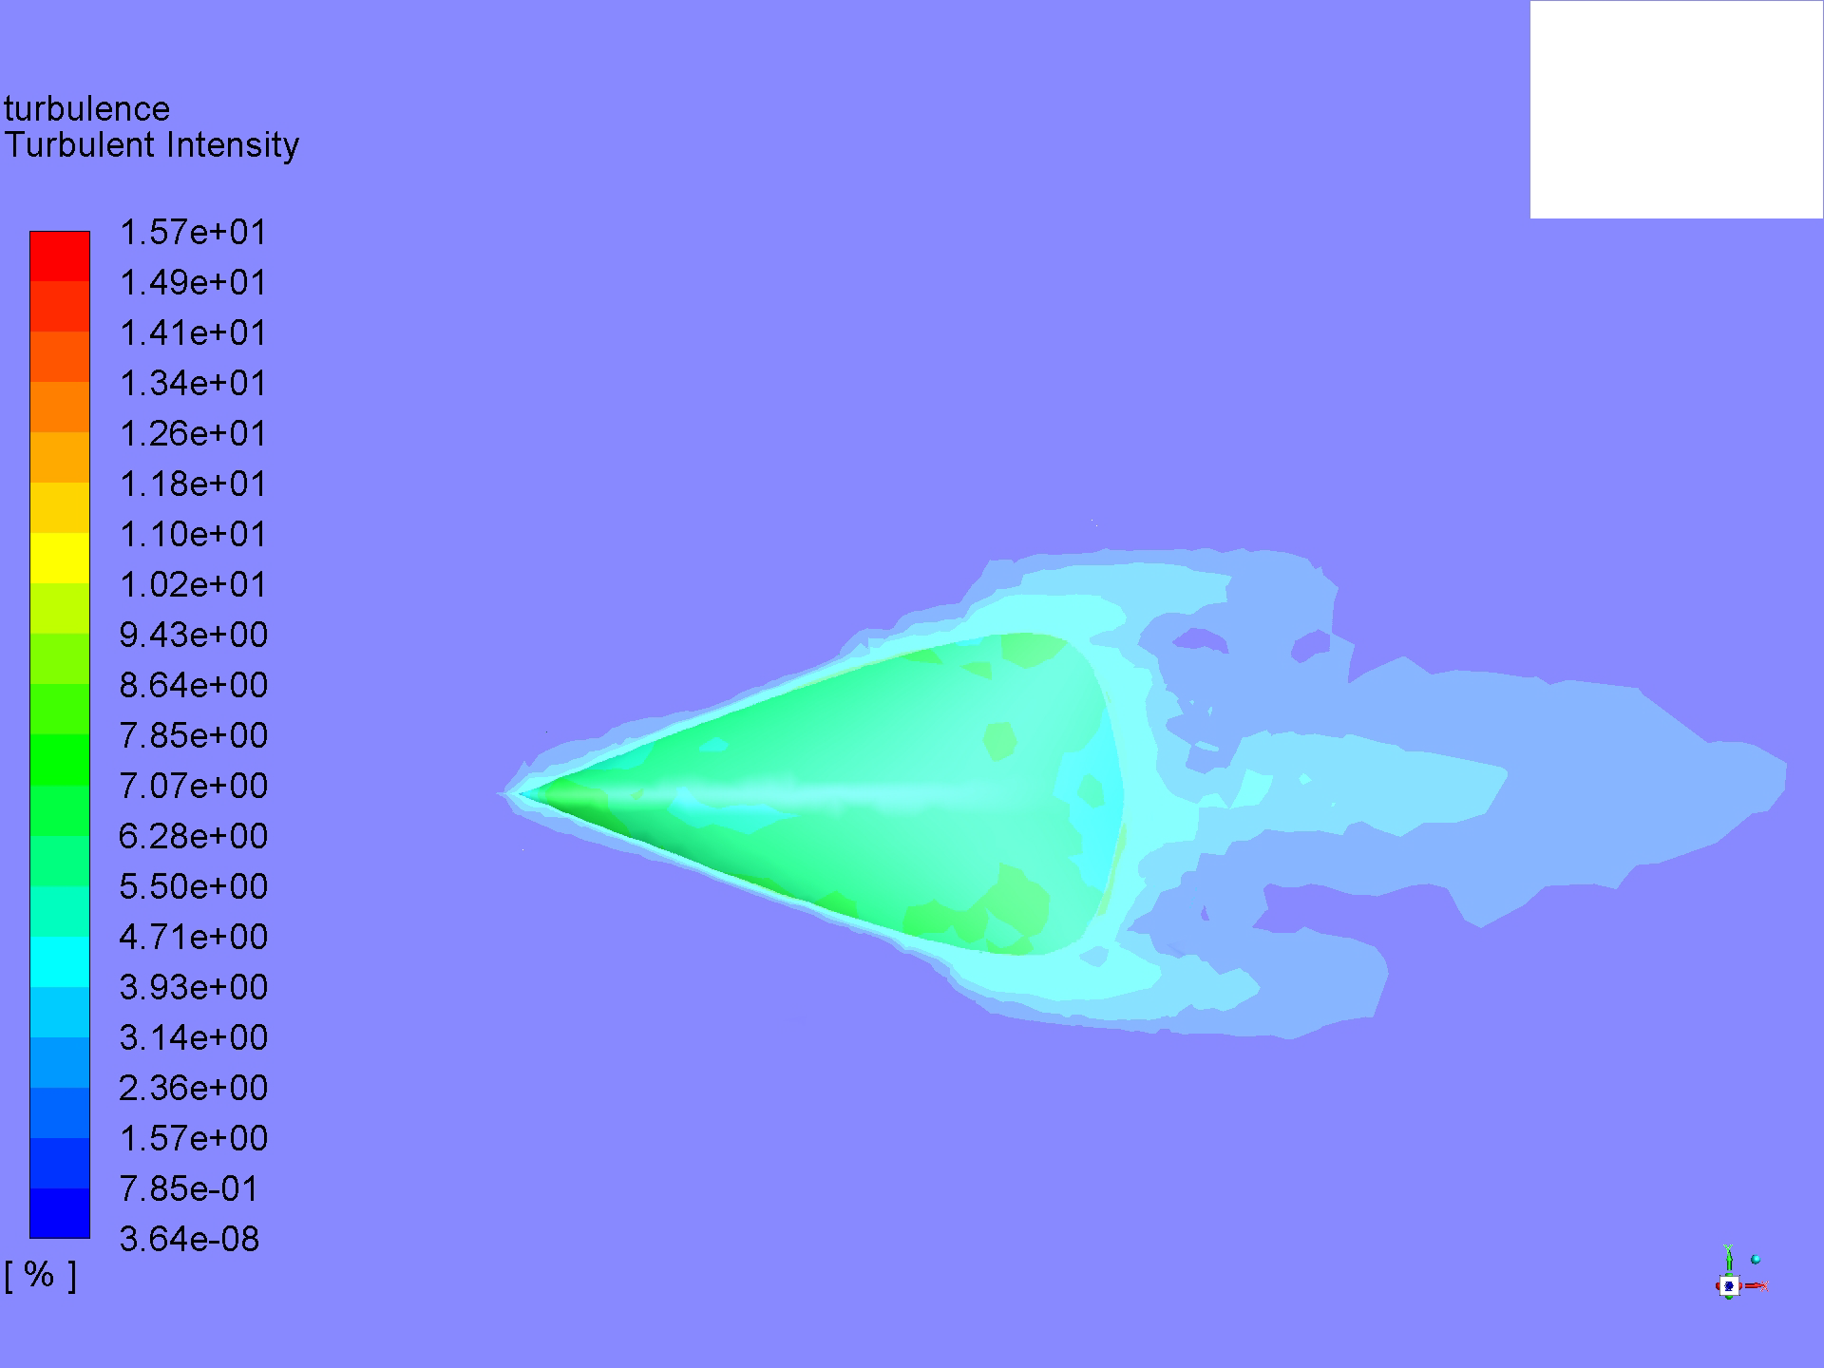
Results: Turbulent Intensity
No winglet
Blended winglet
Raked winglet
Endplate winglet

Slide 26
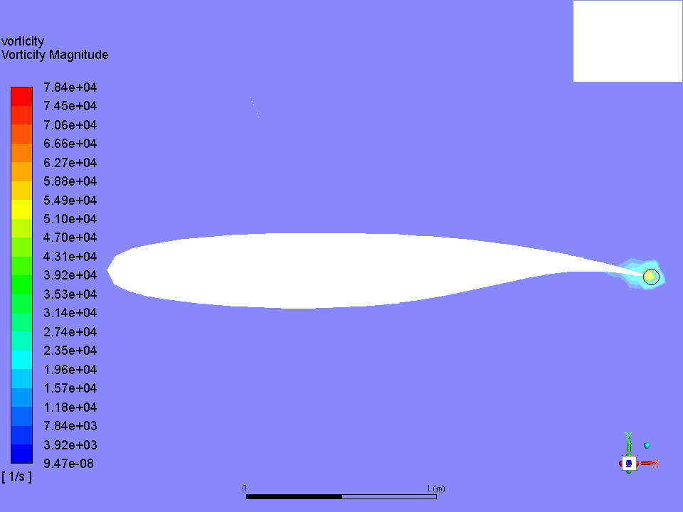
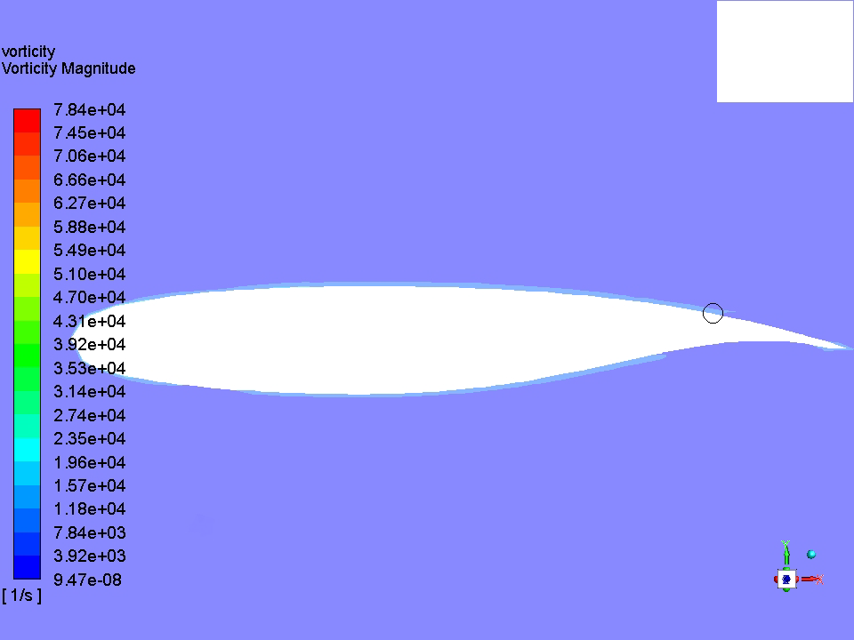
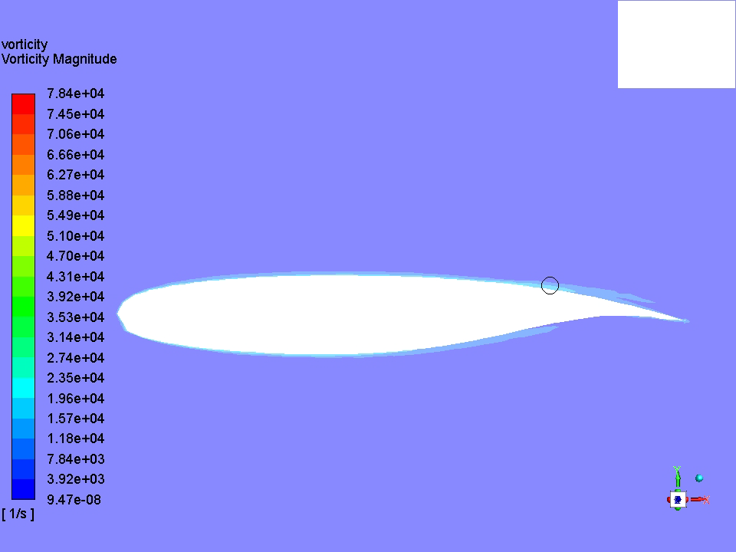
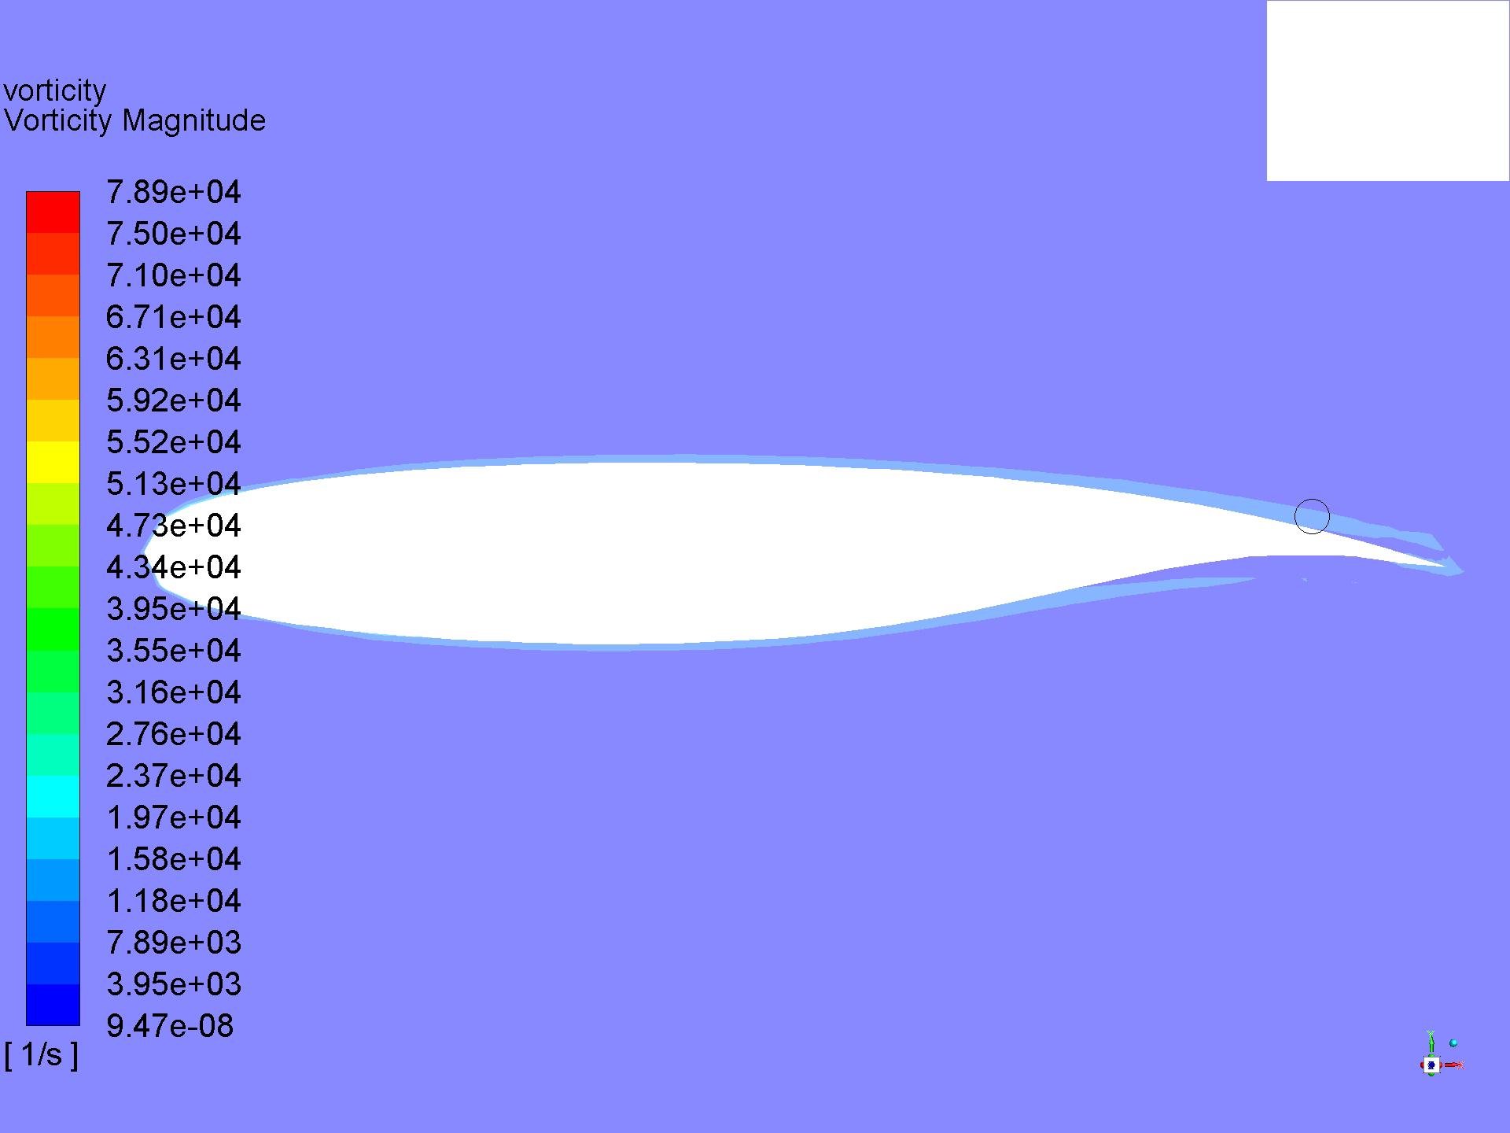
Results: Vorticity
Blended winglet
Endplate winglet
No winglet
Raked winglet

Slide 27
Index
Introduction
CAD Design & Manufacturing
CFD Analysis
  ANSYS: Design Modeler & Meshing
  Fluent: Set Up
Results
Conclusions

Slide 28
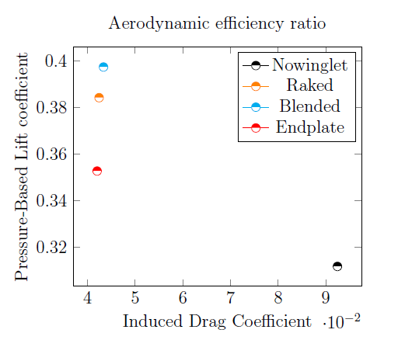
Conclusions

Slide 29
Thank you for your attention
Do you have any questions?

