Slide 1
Bachelor Final Project:
THE REFURBISHING OF THE BROTHERHOOD HOUSE AT SANTA LUCIA’S HERMITAGE
Alumna: ELENA SERRA GARCÍA
Tutores: ENRIQUE DAVID LLÁCER
JAIME LLINARES MILLÁN
Taller: 44_TALLER EN LENGUA INGLESA
Modalidad: CIENTÍFICO_TÉCNICO
Fecha de presentación: JULIO 2013

Slide 2
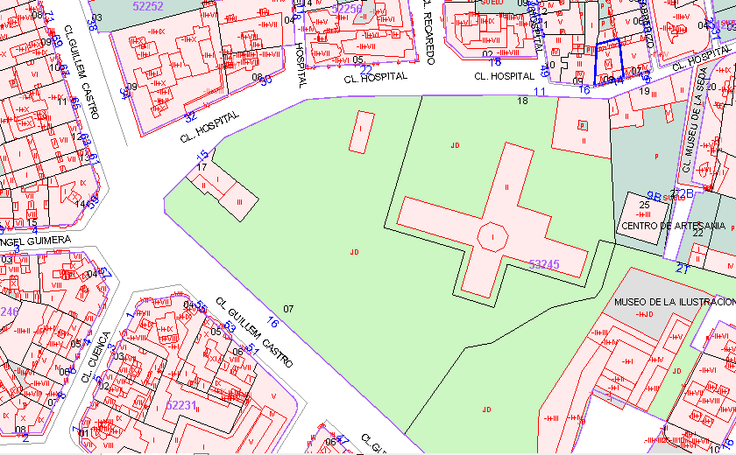

INTRODUCTION
INDEX
      Introduction 4. Pathological Anaysis
      Project Index 5. Intervention Proposal
      Description of the Building 6. Conclusion
Aim of the project: intervention
proposal of the Brotherhood Rooms
at Santa Lucia’s Hermitage
Location: Hospital Street, Valencia
Construction year: 1400 (aC)
Santa Lucia’s Hermitage surroundings cadastre map

Slide 3
PROJECT INDEX
INDEX
      Introduction 4. Pathological Anaysis
      Project Index 5. Intervention Proposal
      Description of the Building 6. Conclusion
Introduction
Historical Background
Photographic Report
Plans
Composition and Architectonic Analysis
Constructive Analysis
Pathological Anaysis
Intervention Proposal
Conclusion

Slide 4
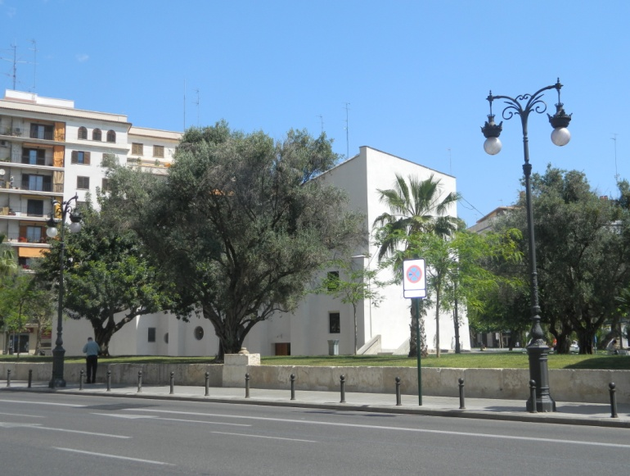
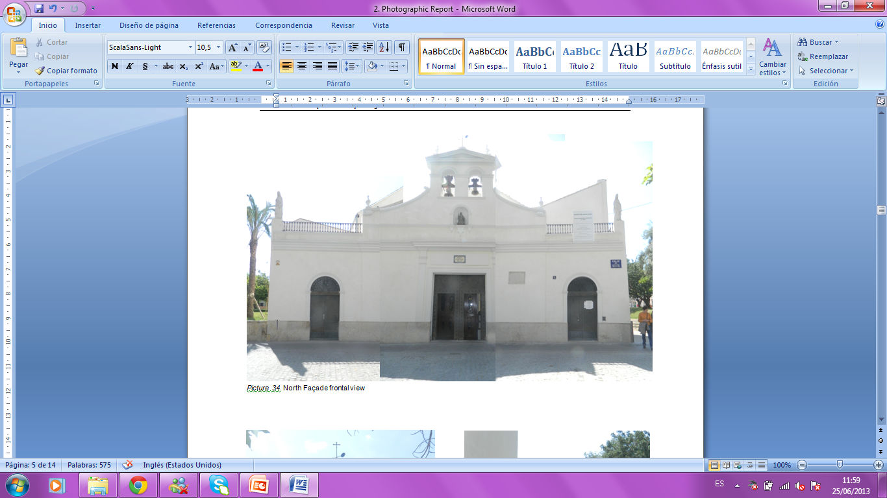
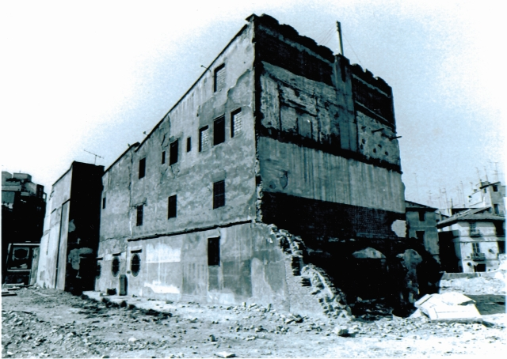
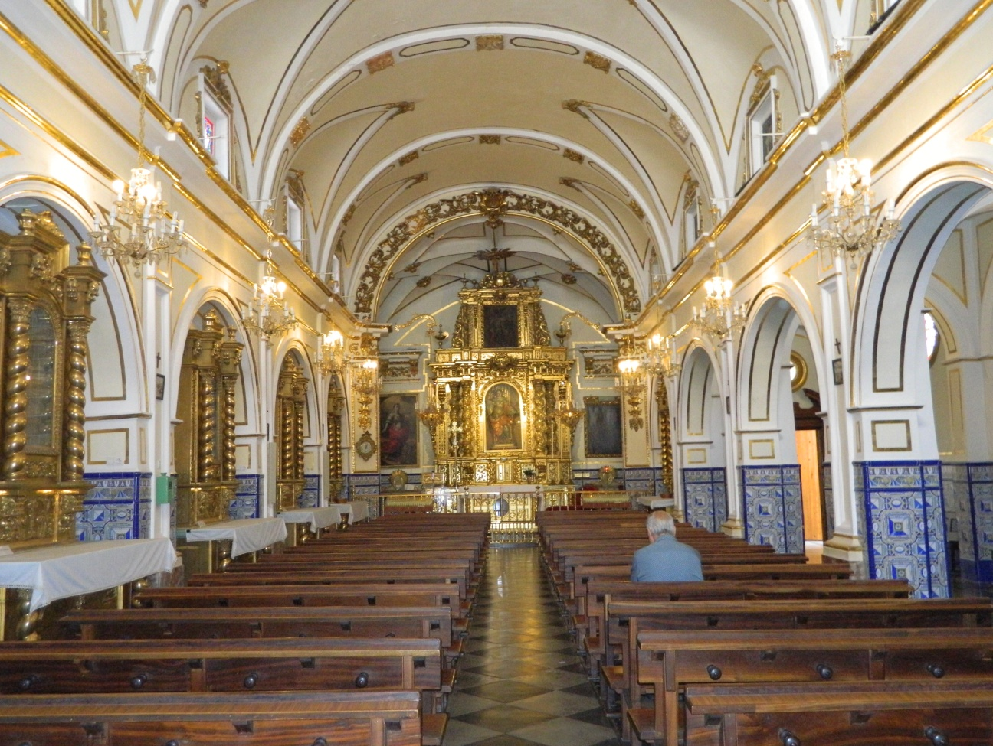
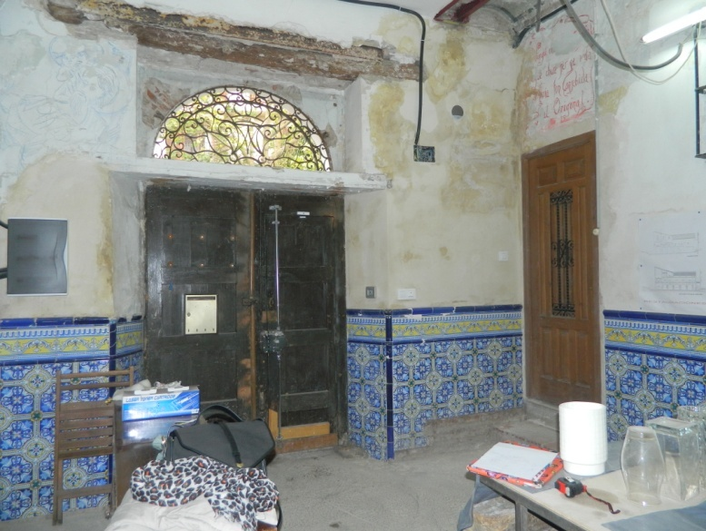
DESCRIPTION OF THE BUILDING
INDEX
      Introduction 4. Pathological Anaysis
      Project Index 5. Intervention Proposal
      Description of the Building 6. Conclusion
National Settings:
Economical, politic, cultural and social crisis
Kingdom governed by the Trastámara dinasty
Black Death epidemic
Local Settings:
Jaime I’s conquer of Valencia
Valencian’s Golden Century
Hermitage view from Guillem de Castro Street
North Façade frontal view
The building in the 1960’s
Principal nave’s frontal
Brotherhood House Entrance

Slide 5
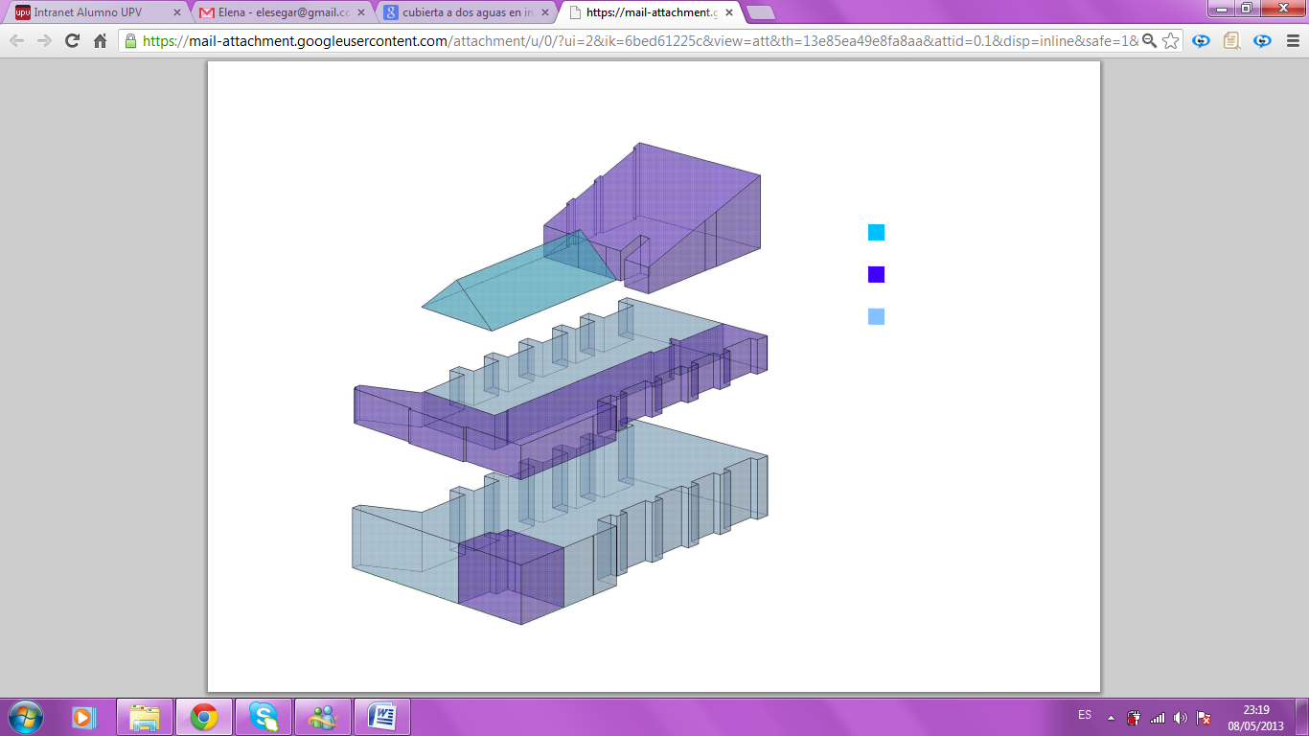
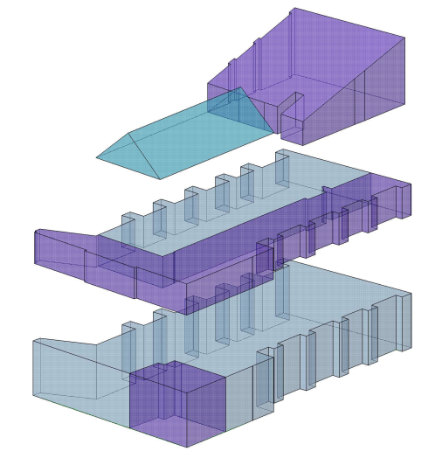
DESCRIPTION OF THE BUILDING
INDEX
      Introduction 4. Pathological Anaysis
      Project Index 5. Intervention Proposal
      Description of the Building 6. Conclusion
Church
Brotherhood House
Gable roof
Ground Floor:
Church
The access to the Brotherhood House
First Floor:
Extended over the lateral nave
Second Floor:
Extended over the presbytery
Gable roof

Slide 6
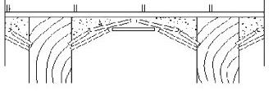
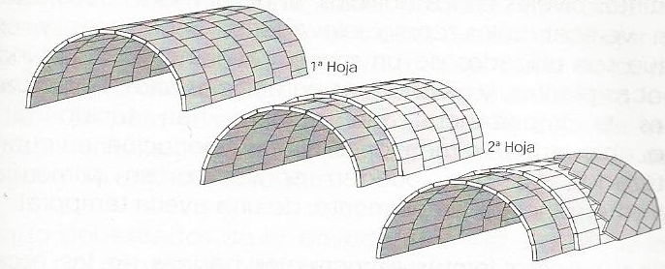
DESCRIPTION OF THE BUILDING
INDEX
      Introduction 4. Pathological Anaysis
      Project Index 5. Intervention Proposal
      Description of the Building 6. Conclusion
1
3
Structure:
Pilars: solid bricks covered by air lime mortar
Floor structures: laminate floor structure and interior vault floor structure
Principal nave vault: three solid big plane brick sheets
Stairs: three solid big plane brick sheets
Walls:
Solid bricks received with sand, lime and water mortar
Valencian’s Mud Wall
2
4
Interior vault floor structure:
1. Pavement
. Wooden joint
. Filling by different materials
. Forming the vault bricks.
Roofs:
Three wood shed roofs
One wood gable roof
Three brick sheets
Elena Serra García

Slide 7
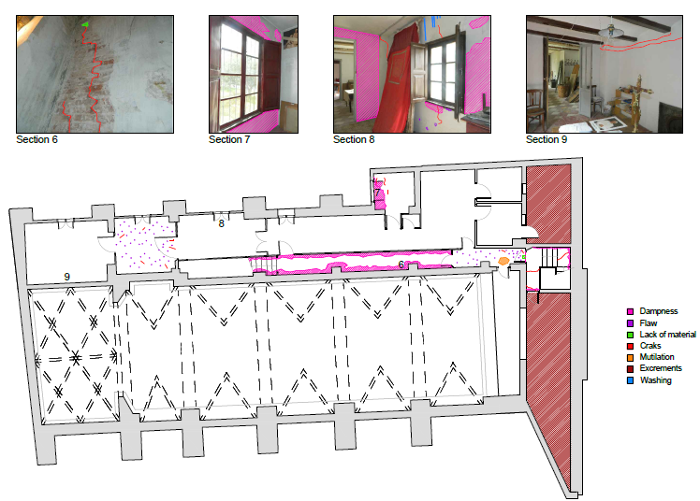
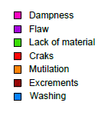
PATHOLOGICAL ANALYSIS
      Introduction 4. Pathological Anaysis
      Project Index 5. Intervention Proposal
      Description of the Building 6. Conclusion
INDEX

Slide 8
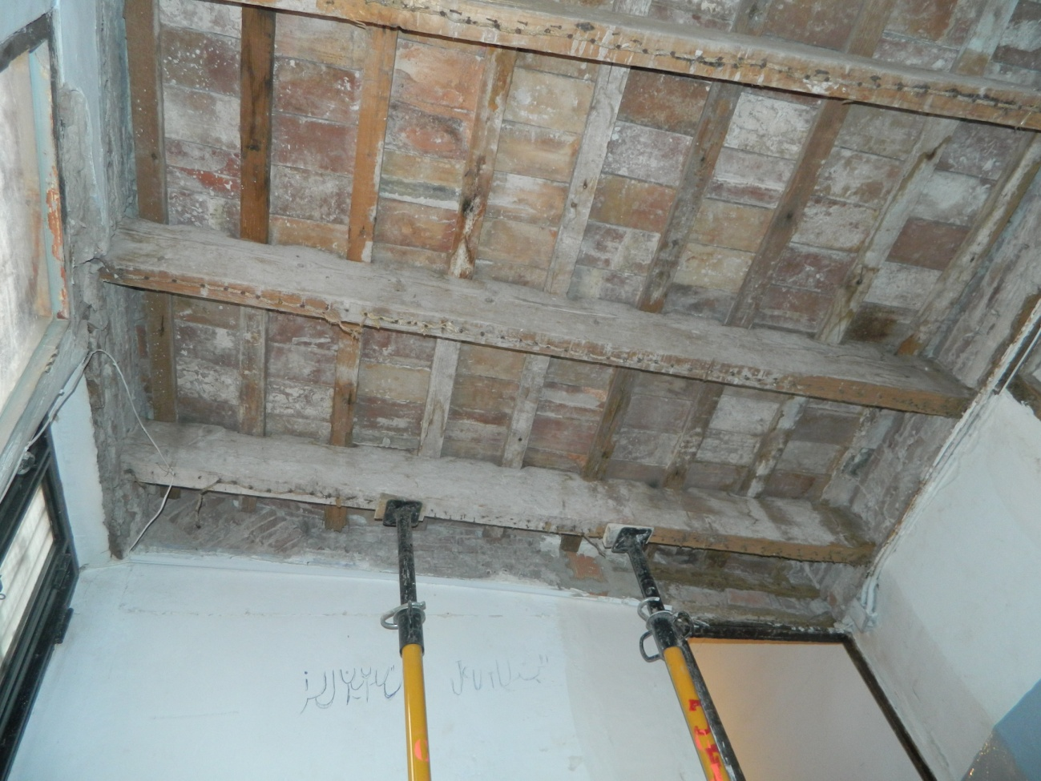
      Introduction 4. Pathological Anaysis
      Project Index 5. Intervention Proposal
      Description of the Building 6. Conclusion
INDEX
PATHOLOGICAL ANALYSIS
TIMBER BEAMS: REDUCTION OF FLEXURAL STRENGTH AND INFLORESCENCES
Causes: inappropriate section for the weight supported and rotting after the dampness filtration
- Long term consequences: structural framework collapse
Elena Serra García

Slide 9
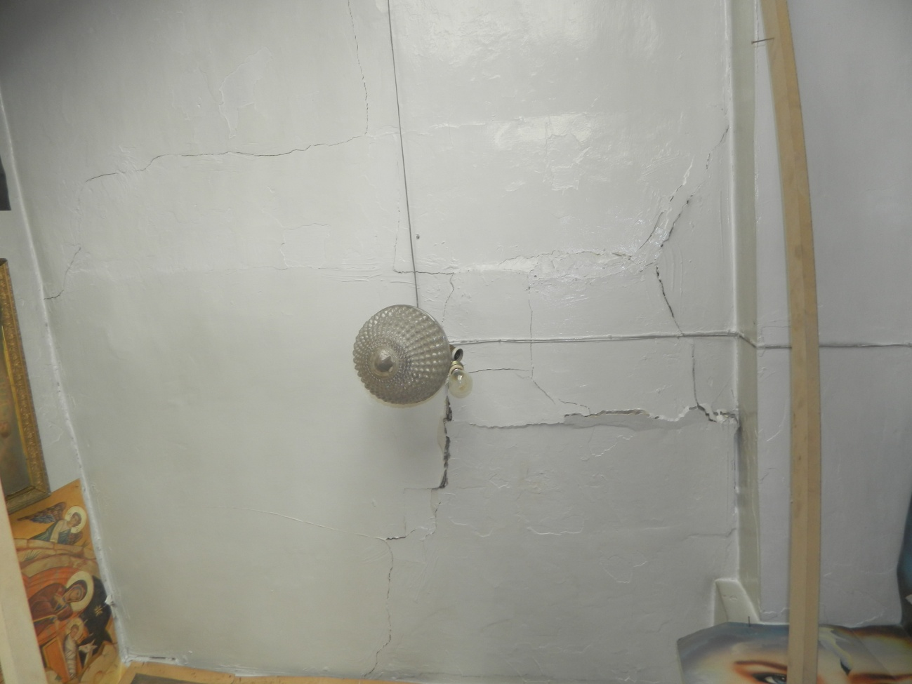
      Introduction 4. Pathological Anaysis
      Project Index 5. Intervention Proposal
      Description of the Building 6. Conclusion
INDEX
PATHOLOGICAL ANALYSIS
FISSURES AND CRACKS IN THE GYPSUM CEILING
Causes: the dampness filtration present in the building has ended up making weak the floor structure
- Long term consequences: collapse of the gypsum ceiling
Elena Serra García
Elena Serra García

Slide 10
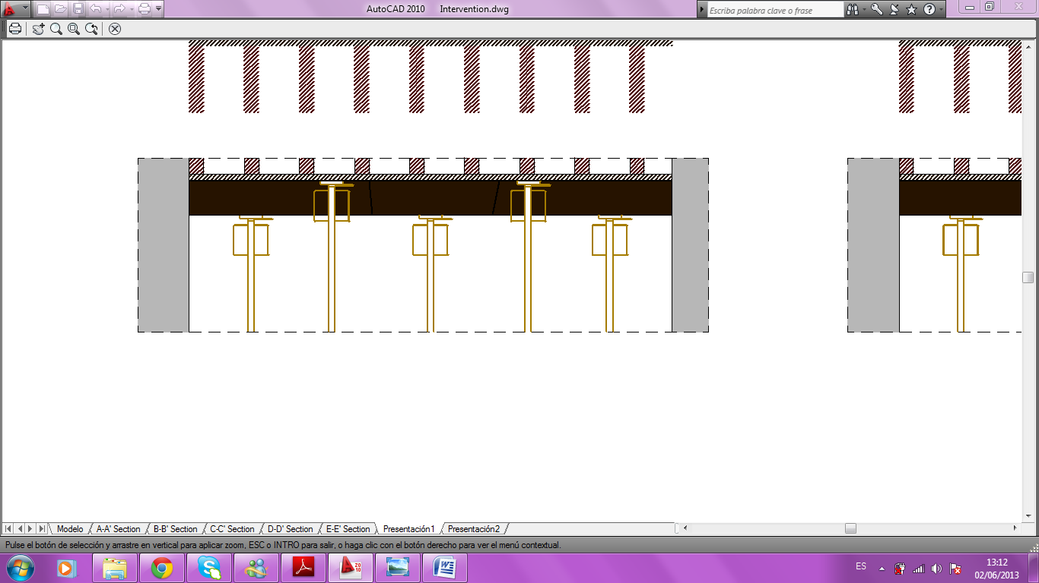
INTERVENTION PROPOSAL
      Introduction 4. Pathological Anaysis
      Project Index 5. Intervention Proposal
      Description of the Building 6. Conclusion
INDEX
Beam’s substitution
1. Beam cut in the middle part
2. Retirement of the beam’s cut central part
3. Retirement of the remaining left side
4. Retirement of the remaining right side
5. New timber beam collocation
1
Elena Serra García
Elena Serra García
Elena Serra García
Elena Serra García

Slide 11
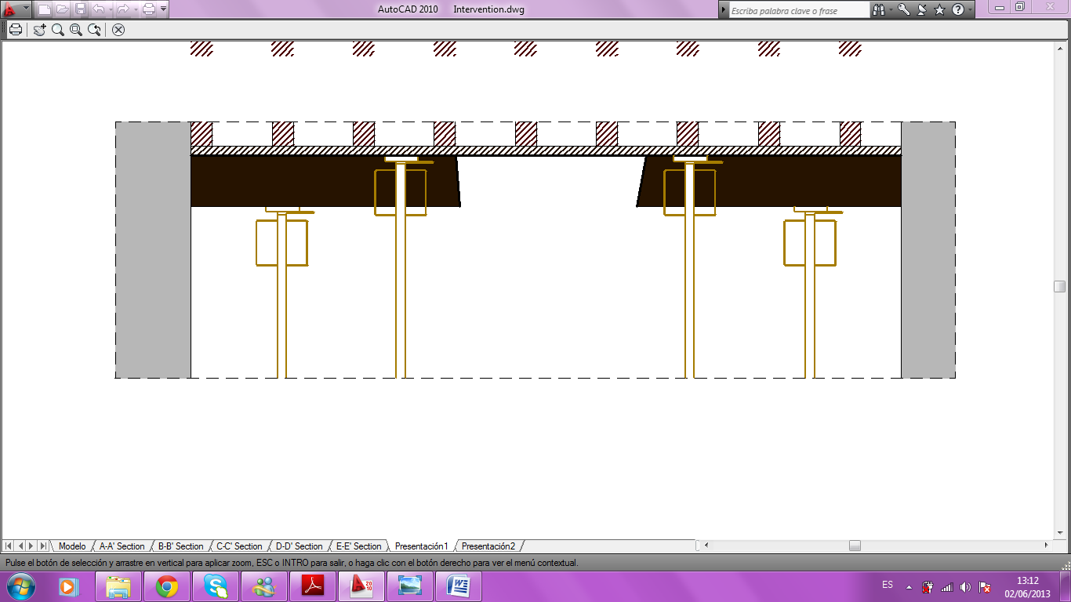
INTERVENTION PROPOSAL
      Introduction 4. Pathological Anaysis
      Project Index 5. Intervention Proposal
      Description of the Building 6. Conclusion
INDEX
Beam’s substitution
1. Beam cut in the middle part
2. Retirement of the beam’s cut central part
3. Retirement of the remaining left side
4. Retirement of the remaining right side
5. New timber beam collocation
2
Elena Serra García
Elena Serra García
Elena Serra García

Slide 12
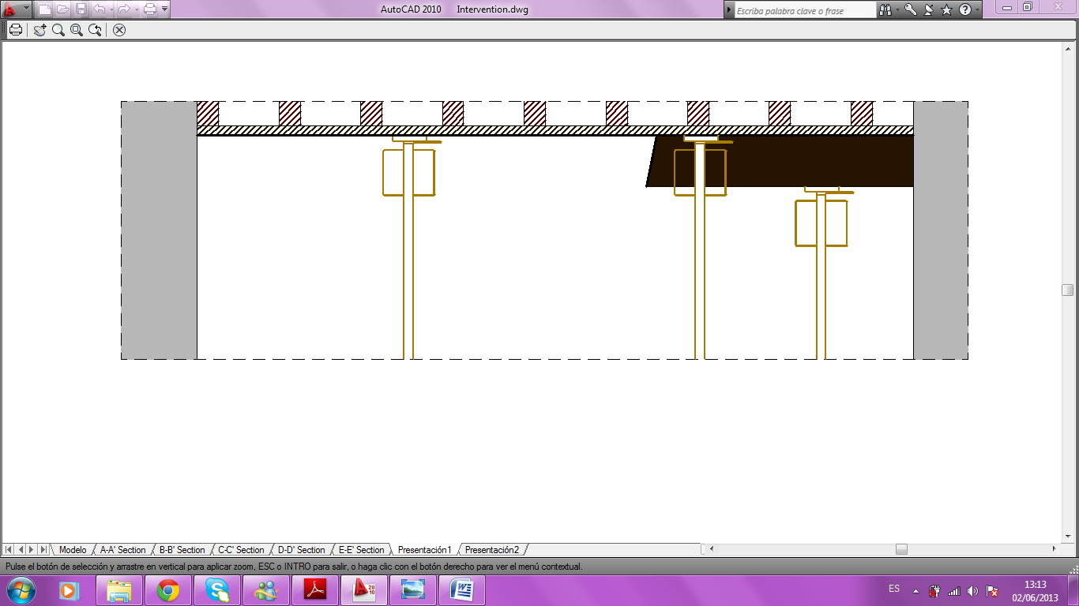
INTERVENTION PROPOSAL
      Introduction 4. Pathological Anaysis
      Project Index 5. Intervention Proposal
      Description of the Building 6. Conclusion
INDEX
Beam’s substitution
1. Beam cut in the middle part
2. Retirement of the beam’s cut central part
3. Retirement of the remaining left side
4. Retirement of the remaining right side
5. New timber beam collocation
3
Elena Serra García
Elena Serra García
Elena Serra García
Elena Serra García

Slide 13
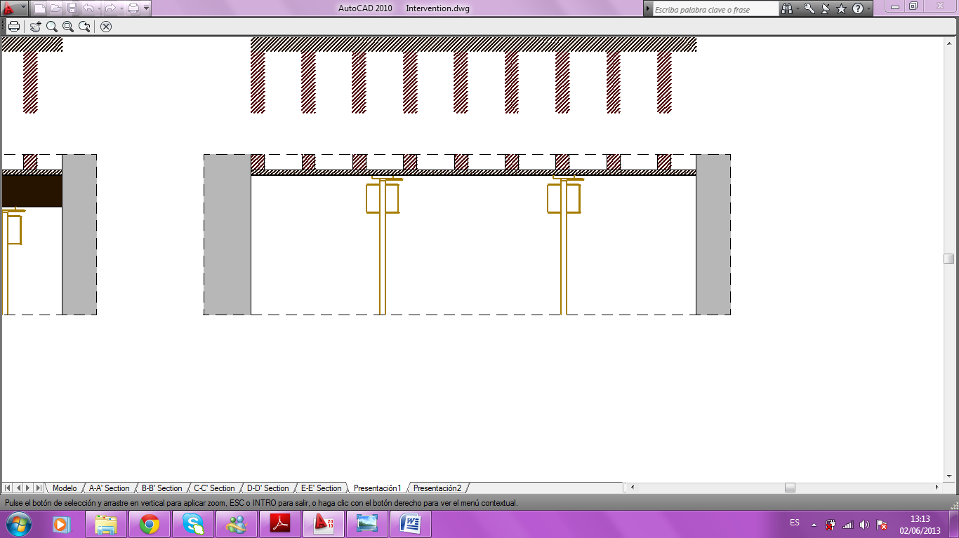
INTERVENTION PROPOSAL
      Introduction 4. Pathological Anaysis
      Project Index 5. Intervention Proposal
      Description of the Building 6. Conclusion
INDEX
Beam’s substitution
1. Beam cut in the middle part
2. Retirement of the beam’s cut central part
3. Retirement of the remaining left side
4. Retirement of the remaining right side
5. New timber beam collocation
4
Elena Serra García
Elena Serra García
Elena Serra García
Elena Serra García
Elena Serra García

Slide 14
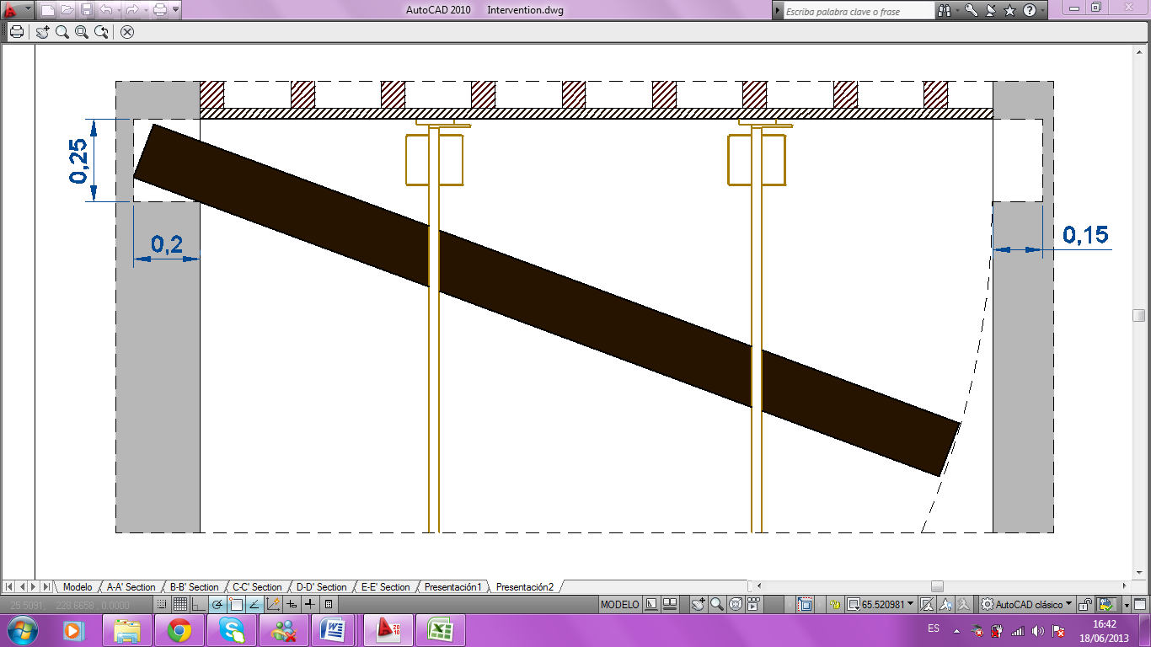
INTERVENTION PROPOSAL
      Introduction 4. Pathological Anaysis
      Project Index 5. Intervention Proposal
      Description of the Building 6. Conclusion
INDEX
Beam’s substitution
1. Beam cut in the middle part
2. Retirement of the beam’s cut central part
3. Retirement of the remaining left side
4. Retirement of the remaining right side
5. New timber beam collocation
5
Elena Serra García
Elena Serra García
Elena Serra García
Elena Serra García
Elena Serra García
Elena Serra García

Slide 15
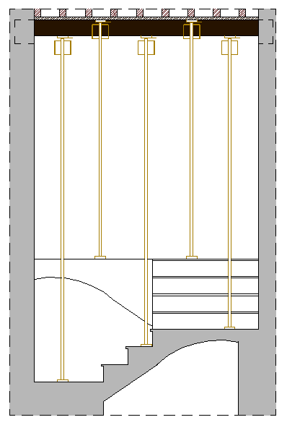
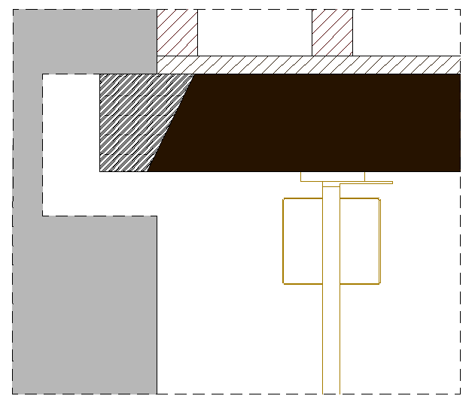
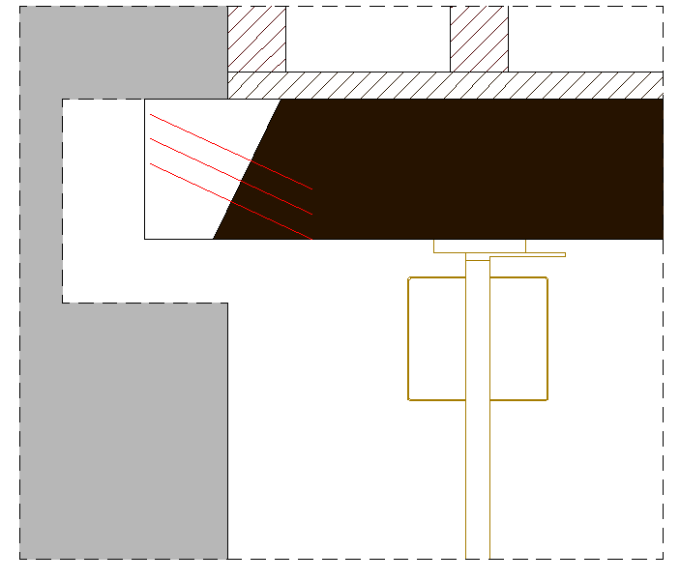
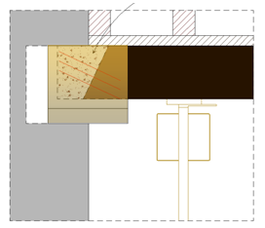
INTERVENTION PROPOSAL
      Introduction 4. Pathological Anaysis
      Project Index 5. Intervention Proposal
      Description of the Building 6. Conclusion
INDEX
Rotten heads substitution
Strutted beam in the stairs
Rotten beams cut
Fiberglass ribs with epoxy resins collocation
Epoxy resins spilled
2
1
3
4
Elena Serra García
Elena Serra García
Elena Serra García

Slide 16
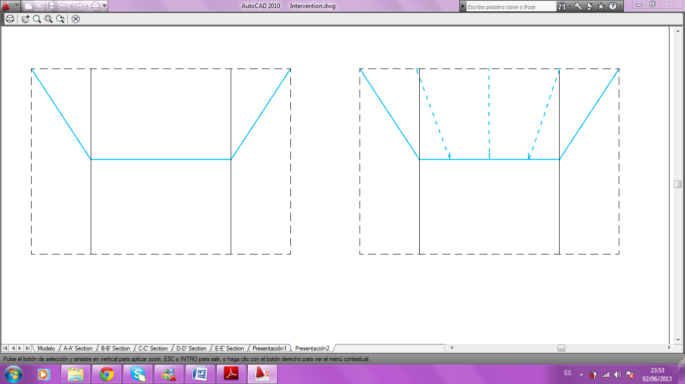
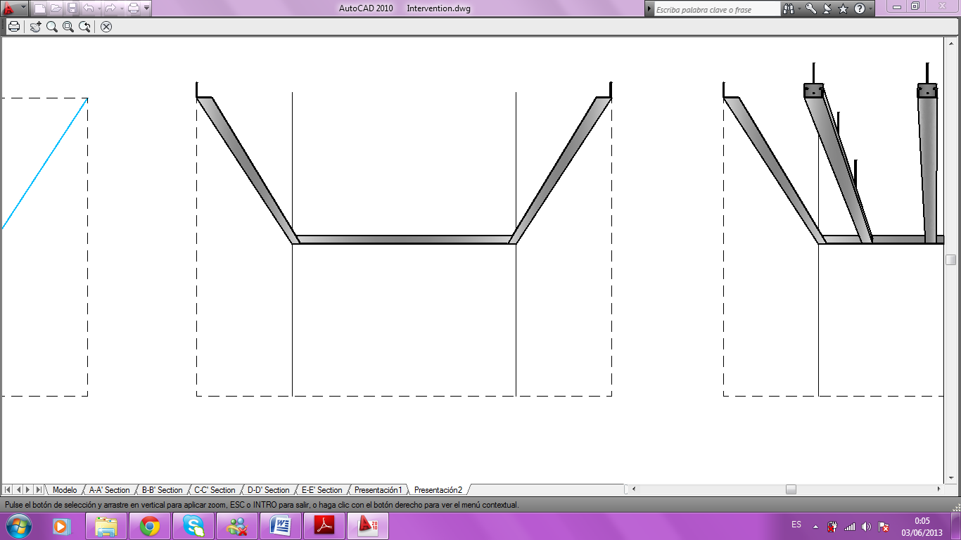
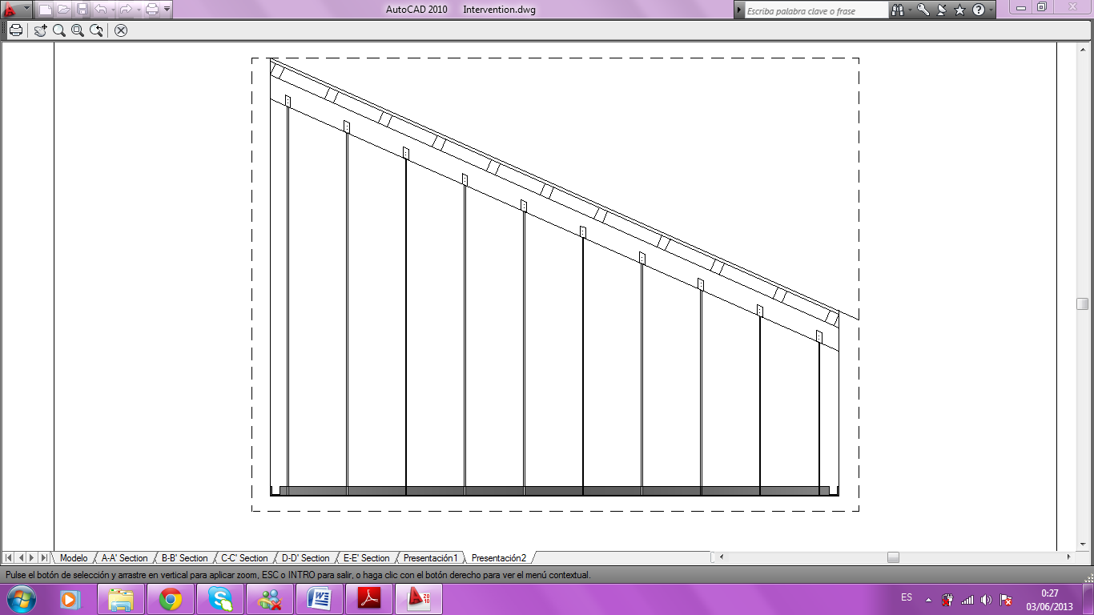
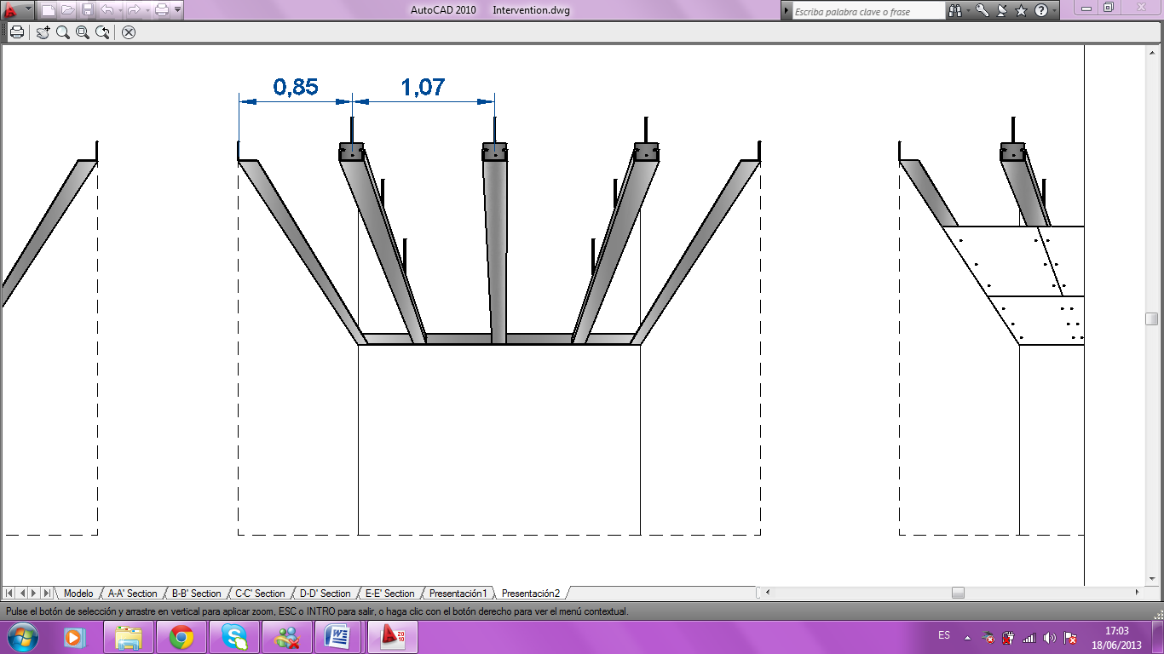
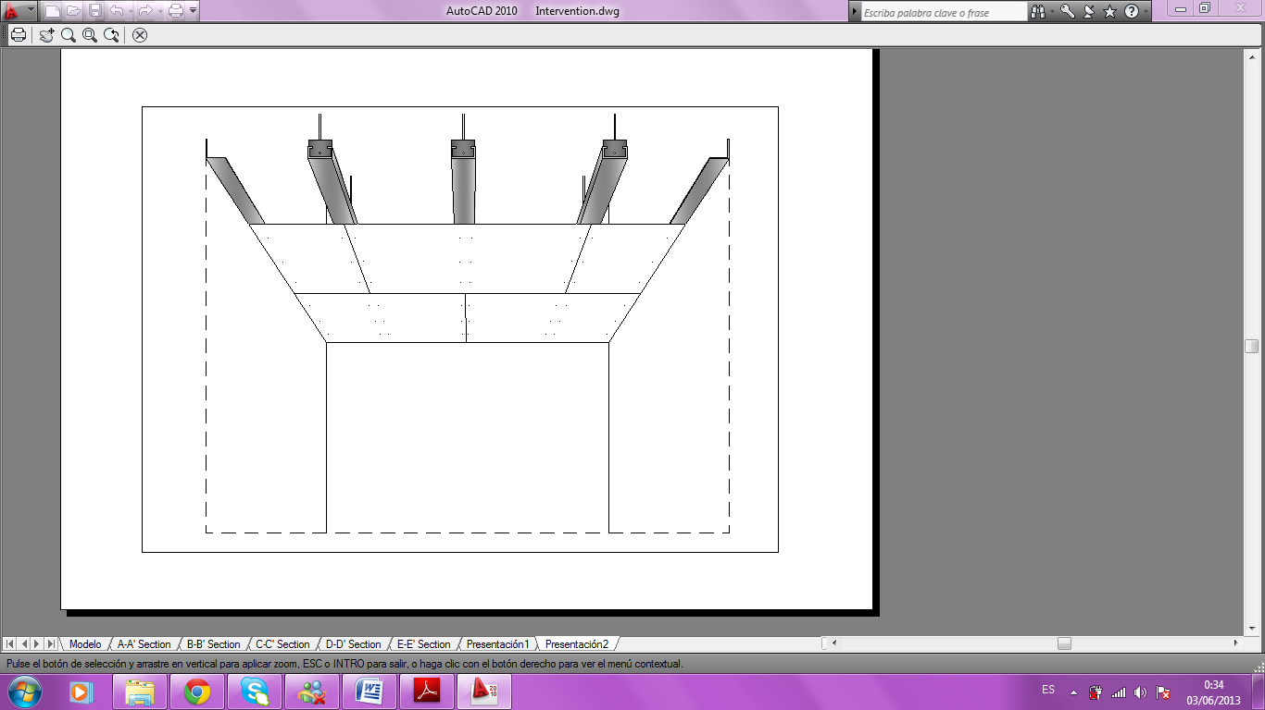
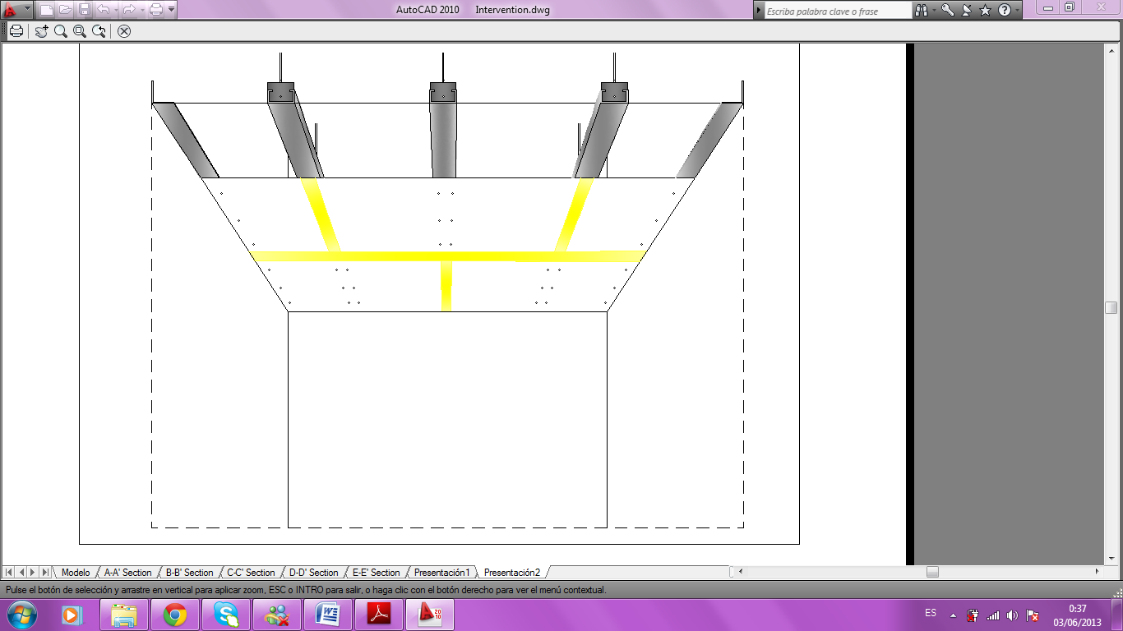
INTERVENTION PROPOSAL
      Introduction 4. Pathological Anaysis
      Project Index 5. Intervention Proposal
      Description of the Building 6. Conclusion
INDEX
1
2
3
4
Gypsum ceiling changed into Pladur
Level marking lines in the vertical surface
Collocation of the angular profiles
Ribs and forks fixed into the wood beam
Longitudinal master profiles installation
Pladur sheets collocation
Joint treatment
5
6
Elena Serra García
Elena Serra García
Elena Serra García
Elena Serra García

Slide 17
CONCLUSIONS
INDEX
      Introduction 4. Pathological Anaysis
      Project Index 5. Intervention Proposal
      Description of the Building 6. Conclusion
Intervention criterion: respectful
Important dampness problems
Not very serious lesions in general
Recommendable to solve them in order not to make them worse

Slide 18
THANK YOU FOR
YOUR ATTENTION

