Slide 1

REMOTE CONTROL OF A MECHATRONICS SYSTEM WITH WIRELESS COMMUNICATIONS
AUTHOR: BHARATH KUMAR MITTAPALLI
TUTOR : JUAN JOSÉ SERRANO MARTÍN

Slide 2
INDEX
Purpose of the Project
Objectives
Study Flow
Our System – CNC Introduction
Block Diagram
Components
  STM32 F3 Discovery
  Telit LE-50 868
  Analog Joystick
Structure
Programming – Keil
Result

Slide 3
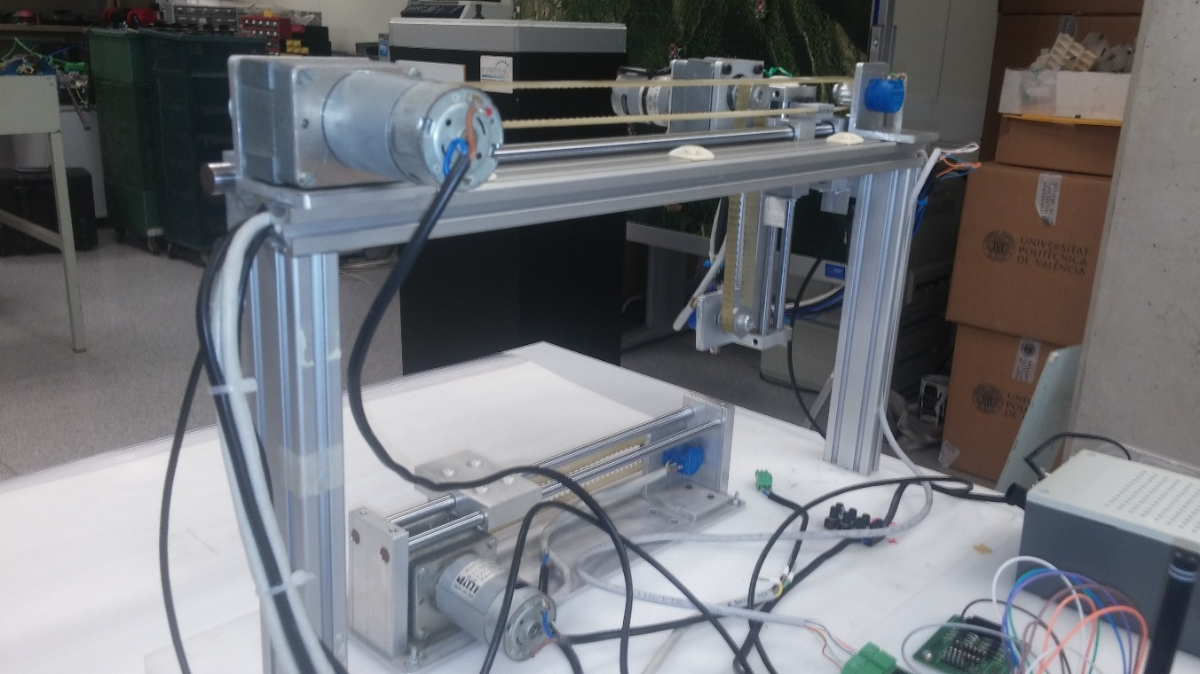
Purpose of the project
Mechatronic Machine – CNC
Re-modelling
Upgradation
Remote Control

Slide 4
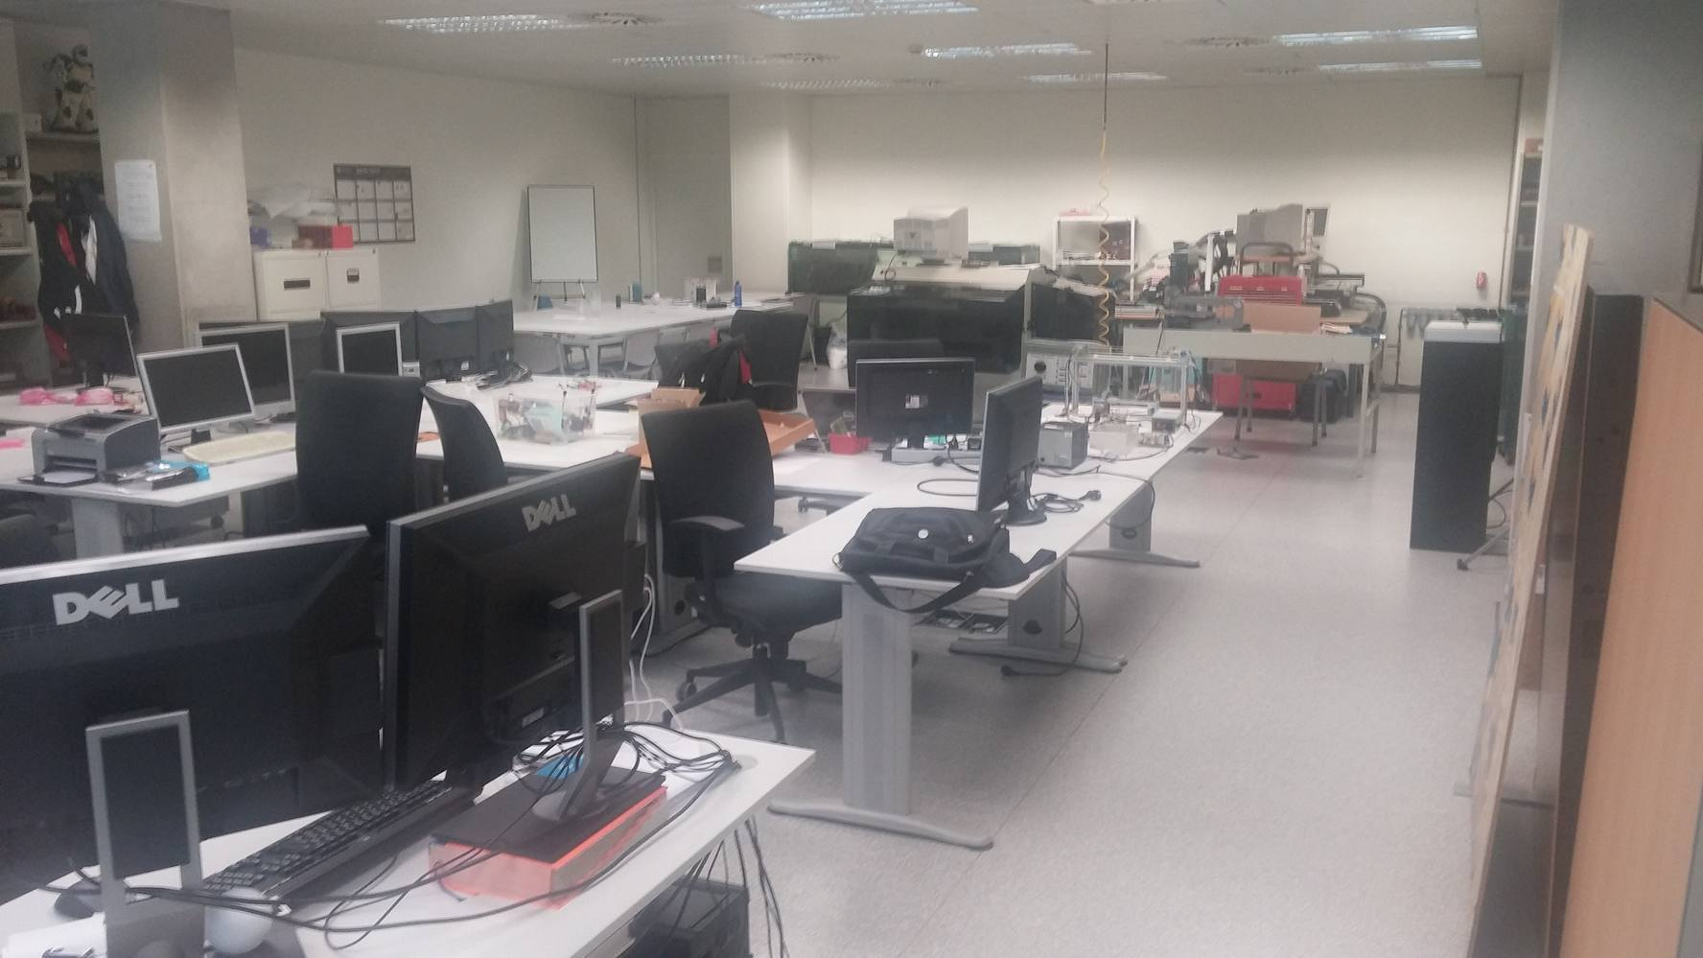
OBJECTIVES
Develop the system by modifying the components.
Check in wired mode
Improve accuracy, stability and ease.
Include a Rf-Module for wireless mode.

Slide 5
STUDY fLOW
Mechanical part of work
Electrical and Electronic connections
Study about our components
Configure the Microcontroller
Write the program
Get ready the Rf-module and joystick
Update the code
Check the functioning of the machine

Slide 6
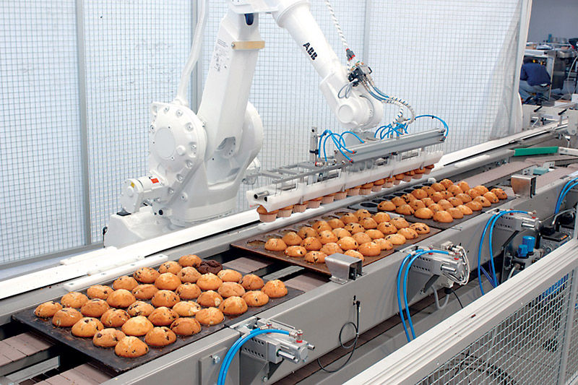
CNC SYSTEM
First cnc concept introduced by Professor John T. Parsons in early 1950’s
First cnc model designed in1953 by Professor John T. Parsons company along with US Airforce at MIT
Initially point-to-point movement. Later linear and Circular movements

Slide 7
BLOCK DIAGRAM
Telit LE50-868
RF Module
STM 32 F3 Discovery Board
Microcontroller
Mechatronic System
Motor X
Motor Y
Limit Switches
12V Power Supply
Receiver End

Slide 8
BLOCK DIAGRAM
Telit LE50-868
RF Module
STM 32 F3 Discovery Board
Microcontroller
Analog Joystick
PC
Or
Laptop
Transmission End

Slide 9
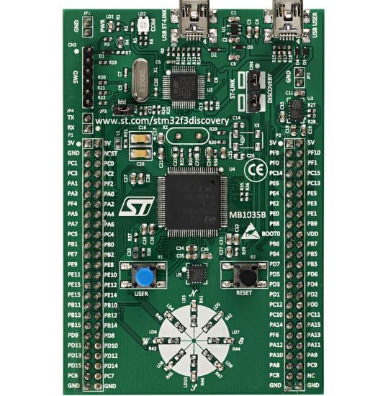
COMPONENTS
32-bit MCU device
100 pin package
256 kB flash
48 kB RAM
LED’s, GPIO’s, timers, convertors, Usart channels, etc.

Slide 10
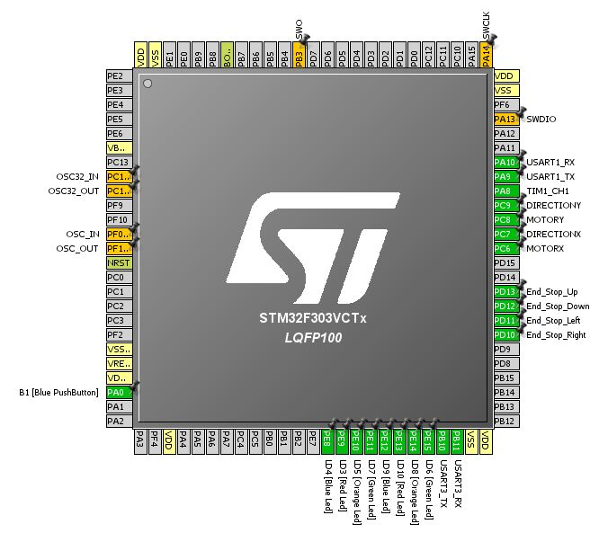
CONFIGURATION WITH STM32CubeMX

Slide 11
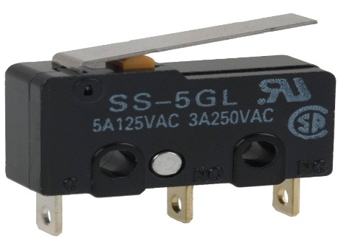
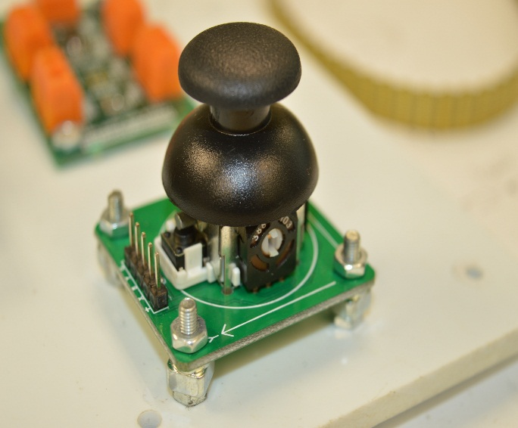
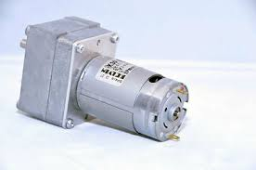
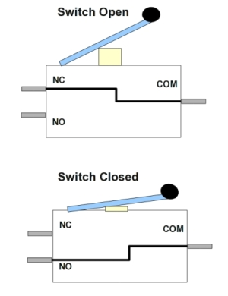
COMPONENTS
Analog Joystick
Two analog inputs
One digital input
DC motor
Kelvin K30 37.62
Limit switch

Slide 12
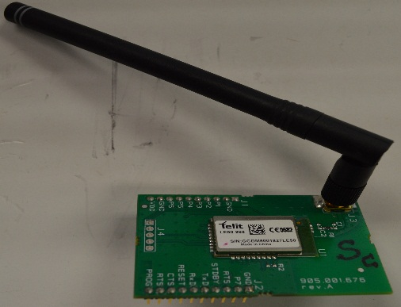
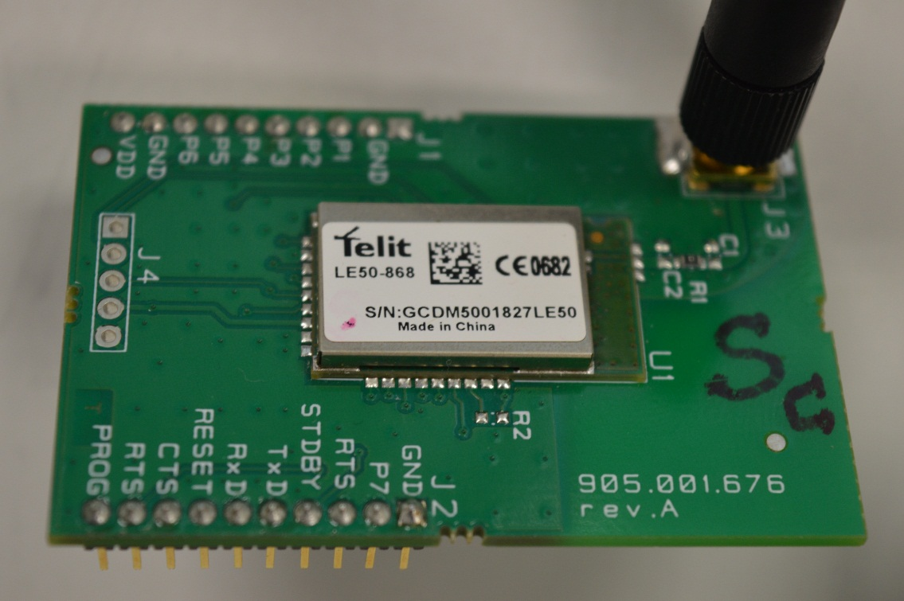
Components
Telit LE50-868 Rf Module
Range up to 2000m
Flash up to 128 kB, RAM of 4 kB, EEPROM of 2 kB
4 timers, 32.768 kHz real time clock (RTC)
Excellent Receiver Sensitivity
9 I/O ports maximum available

Slide 13
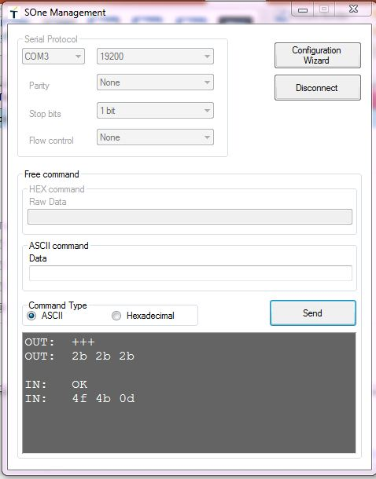
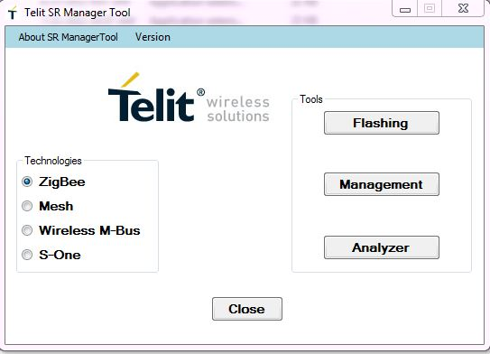
CONFIGURATION OF RF MODULE
Configure parameters using Telit SR Manager tool

Slide 14
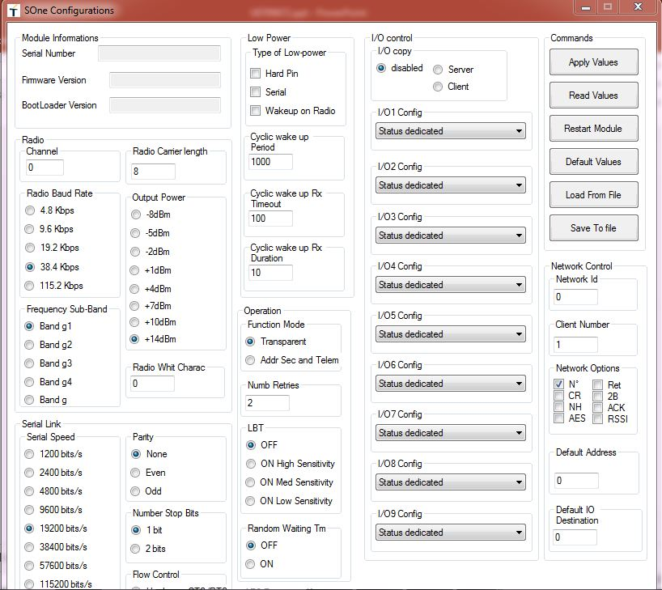
CONFIGURATION OF RF MODULE

Slide 15
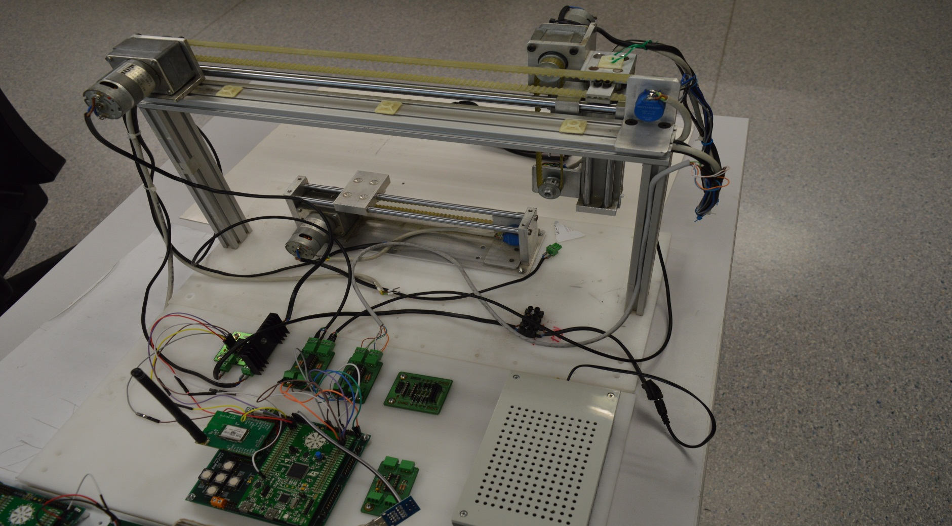
STRUCTURE
Receiver End

Slide 16
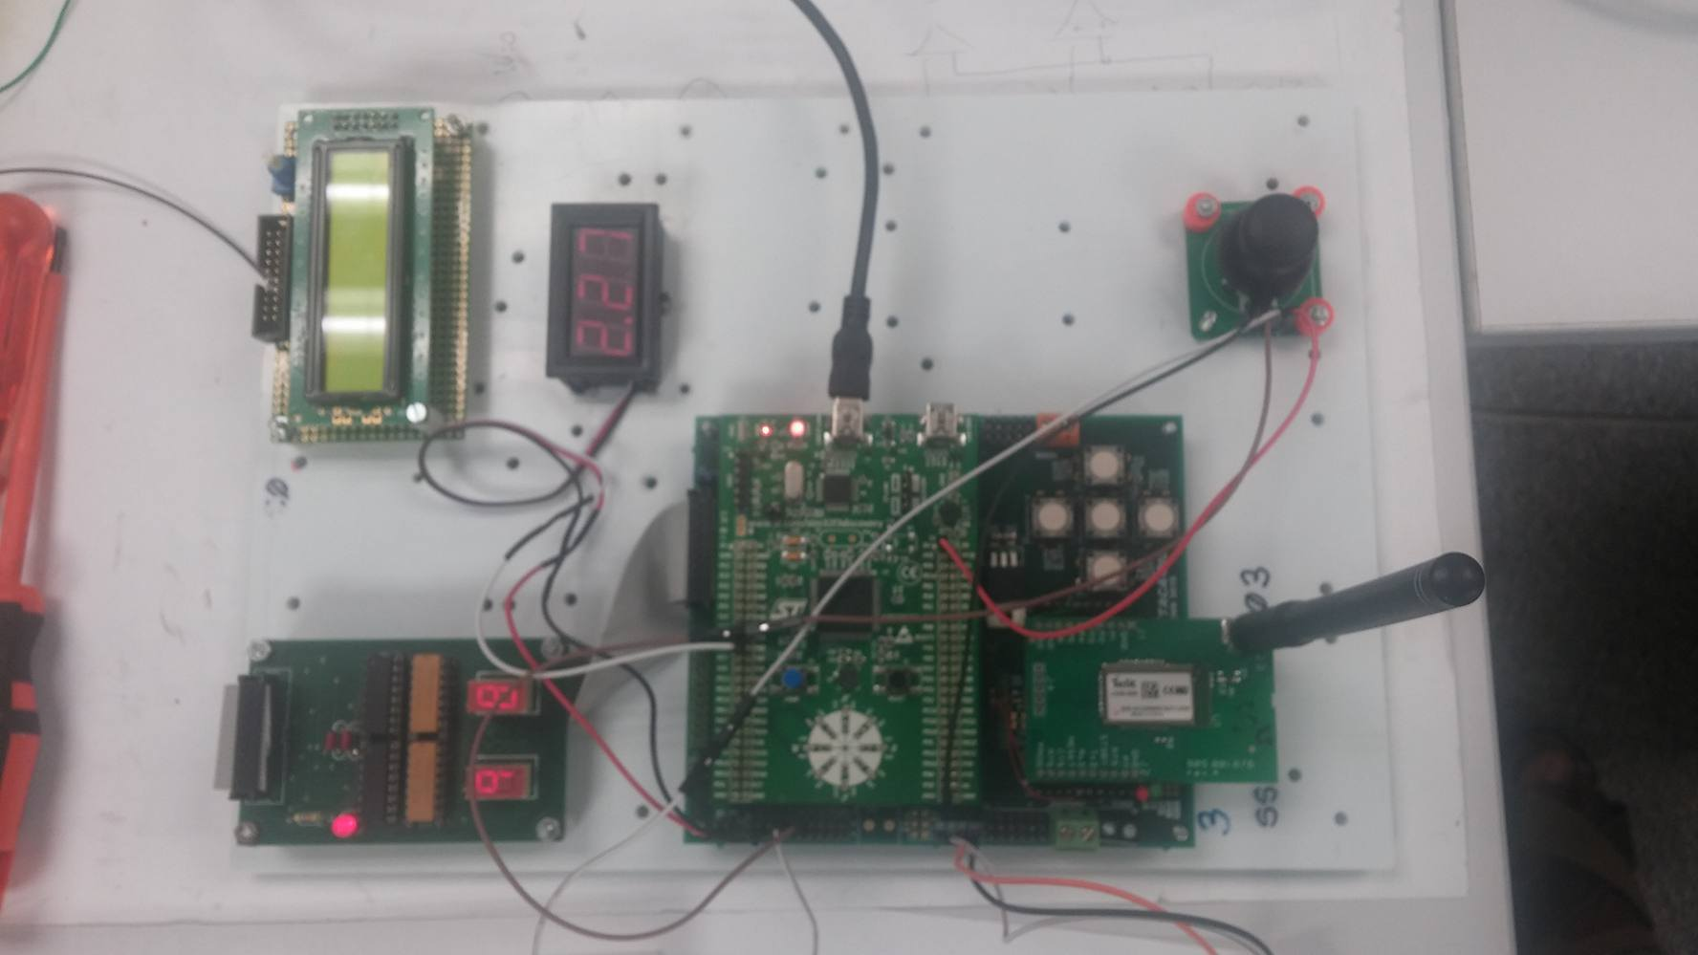
STRUCTURE
Transmission End - Joystick

Slide 17

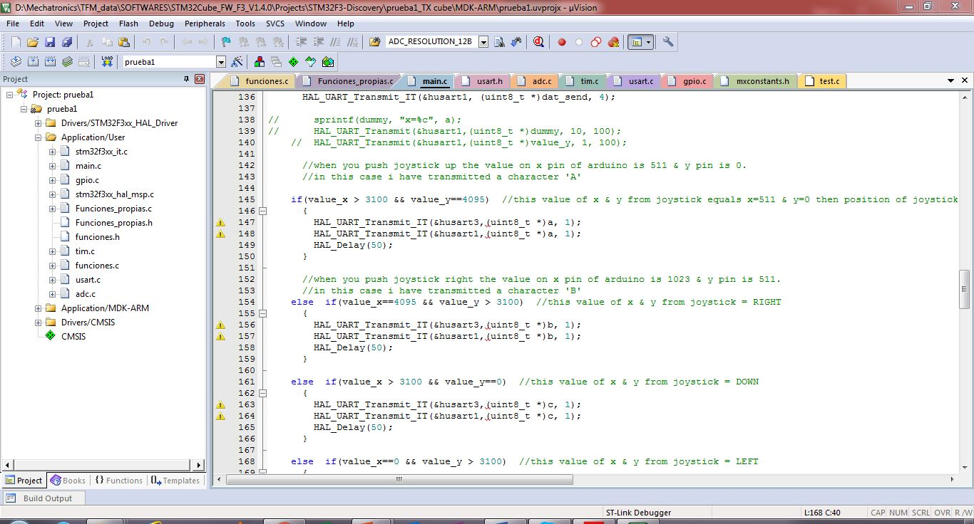
PROGRAMMING - KEIL
Software development toolchain
Programming, compiling and debugging
Keil version 5

Slide 18
RESULT
The movement of the motors of the machine is satisfactory
The rf module functions well in a good range
Transmission data can be viewed on the hyper-terminal
Limit switches are sensitive and taken care of
Motors are smooth running and good response
Future scope
Can be improvised to do in three axes (3D)
The rf module can be replaced by a wi-fi module
The end effector can be adapted as required in various fields.

Slide 19


