Slide 1
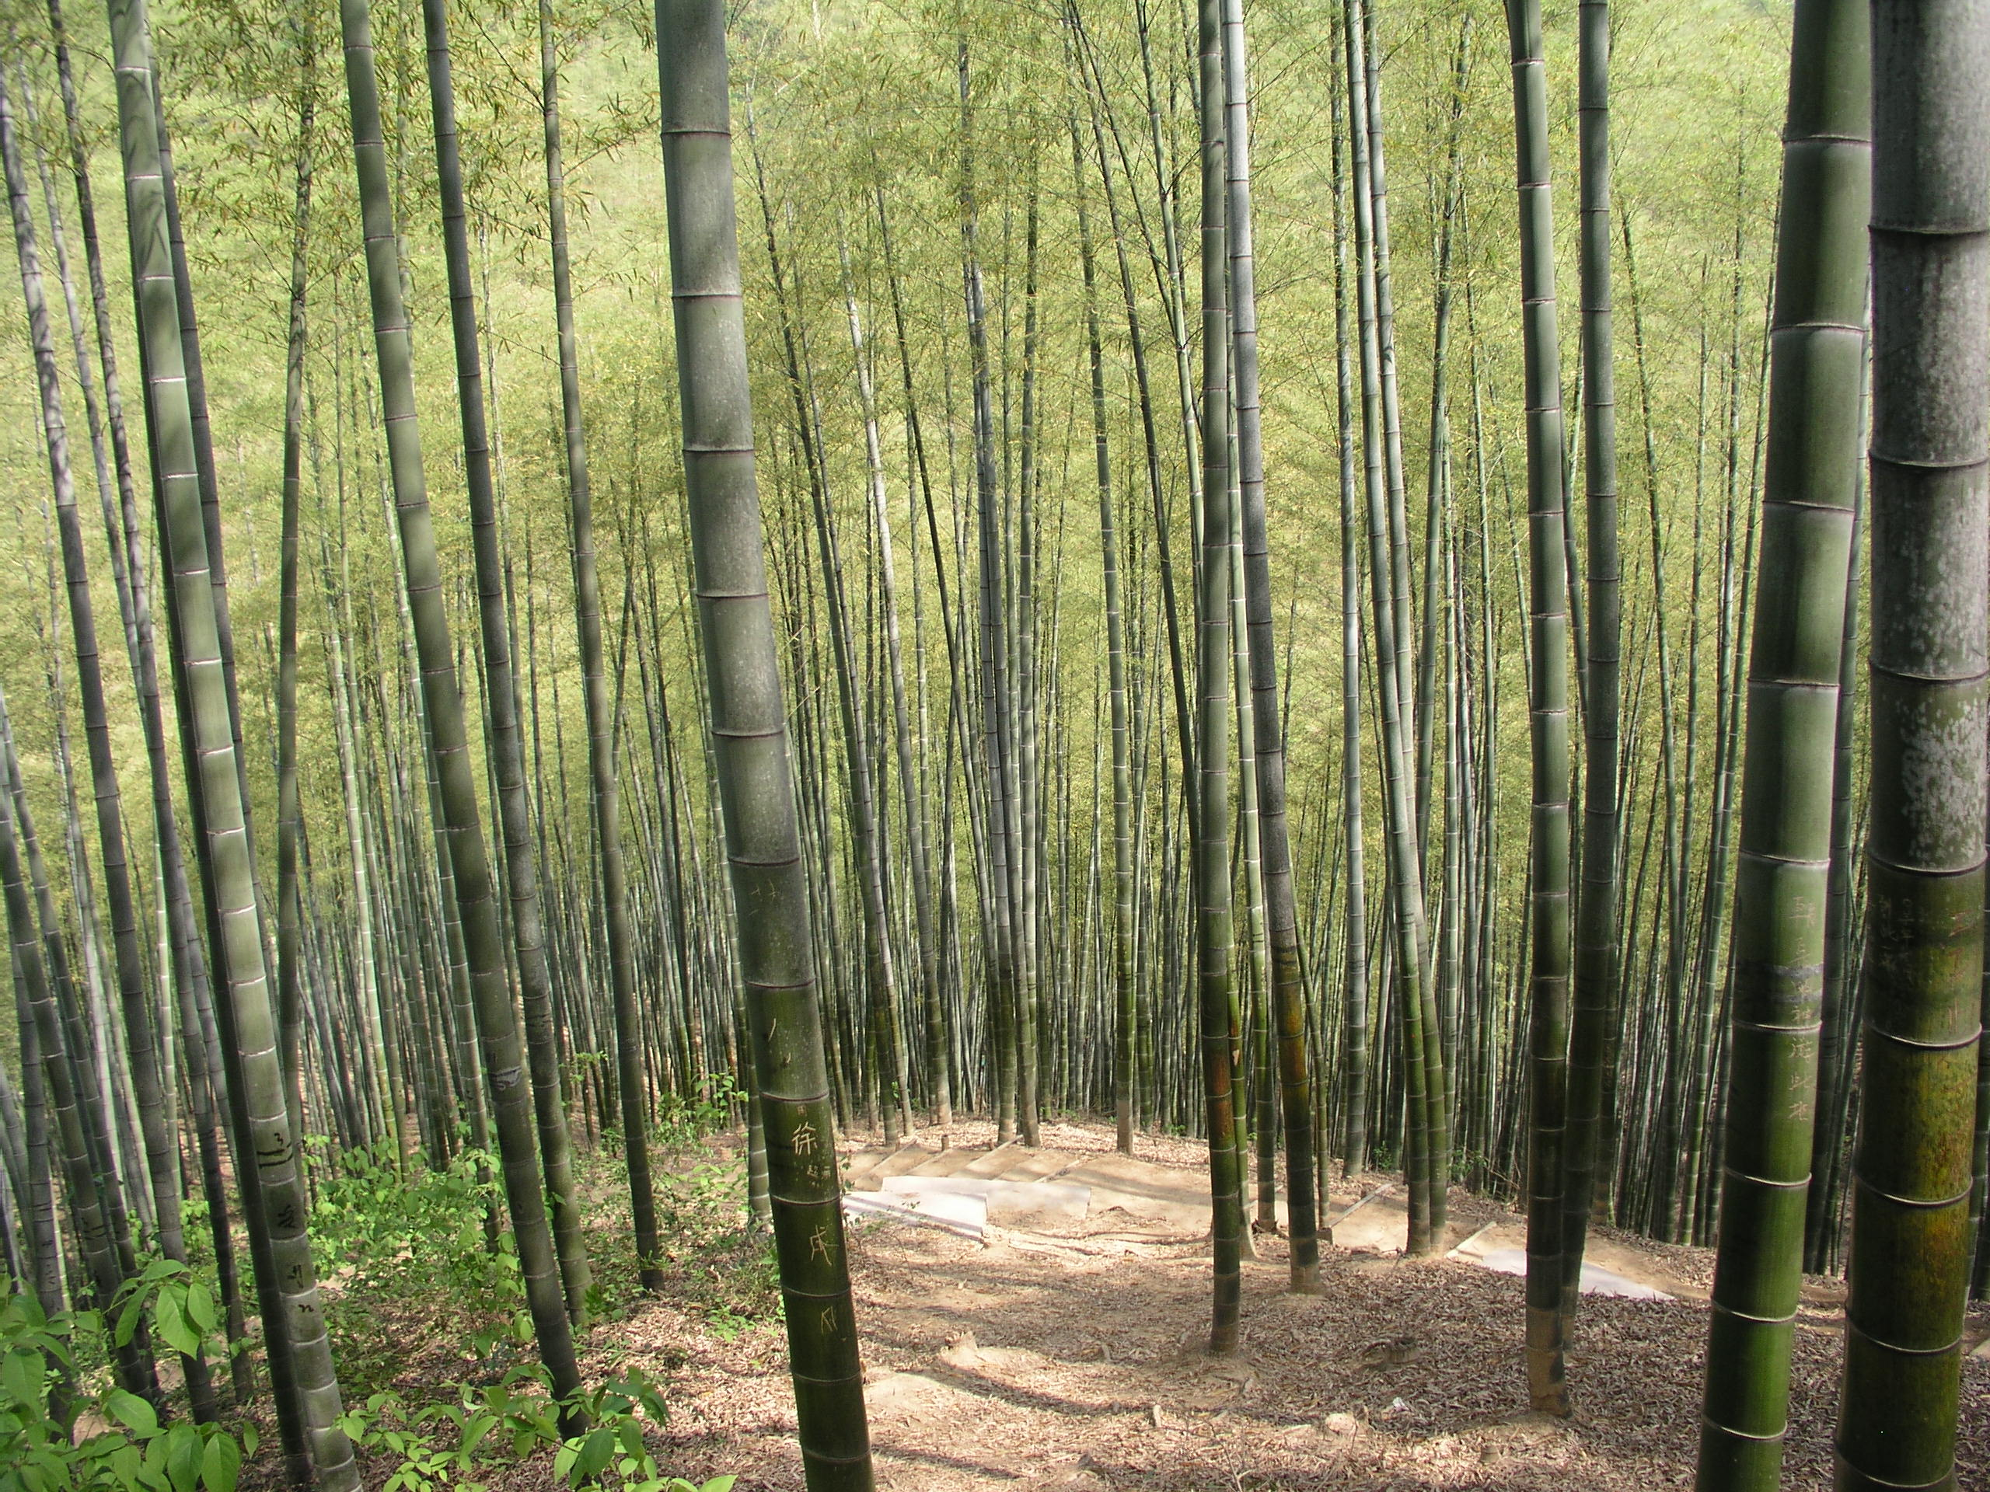



NEW MATERIALS AND TECHNOLOGIES APPLIED TO SUSTAINABLE BUILDING CONSTRUCTION
TITULACIÓN: GRADO EN ARQUITECTURA TÉCNICA
ALUMNO: CARLOS SANTAMANS LÓPEZ
DIRECTOR ACADÉMICO: ENRIQUE DAVID LLÁCER
FECHA DE PRESENTACIÓN: 01/07/2013
MODALIDAD: CIENTIFICO-TÉCNICO

Slide 2
CONTENTS OF THE PROJECT
SECTION 1 STATE OF THE ART
SECTION 2 APPLICATION OF TITANIUM DIOXIDE
SECTION 3 INNOVATIVE INSULATING MATERIALS
SECTION 4 QUESTIONNAIRE ON SUSTAINABILITY

Slide 3
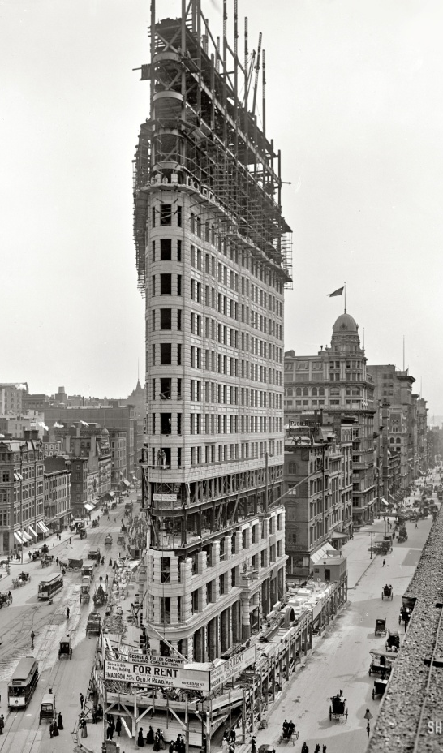
SECTION 1 → STATE OF THE ART
Section 2 → Application of titanium dioxide
Section 3 → Innovative insulating materials
Section 4 → Questionnaire on sustainability
BEFORE THE BEGINNING OF THE 20TH CENTURY
Buildings contributed little to environmental degradation
AROUND THE BEGINNING OF THE 20TH CENTURY
Discovery of several technical systems
BY THE MIDDLE OF THE 20TH CENTURY
Expansion of the technology on buildings, transportation…
Resulting on an increase of the world’s energy use.
AROUND THE 70’s
The world begins to be aware of the abuse on the planet’s resources and our extreme dependence on energy (1973 oil crisis).

Slide 4
SECTION 1 → STATE OF THE ART
Section 2 → Application of titanium dioxide
Section 3 → Innovative insulating materials
Section 4 → Questionnaire on sustainability
What is Sustainable Construction?
CHARLES KIBERT (1994)
‘SUSTAINABLE CONSTRUCTION IS THE CREATION AND RESPONSIBLE MANAGEMENT OF A HEALTHY BUILT ENVIRONMENT BASED ON RESOURCE EFFICIENT
AND ECOLOGICAL PRINCIPLES’
Sustainable Construction Principles
1. Minimization of resource consumption
2. Maximization of resource reuse
3. Use renewable and recyclable resources
4. Protection of the natural environment
5. Creation of a healthy and non-toxic environment
6. Pursue quality in creating the built environment

Slide 5
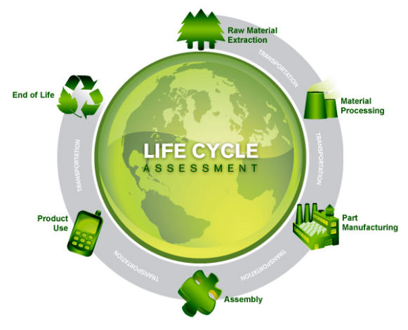
SECTION 1 → STATE OF THE ART
Section 2 → Application of titanium dioxide
Section 3 → Innovative insulating materials
Section 4 → Questionnaire on sustainability
LCA
LIFE-CYCLE ASSESSMENT IS A SCIENTIFIC METHOD THAT ALLOWS US TO ANALYZE THE ENVIRONMENTAL IMPACT OF A PRODUCT OVER ITS ENTIRE LIFE CYCLE

Slide 6
SECTION 1 → STATE OF THE ART
Section 2 → Application of titanium dioxide
Section 3 → Innovative insulating materials
Section 4 → Questionnaire on sustainability
GREEN FEATURES TO ACHIEVE SUSTAINABLE CONSTRUCTION
MANUFACTURING PROCESS
BUILDING OPERATIONS
WASTE MANAGEMENT
WASTE REDUCTION (WR)
POLLUTION PREVENTION (P2)
RECYCLED (RC)
EMBODIED ENERGY REDUCTION (EER)
NATURAL MATERIALS
F) ENERGY EFFICIENCY
(EE)
G) WATER TREATMENT &
CONSERVATION (WTC)
H) NONTOXIC
I) RENEWABLE ENERGY
SOURCE( RES)
J) LONGER LIFE( LL)
K) BIODEGRADABLE (B)
L) RECYCLABLE (R)
M) REUSABLE (RU)
N)OTHERS (O)

Slide 7
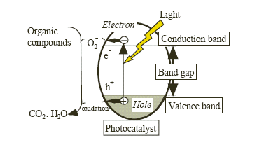
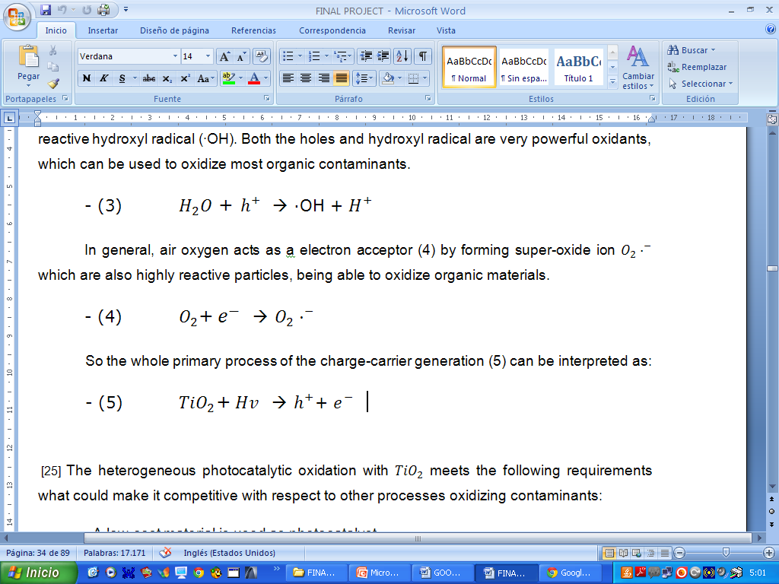
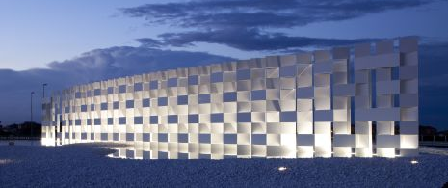
section 1 → state of the art
SECTION 2 → APPLICATION OF TITANIUM DIOXIDE
Section 3 → Innovative insulating materials
Section 4 → Questionnaire on sustainability
Beginning of photocatalysts → 1996 Honda and Fujishima

Slide 8

section 1 → state of the art
SECTION 2 → APPLICATION OF TITANIUM DIOXIDE
Section 3 → Innovative insulating materials
Section 4 → Questionnaire on sustainability
Applications of Titanium Dioxide
SELF-CLEANING EFFECT
Titanium Dioxide + LIGHT
AIR-CLEANING EFFECT
ANTI-BACTERIAL EFFECT

Slide 9
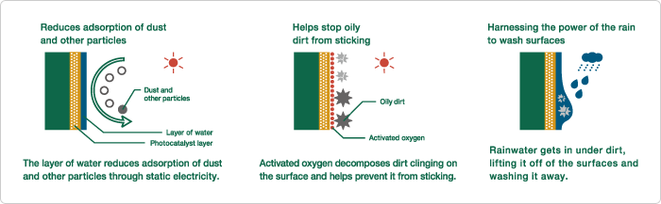
section 1 → state of the art
SECTION 2 → APPLICATION OF TITANIUM DIOXIDE
Section 3 → Innovative insulating materials
Section 4 → Questionnaire on sustainability
SELF-CLEANING EFFECT
Exhaust fumes and particles dispersed in the air become incorporated in the raindrops and adhere to the surfaces of buildings
a) The reduction of adsorption of dust and particles
b) It helps stop oily dirt from sticking
c) It harnesses the power of the rain to wash the surfaces

Slide 10
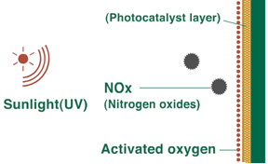


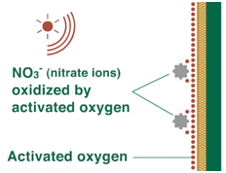
section 1 → state of the art
SECTION 2 → APPLICATION OF TITANIUM DIOXIDE
Section 3 → Innovative insulating materials
Section 4 → Questionnaire on sustainability
AIR-CLEANING EFFECT
Nitrogen dioxide is a group of highly reactive gasses formed from the emissions of cars, power plants…producing adverse effects on the respiratory system.

Slide 11
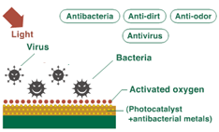
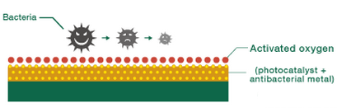
section 1 → state of the art
SECTION 2 → APPLICATION OF TITANIUM DIOXIDE
Section 3 → Innovative insulating materials
Section 4 → Questionnaire on sustainability
ANTI-BACTERIAL EFFECT
Titanium Dioxide can be used in both external and internal walls.
- Primarly used in bathrooms and kitchens
- GOAL ?? → Improve indoor air quality by reducing the amount of bacteria

Slide 12
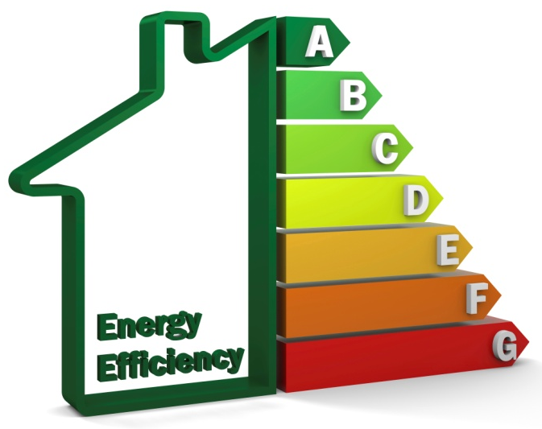
section 1 → state of the art
section 2 → application of titanium dioxide
SECTION 3 → INNOVATIVE INSULATING MATERIALS
Section 4 → Questionnaire on sustainability
- Heat flows from warmer to cooler spaces
- To maintain comfort → WINTER→ Heat Lost replaced by heating system
SUMMER→ Heat Gained removed by cooling system
50% to 70% of the energy used in the average home in the US is for heating or cooling.
Necessary use of thermal insulation to reduce that energy consumption.
- Action Plan For Energy Efficiency adopted by the European Commission, energy consumption reduction of 20% by 2020

Slide 13
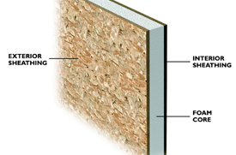
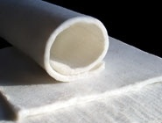
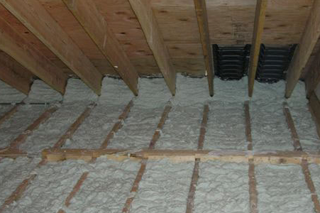
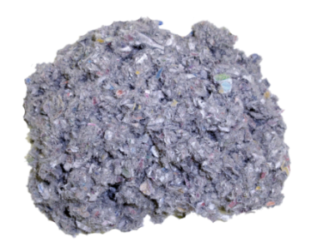
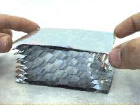
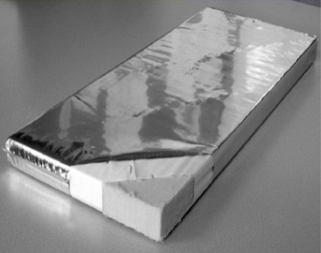
section 1 → state of the art
section 2 → application of titanium dioxide
SECTION 3 → INNOVATIVE INSULATING MATERIALS
Section 4 → Questionnaire on sustainability
INSULATING MATERIALS
STRUCTURAL INSULATED PANELS (SIP)
SILICA AEROGEL INSULATION BLANKETS
ULTRA-LIGHT CEMENTITIOUS FOAM
CELLULOSE INSULATION
GASS-FILLED PANELS (GFP)
VACUUM INSULATED PANELS (VIP)

Slide 14
section 1 → state of the art
section 2 → application of titanium dioxide
SECTION 3 → INNOVATIVE INSULATING MATERIALS
Section 4 → Questionnaire on sustainability
INSULATION MATERIALS | THERMAL CONDUCTIVITY (W/mK)
SIP (PUR) | 0,025
SIP (EPS) | 0,038
SIP (XPS) | 0,029
SIP (Polyiso) | 0,022
Cellulose Insulation | 0,035
Silica Aerogel Blanket | 0,013
GFP (Xenon) | 0,0074
GFP (Krypton) | 0,0116
GFP (Argon) | 0,0199
GFP (Air) | 0,0281
Cementitious Foam | 0,0371
VIP | 0,005

Slide 15
section 1 → state of the art
section 2 → application of titanium dioxide
SECTION 3 → INNOVATIVE INSULATING MATERIALS
Section 4 → Questionnaire on sustainability
FIRE PROTECTION (CODE ASTM E84-81 A)

Slide 16
section 1 → state of the art
section 2 → application of titanium dioxide
SECTION 3 → INNOVATIVE INSULATING MATERIALS
Section 4 → Questionnaire on sustainability
INSULATION MATERIALS | EMBODIED ENERGY (MJ/Kg)
SIP (PUR) | 72
SIP (EPS) | 89
SIP (XPS) | 89
SIP (Polyiso) | 69,80
Cellulose Insulation | 3,3
Silica Aerogel Blanket | 53,00
GFP - Barrier Virgin aluminum | 218
GFP - Recycled Aluminum | 29
Cementitious Foam | 27,9
VIP | -
INSULATION MATERIALS | CARBON ENERGY (Kg of CO2/Kg)
SIP (PUR) | 3
SIP (EPS) | 2,5
SIP (XPS) | 2,5
SIP (Polyiso) | 5,5
Cellulose Insulation | 0,106
Silica Aerogel Blanket | 4,2
GFP - Barrier Virgin aluminum | 11,46
GFP - Recycled Aluminum | 1,69
Cementitious Foam | -
VIP | -

Slide 17


section 1 → state of the art
section 2 → application of titanium dioxide
section 3 → innovative insulating materials
SECTION 4 → QUESTIONNAIRE ON SUSTAINABILITY
  QUESTIONNAIRE
- GOAL??? →To understand better sustainable practices.
CONTENT:
SECTION A → QUESTIONS 1 to 6
SECTION B → QUESTIONS 7 to 13
SECTION C → QUESTIONS 14 to 22

Slide 18
section 1 → state of the art
section 2 → application of titanium dioxide
section 3 → innovative insulating materials
SECTION 4 → QUESTIONNAIRE ON SUSTAINABILITY
SECTION A

Slide 19
section 1 → state of the art
section 2 → application of titanium dioxide
section 3 → innovative insulating materials
SECTION 4 → QUESTIONNAIRE ON SUSTAINABILITY
SECTION B
% of people who have an environmental
department in the company
Qualification of education on sustainability
- BREEAM (Building Research Establishment Environmental Assessment Methodology)
- LEED (Leadership in Energy & Environmental Design)
- GREEN BUILDING INSTITUTE
- PASSIVEHAUS
- CE3X (for energy efficient certificates)
- CALENER VYP
- QUALITY PROFILE – ENERGY CERTIFICATE
- CERTIFICATE FOR SUSTAINABLE FOREST WOOD
ENERGY CERTIFICATIONS

Slide 20
section 1 → state of the art
section 2 → application of titanium dioxide
section 3 → innovative insulating materials
SECTION 4 → QUESTIONNAIRE ON SUSTAINABILITY
SECTION C
Cost of sustainable construction compared to traditional construction
1. - ENERGY EFFICENCY & CO2 EMISSION REDUCTION
2. - WATER CONSUMPTION REDUCTION
3. - APPLICATION OF NEW SUSTAINABLE MATERIALS
4. - CONSTRUCTION WASTE REDUCTION
5. - POLLUTION PREVENTION MEASURES
6. - HEALTH AND INDOOR AIR QUALITY
7. - REUSABILITY AND RECYCLABILITY OF MATERIALS
8. - EMBODIED ENERGY REDUCTION OF MATERIALS
9. - USE OF RENEWABLE ENERGY SOURCES

Slide 21
section 1 → state of the art
section 2 → application of titanium dioxide
section 3 → innovative insulating materials
SECTION 4 → QUESTIONNAIRE ON SUSTAINABILITY
SUSTAINABLE PRACTICES
SUSTAINABLE MATERIALS
- CO2 emissions reduction
- Solar panels for domestic hot water and heating
- Use of Biomass boilers
- Trombe wall
- Cross ventilation
- Rainwater harvesting systems
- Passive design
- Use of renewable energies (Aerothermia, Biomass…)
- Reutilization of demolition materials
- Analysis of the orientation of the house, sunlight control…
- Cellular Concrete “Ytong”
- Natural cork
- Concrete with recycled aggregates
- Treated wood
- Cellulose Insulation
- Natural coatings
- Exterior pavement “Bio-Innova” (photocatalysis)
- Release agent with non-toxic particles
- Soil bags as a grand mass envelope insulation
- Not using PVC in a whole building
- Green roofs
SECTION C

Slide 22
section 1 → state of the art
section 2 → application of titanium dioxide
section 3 → innovative insulating materials
SECTION 4 → QUESTIONNAIRE ON SUSTAINABILITY
Strategies of involvement on sustainability
Major obstacle within Spain sustainability progress

Slide 23

THANKS FOR ATTENDING

