Slide 1


Actions for Open Science at Universitat Politecnica de Valencia
Inmaculada Ribes-Llopes
ribes@bib.upv.es
Library
Universitat Politècnica de València (UPV)
November 8th 2019
Notes:
Than you profesor Rosado for this opportunity to have this talk and to meet you.
I am going to talk about the implementation of Open Access at UPV.
My University has three campus in three cities: Valencia, Gandía and Alcoy. The first one is the biggest and welcomes the rectorship and main services.

Slide 2
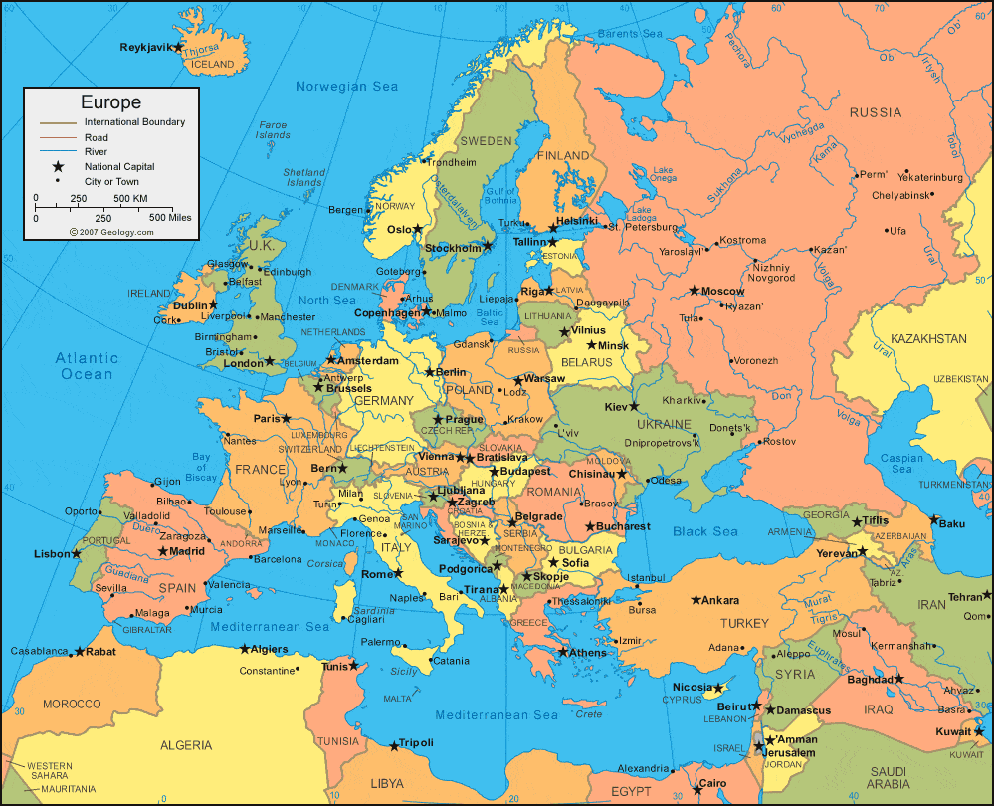

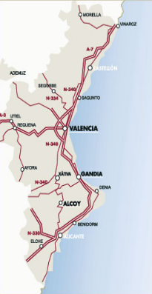

Welcome and thanks
Notes:
Welcome you all to Valencia, a lovely city with many things to visit and experiences for sharing
I work on the campus of Valencia.

Slide 3







UPV in rankings
1st Technical Spanish University
1st Spanish Univ. in Chemical Engineering, Agriculture, Forestry…
101-200 World Rank
… AND
5th Spanish Univ. in % Open Green
Notes:
UPV is one of the four technical universities in Sapin. We have Engineering Studies, Architectural, Bussiness and Fine Arts Schools.
It a young university, only 50 years, but it is already well established, with a good score in common indicators and rankings: ARWU, QS, THE…
But we are specially proud with this one: Leiden. Here UPV reaches 5th position in Spanish Univ. in % Open Green Indicator, and this is thanks to RiuNet, our institutional repository.

Slide 4
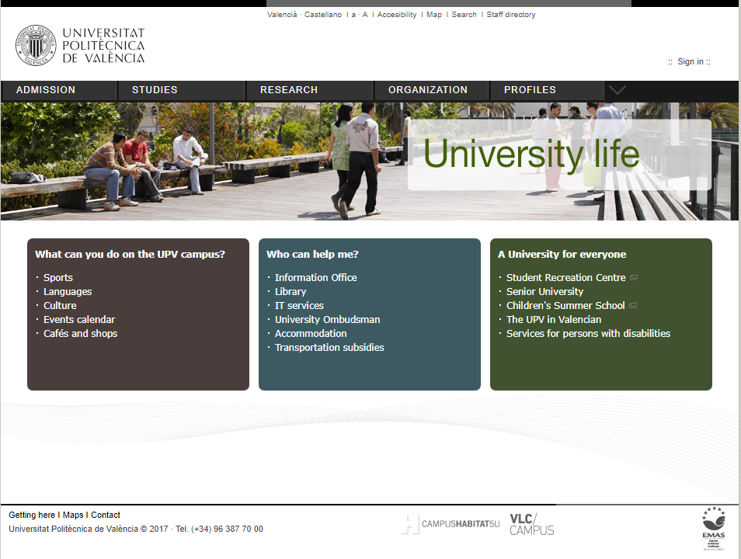
The Library is a central service in universitary life
Notes:
In last years, the weight of the Library in the university scene has grown remarkably, and you can find different services of the Library in many parts of the university website, RiuNet is present at the home page.
On the other hand, the Library occupies an important place in the life of the university community, it is probably the best known and used Service. It is also very well valued and recognized, annually the University Quality Unit passes a survey to the entire university community to know satisfaction with the different services. In these surveys the services offered by the Library always obtain excellent results. More info, only in Spanish, here https://aplicat.upv.es/pegasus-app/public/unit_results/unit.xhtml?harvestId=12&unitId=13
In addition, in the Strategic Plan of the University, Open Access has a specific section, endowed with a budget, thanks to which it has been possible to contract a librarian for four years in order to upload retrospective publications in the CRIS and then disseminate them on RiuNet.

Slide 5
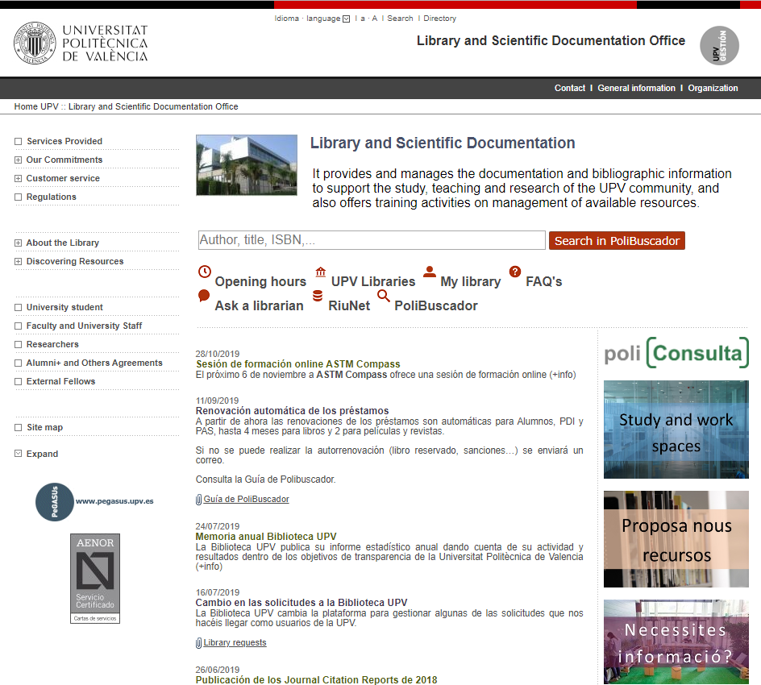
The Library
Notes:
This is the website of the Library.
Focusing on Open Access I would like us to pay attention to these two points:
RiuNet is the institutional repository, and
PoliConsulta is our institutional portal for Ask a Librarian Service, but not only for the Library, but for the whole university

Slide 6
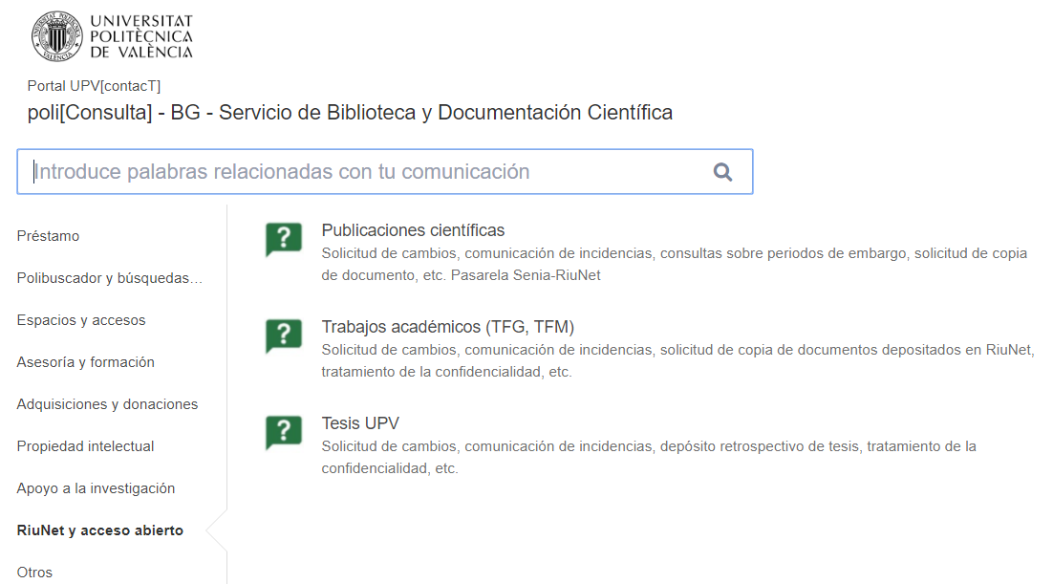
PoliConsulta, our Ask a Librarian
Notes:
Here we can see the PoliConsulta interface on topics related to Library. There are eight topics, our team attends the last three: Copyright, Research Support, and RiuNet for Open Access topics

Slide 7
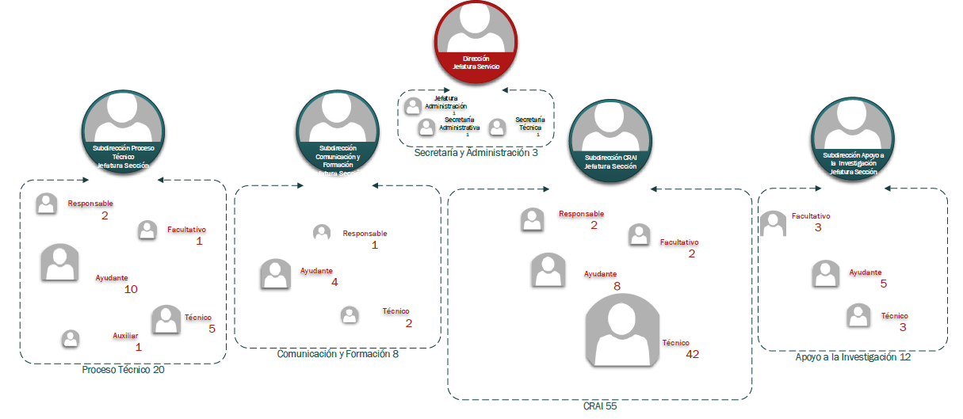
How we organize
Notes:
Going bak to the Library this is the organization chart. We have four Units: Collections; Quality, Communication and Training; Loans and Spaces; and Research Support

Slide 8
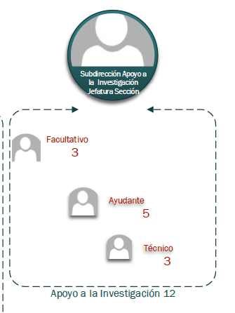
My team.
Research support
TASKS
RiuNet
PoliPapers
Bibliometrics studies
CRIS: metadata, APIs with RiuNet
Copyright
Support researchers
Mendeley
…
Notes:
My team is Research Support. It is planned that we are a team of 12 people, but for now we are only 9!!!
These are the issues, taks, we address…

Slide 9






The Library and the Open Access. Gateways among internal databases
External ddbb (WoS…)
CRIS (Senia)
UPV Editorial
Learning objetcs
Doctoral theses
Master and bachelor theses
Notes:
Focusing on Open Access, I think one of our strengths is the use of gateways between RiuNet and other internal databases.
Ours is a "technical" university, and therefore the efficiency in the processes is highly valued, for that reason, the use of semi-automatic processes that avoid duplication in metadata filling and file loading is enhanced.
In the field of research, the gateway with the CRIS is the most important. But firstly, when authors load their publications on the CRIS, they have available an API with Web of Science database.
Gateways with different Editorial collections, Research, Teaching, Congress… load records and files in RiuNet.
The same can be said about Doctoral Thesis and master/bachelor theses, they are managed in their own apliccations and once they have been defended, goes on repository.
On other hand PoliMedia is a collection of Learning Objects made by professors for their students, they are elaborated in a specific application and finally go on RiuNet https://riunet.upv.es/handle/10251/192 .
PoliPapers is the portal of journals published by the University and is managed by two Units: Editorial and Library https://polipapers.upv.es/ . Now we have 28 journals and the content go from PoliPapers to RiuNet.
All these gateways are semiautomatic process, Library reviews and completes metadata, files, etc., but nobody “retype” metadata twice.

Slide 10
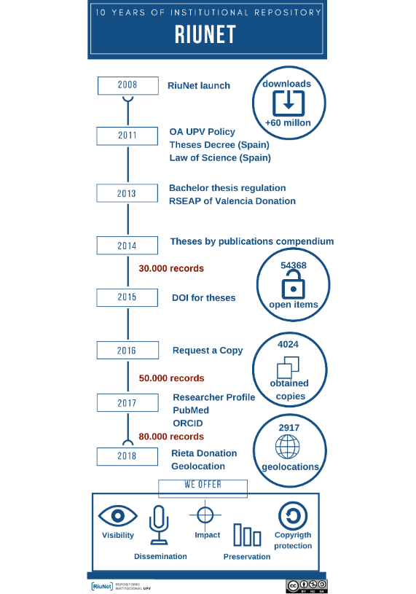
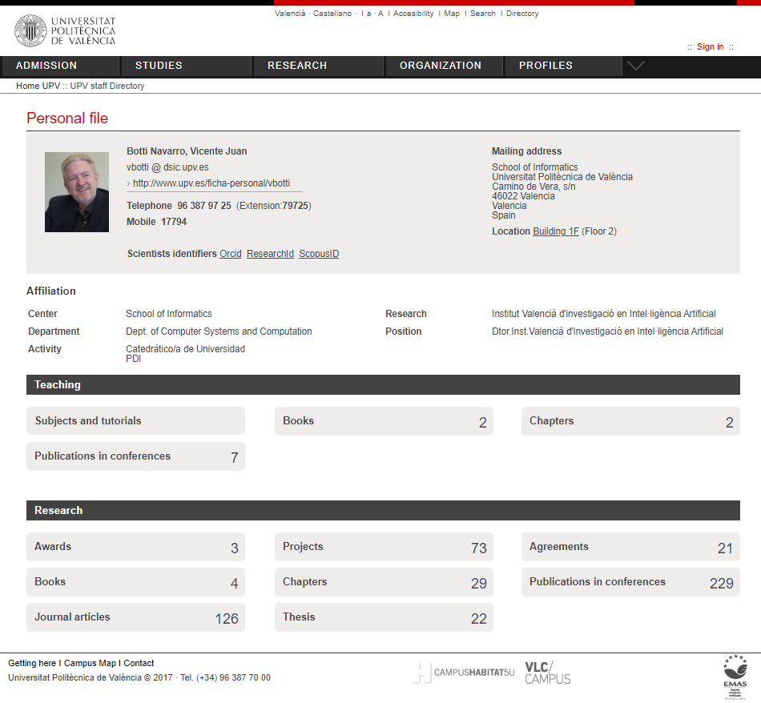
The repository, step by step
www.riunet.upv.es
https://riunet.upv.es/handle/10251/11342
https://www.boe.es/buscar/pdf/2011/BOE-A-2011-2541-consolidado.pdf
https://www.boe.es/buscar/pdf/2011/BOE-A-2011-9617-consolidado.pdf
https://riunet.upv.es/handle/10251/112322
Notes:
In this infographic we can follow successives steps in life of RiuNet.
Was launched RiuNet eleven years ago and from the beginning it has been managed by Library.
2011 was an important year for Open Access in Spain.
The Law of Science, in article 37, strongly committed to Open Access, forcing the deposit in a repository of publications resulting from publicly funded research
In addition, the Royal Decree on Doctoral Studies, in article 14, forces the university where the thesis has been read to take care of the open archive in an institutional repository
With this legal support the Spanish universities began to dictate their own Open Access Policies, and so did the Universitat Politécnica de Valencia (UPV).
Two years later the university regulates the bachelor thesis, opening the way to its open deposit in RiuNet, although University leaves the decision in the hands of the student.
In 2014 the "doctoral theses by compendium" are generalized, that is, theses in which previously published articles are collected. The deposit in RiuNet under open access generates conflicts, since generally the articles have copyright protected. The procedure for these cases is written to editors, requesting permission, generally they grant it and, if applicable, thesis have a embargo period until the last term expires.
In 2015 we started assigning DOIs to doctoral theses, and the following year the functionality of Request a Copy was implemented, by the end of 2018 4,024 publications had already been sent by this way.
In 2017, the university launched the author profile portal, and linked it to the institutional directory. Although the project has a limited scope, at least it makes more visible the production of the UPV authors.
In 2018 RiuNet incorporates some new heritage collections and starts up the Geolocation Service that allows you to relate a document to a territory.
At the end of 2018 Riunet had more than 60 millions of downloads, more than 50.000 open publications, almost 3.000 geolocations and had provided more than 4.000 publications.

Slide 11
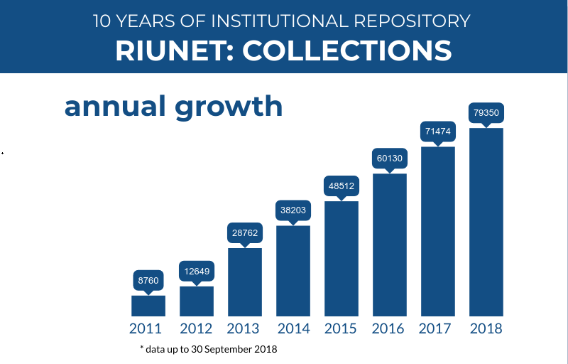
Notes:
Here we can see the growth of Riunet every year.

Slide 12
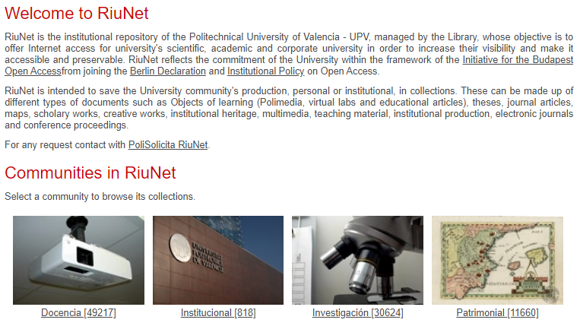
RiuNet today
Notes:
And here we can see the structure of RiuNet and the current figures in November 2019
49.217 records in the Teaching Collections
818 Institutional records
30.624 records in Research Collections
11.660 Patrimonial Records
In total 92.319 records

Slide 13









RiuNet in the world
And more…
Notes:
Obviously we try to make RiuNet visible in the world.
RiuNet Contents in: Recolecta, OpenDOAR, Scholar, BASE, Hispana, OpenAire…
RiuNet in directory in OpenDOAR…
UPV Open Access Politics in ROARMAP…
Work groups: CRUE-Rebiun, FECYT…

Slide 14
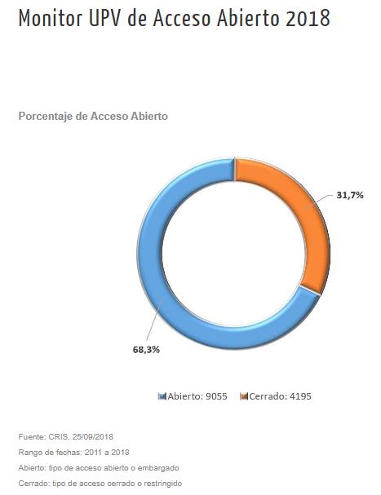
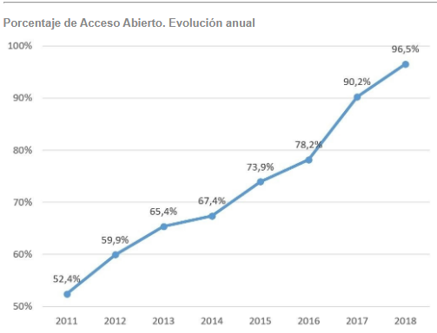
Percentage Open Access and
Annual evolution
Notes:
The CRIS is the source for this monitoring OA that you can find here https://poliscience.blogs.upv.es/monitor-upv-del-acceso-abierto/
According to our CRIS 68,3% of articles 2011-2018 is OPEN in September 2018
The annual increase in the percentage of Open Access must be qualified considering that the source of the data is the CRIS and the first records to be deposited in the CRIS are usually Open articles.

Slide 15
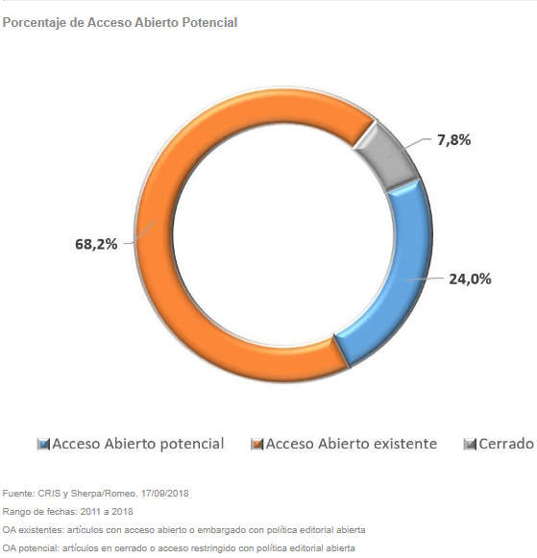
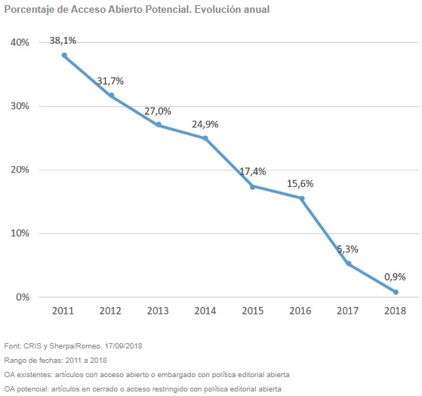
Percentage Potencial Open Access and
Annual evolution
See more https://poliscience.blogs.upv.es/monitor-upv-del-acceso-abierto/
Notes:
In September 2018 the Potential Open Access that is not Open in fact reaches 24,0%
In the next graph we can see how Potential Open Access is decreasing. Once again this figure must be qualified, considering that the source of the data is the CRIS and the first records to be deposited in the CRIS are usually Open articles.

Slide 16


Improving the CRIS to increase Open Access
Have you paid for an APC?
How much did it cost?
Monitoring of APCs
Normalization of funders
Communication flow with authors
Some bug in funders of proyects
Loading in CRIS by librarians (not only by researchers)
Not only articles, also conferences, congress… in gateway CRIS - RiuNet
4 months
12 months
Notes:
And finally comment that we are involved in improvement plans.
For example two days ago we have launched an improvement, that will allow us to monitor how many publications in our CRIS have been paid by APCs and what was the cost. This is possible thanks to new metadata in the CRIS that authors, or librarians must fill. This point is very important given the trend to Open Access by the Gold Via, for example in Plan S.
In three or four months we will be able to normalize funders, and will improve the authors flow in process of uploading publications in the CRIS.
And later, next year we will introduce a radical change in the CRIS flow, until now author uploads publications, from then librarians will uploads them by delegation, of course authorwill be allowed to continue uploading records for themselves.
And we will begin to process other types of publications, such as conferences, and not only articles like now.

Slide 17
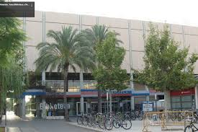


You can find us at
+34 96 387 7085
And here
Thank you, and have a nice travel

